Slide 1
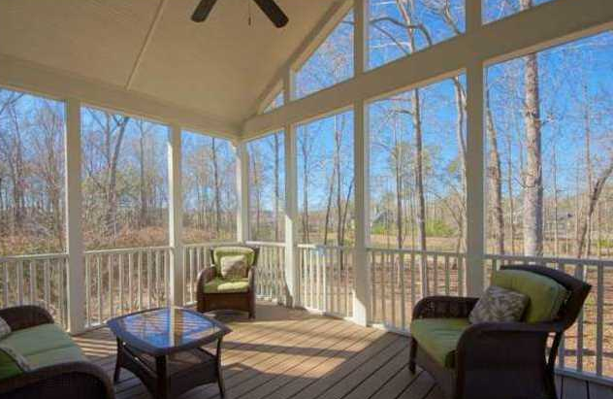
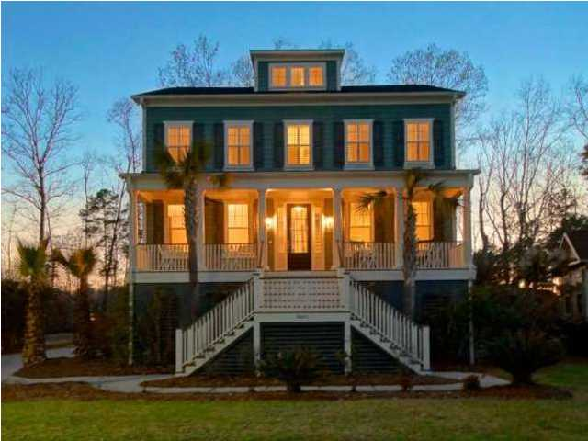
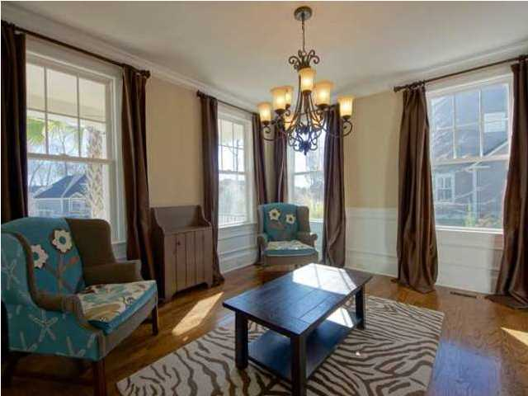
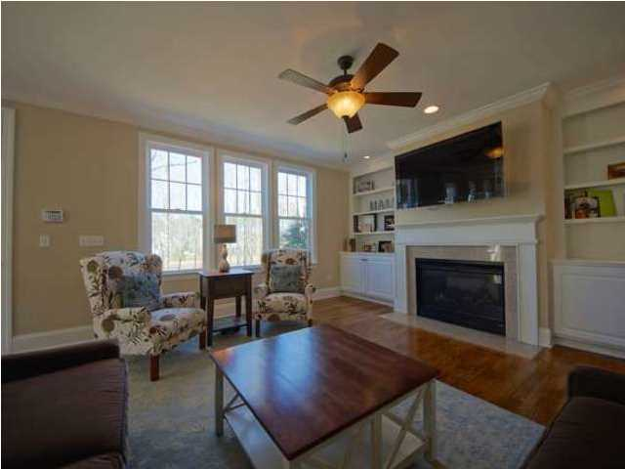
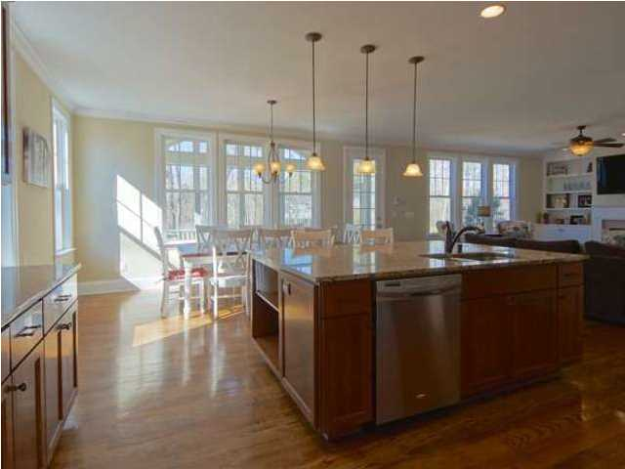
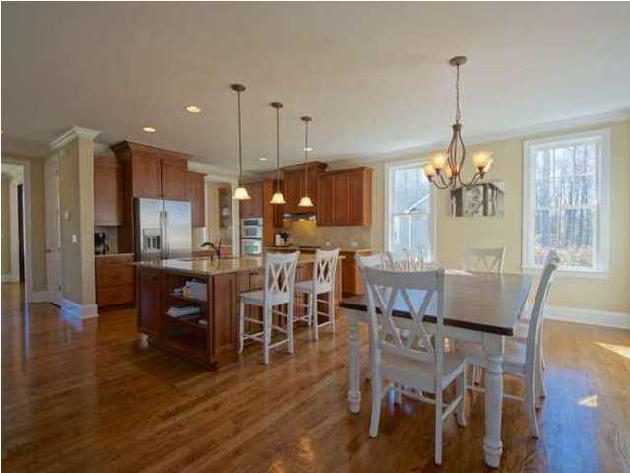
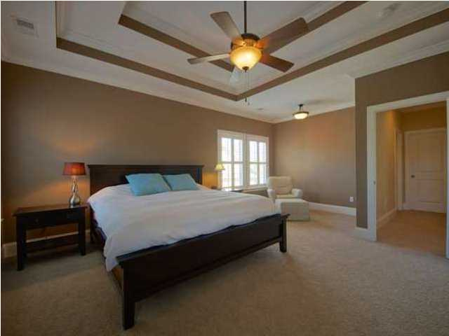
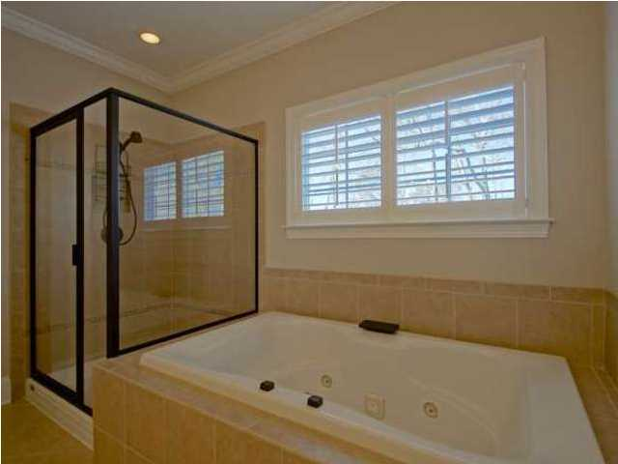
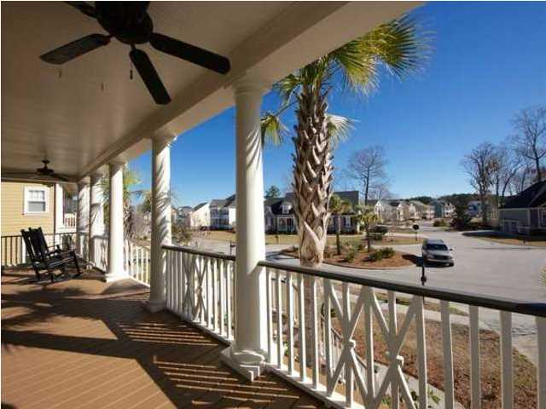
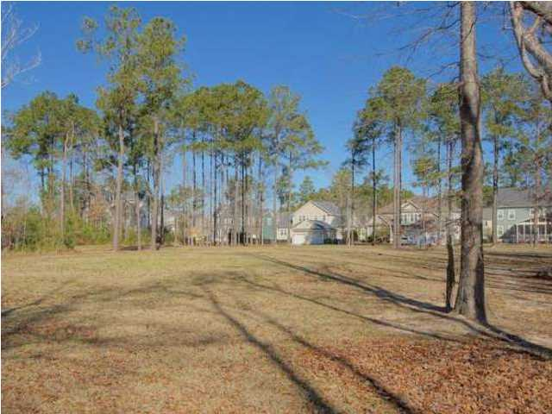

Price Reduced!
Dunes West Stunner!
3085 Yachtsman Dr ~ Mt Pleasant ~ MLS# 1407126 ~ $629,900
Welcome to Dunes West where this five bedroom, four and a half bath, two car garage home will check off every item on your house hunting wish list. A full front porch with ceiling fans and nearby palm trees ensures a cool breeze while you relax on your rocking chair. Step through the front door to find 3,674 beautifully constructed square feet of living area where high ceilings, crown molding, baseboard molding and gorgeous hardwood floors make up a fantastic floor plan. The heart of the home is definitely the massive gourmet kitchen that opens up to the family room with its cozy, gas fireplace and built-in shelving on either side. You'll love cooking and spending lots of time in this kitchen with its huge center island, granite counters, staggered counters, recessed lighting and large eat-in area. From the kitchen area you can access the screened-in porch, a fully functional outdoor living space that looks out to the protected green space and backyard with towering trees. Upstairs the owner's retreat is a haven you'll look forward to visiting every night. Equipped with a tray ceiling, sitting area and two walk-in closets, this master suite is sure to please. The en-suite bath boasts a dual vanity, walk-in shower, and relaxing jacuzzi tub. You'll find that the bonus area on the third floor makes for a great sitting room, play room or whatever additional space you may need. This home also has some very unique features such as custom windward fabric shutters for hurricane protection, Ethernet wired throughout the whole house, and a lawn irrigation system. As a part of the gated, golf community of Dunes West, you'll have full access to the pool, tennis courts, play ground, private boat ramp and crab dock. Come see all that this home has to offer and experience the Dunes West lifestyle for yourself!
Call or email for details: (843) 654-7777 or Matt@MattOneillTeam.com

