Slide 1
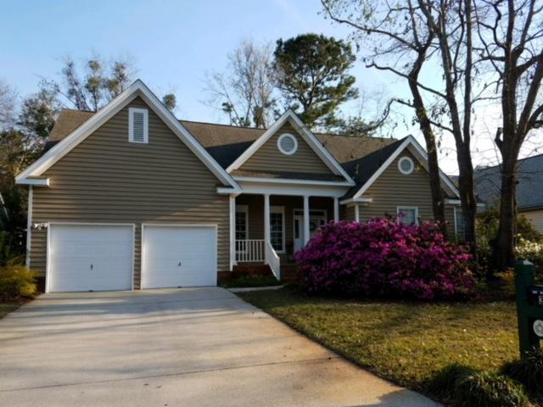
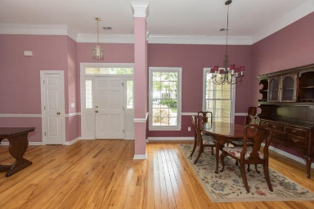
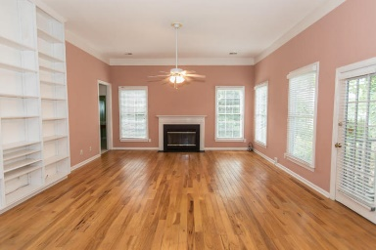
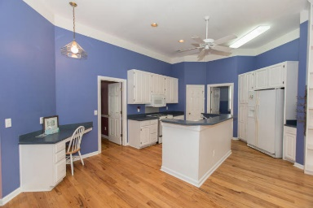
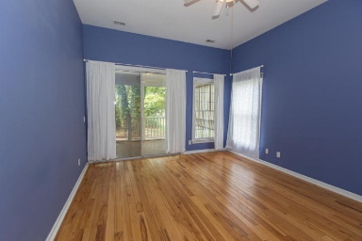
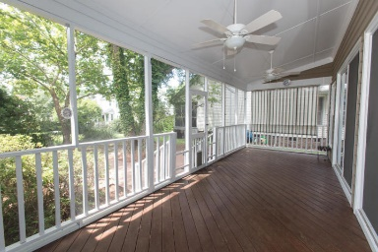
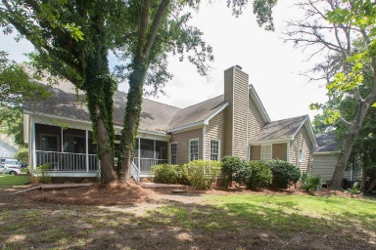


Just Reduced!
Beautiful Home in Charleston National
3089 Linksland Road
Charleston National · Mount Pleasant, SC 29466
MLS# 18020777 · $399,000
Michael Dew
O 843-769-5100
M 843-870-7000
michaeledew@gmail.com
www.michaeldewrealestate.com
Nice and very clean 3 bed 2 bath home in Charleston National. 1 story open floor plan. High ceilings and hardwood floors. Large master with en suite separated from other bedrooms. Screened in porch overlooking wooded lot. New exterior paint.
AgentOwned Charleston Group
902 Savannah Hwy
Charleston, SC 29407
Real Estate ● Mortgage
Insurance ● Business Brokerage

