Slide 1
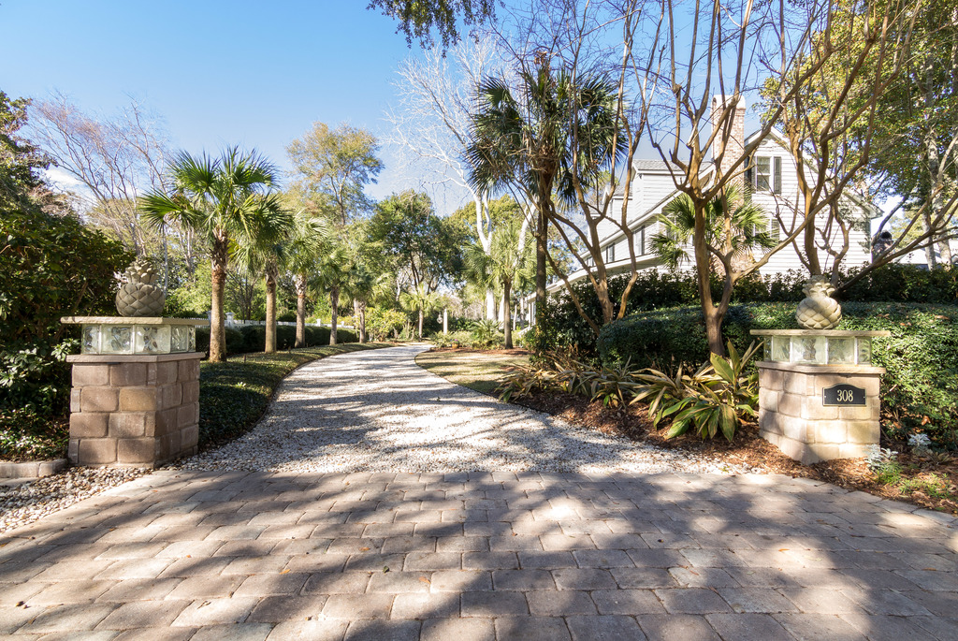
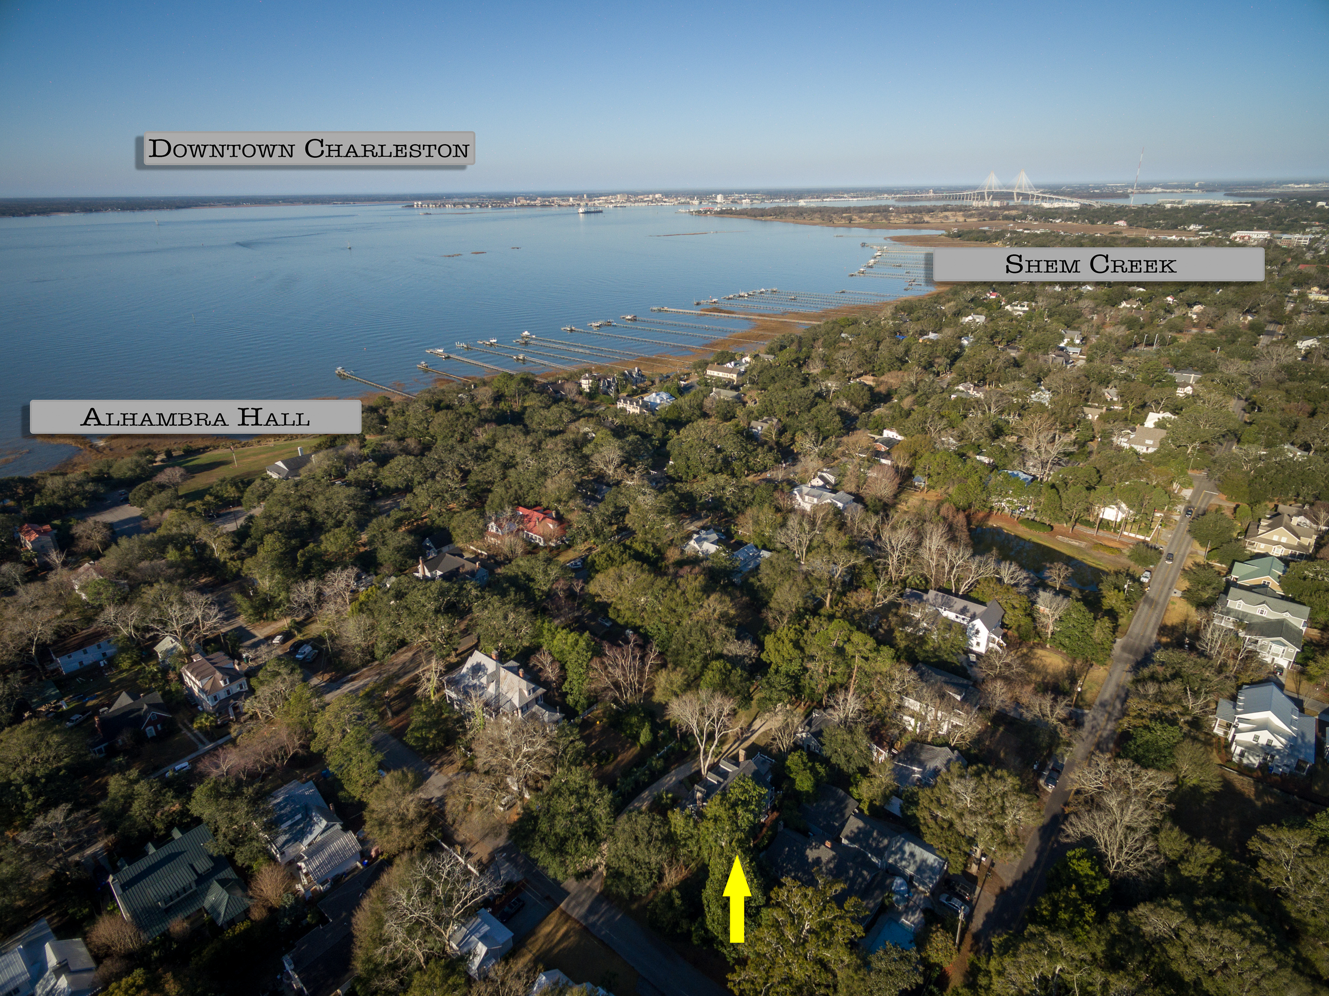
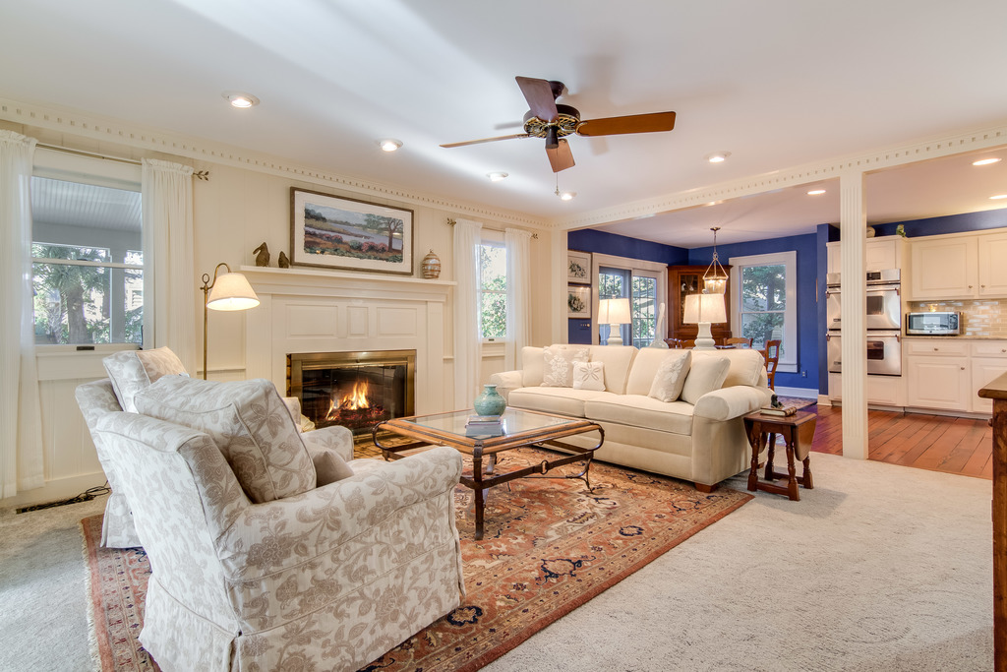
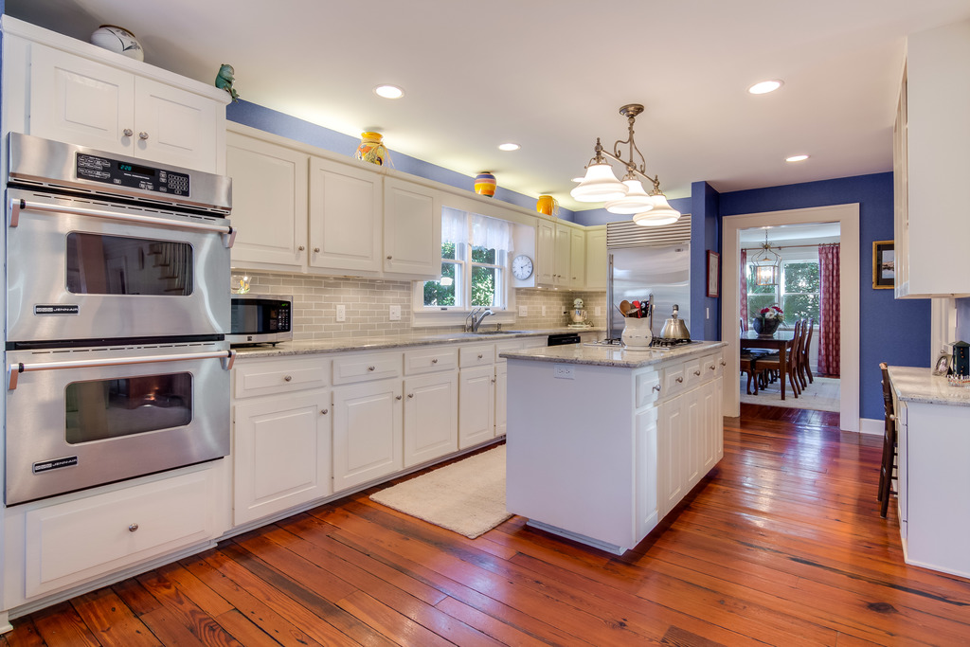
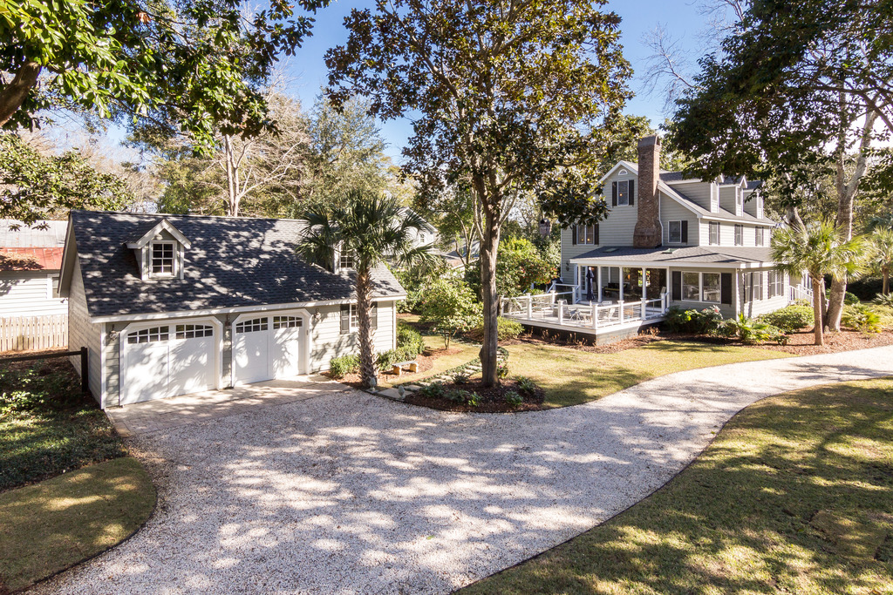
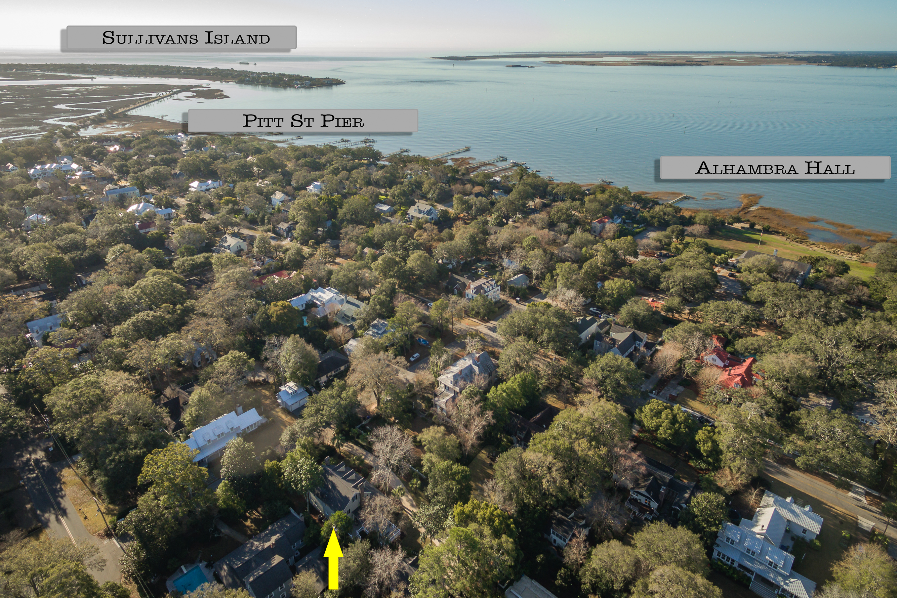
New Listing in the Old Village
308 McCormick Street
Mount Pleasant, SC 29464
MLS# 17001214 ~ $1,885,000
This new listing in the sought after Old Village Community in Mt. Pleasant is a gem! The three story home with four bedrooms sits on a double lot with nearly a half acre of stunning landscaped yard. It is nestled away creating a private retreat. Recently, numerous improvements have been made to enhance this home including a kitchen renovation sure to impress any cook, new HVAC units, encapsulation of the crawl space and new duct work under the home, new roofs on the home and detached garage, and full painting of the exterior of the home and garage as well as the entire interior, trim and moldings included. A new spa on the recently expanded deck provides year round enjoyment with heating and cooling options. Located one block from Alhambra Hall and a short walk to the Pitt Street Bridge, the location is ideal. It is a short drive to historic Downtown Charleston and an even shorter drive to the beautiful beaches on Sullivans Island and Isle of Palms. Children can walk or bike to school and play at the playground right down the street. Dog owners will love the huge dog play pen located by the garage! If you have clients looking to buy into the lifestyle of the Old Village, then this is a must see.
Check out the 3D Walk Through Tour: http://southcarolina3drentals.com/index.php/3d-model/308-mccormick/fullscreen/
Ellen O'Neil
Broker/Owner
Ellen O'Neil Realty
ABR, e-PRO, CNE
Charleston Realtor of Distinction
(843)300-8530
http://EllenONeilRealty.com

