Slide 1
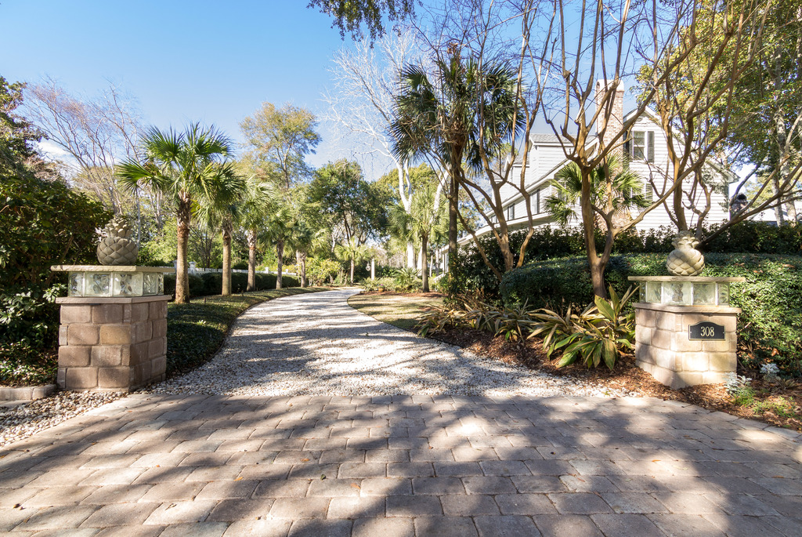
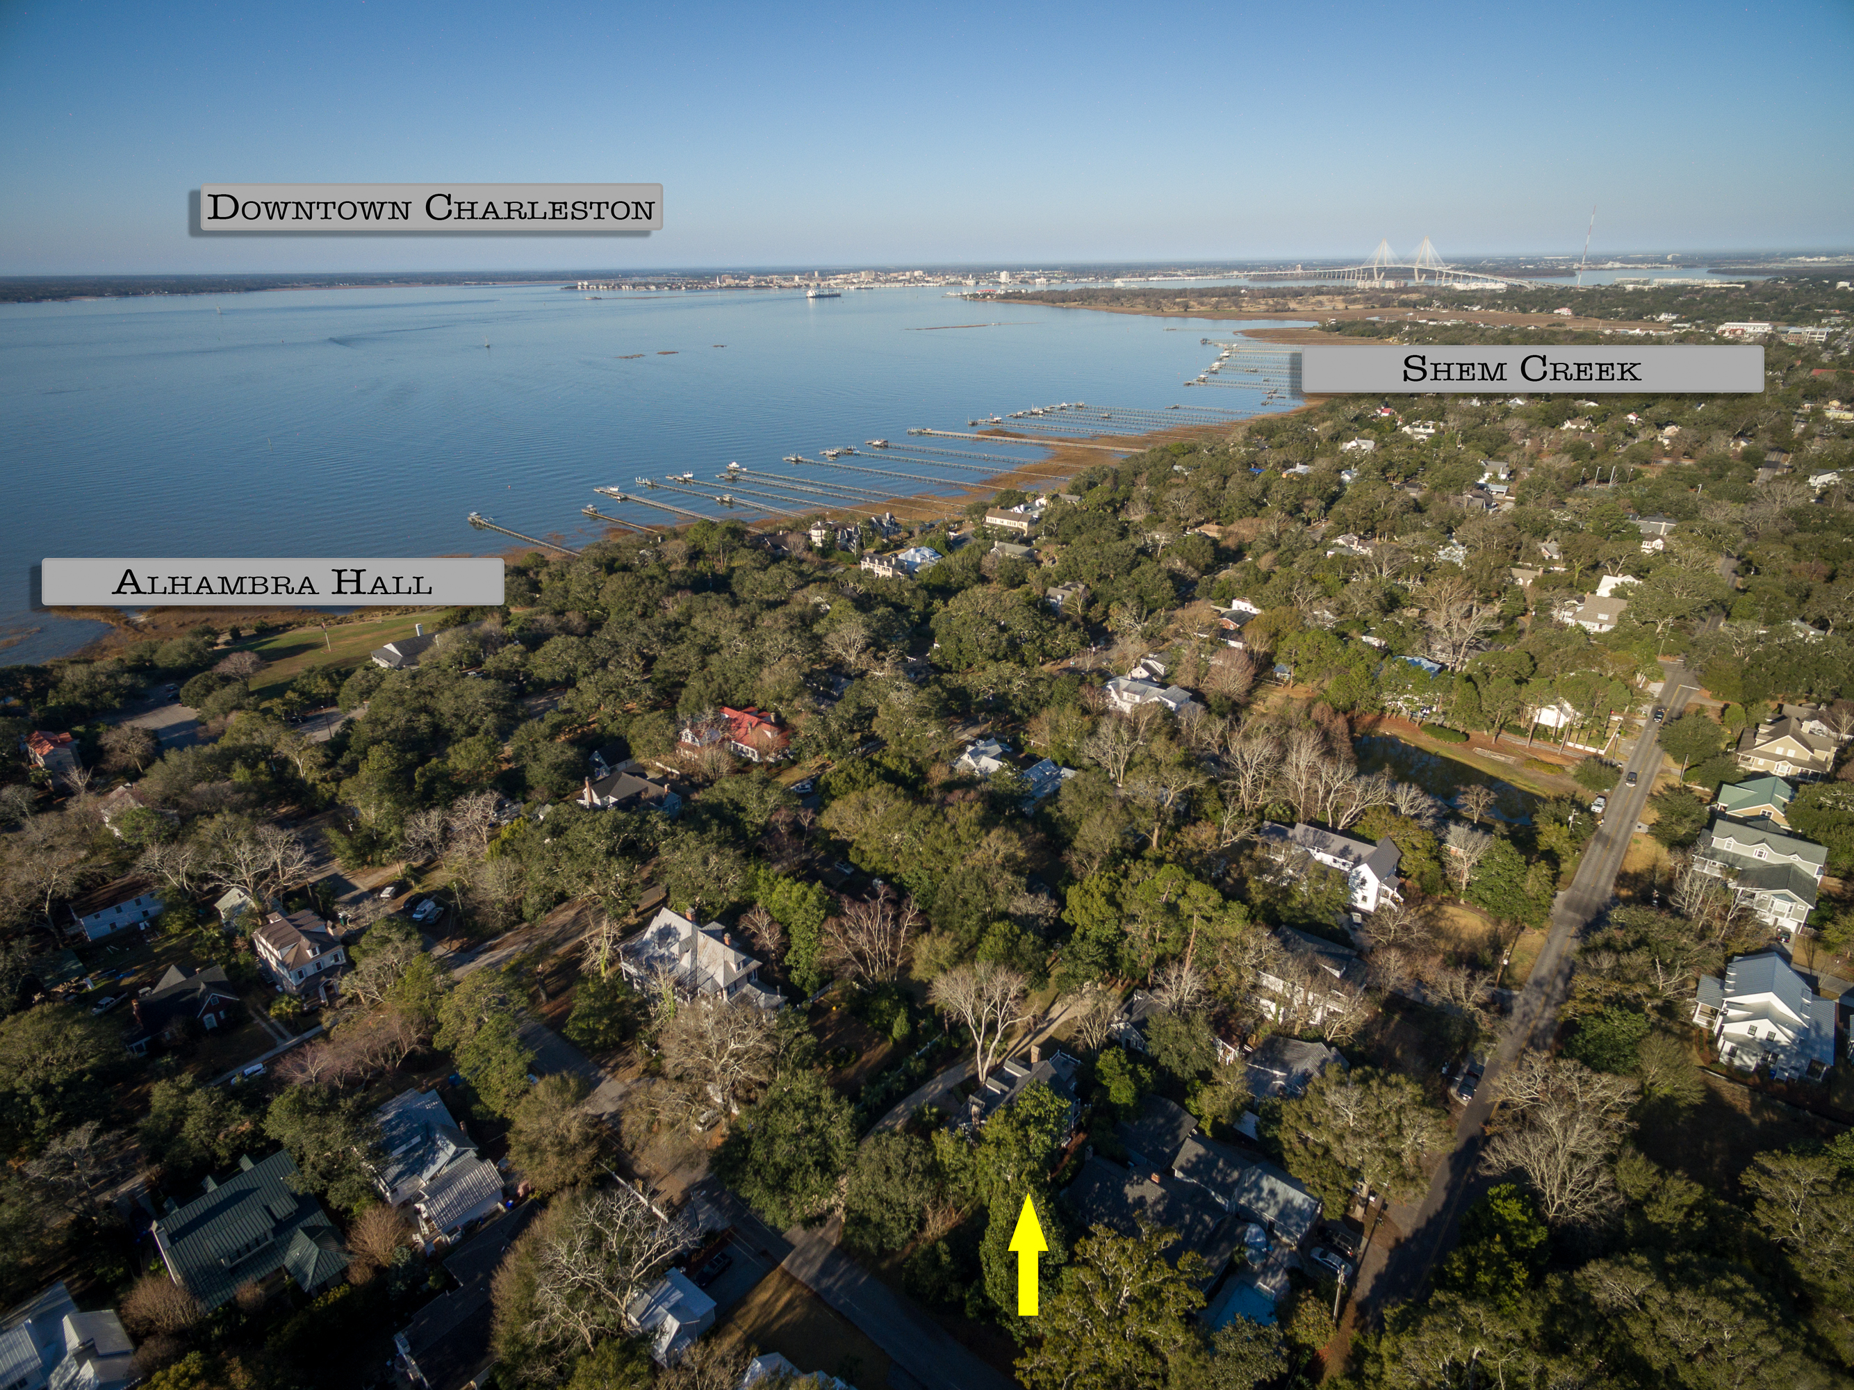
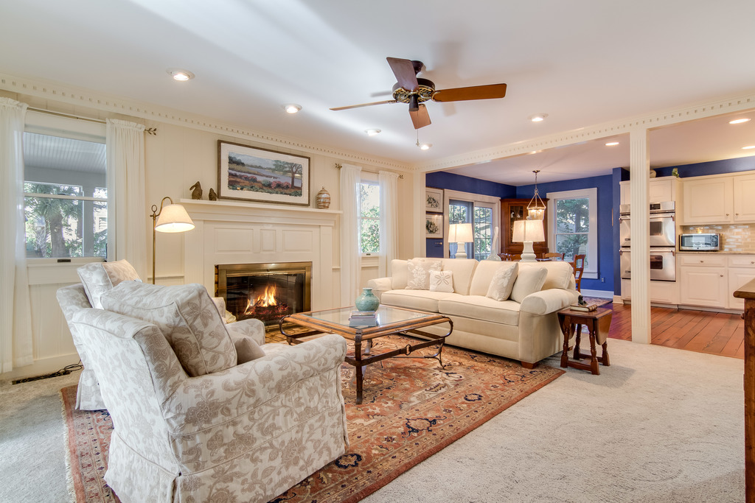
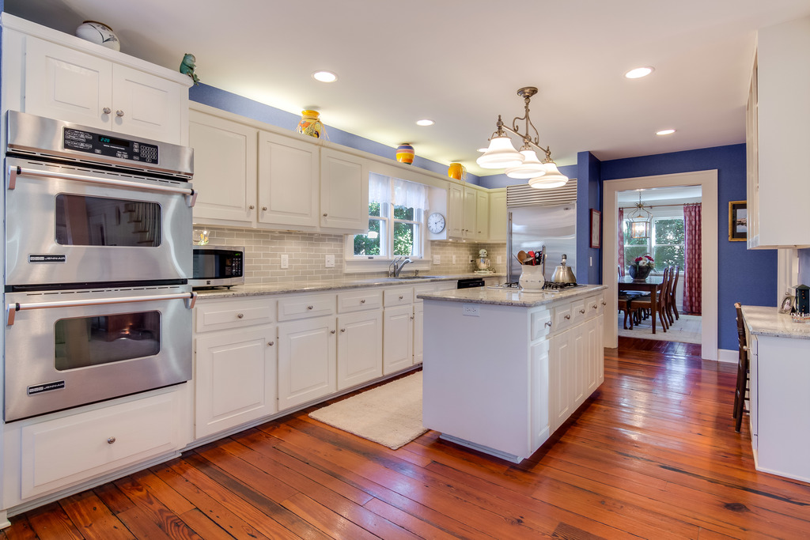
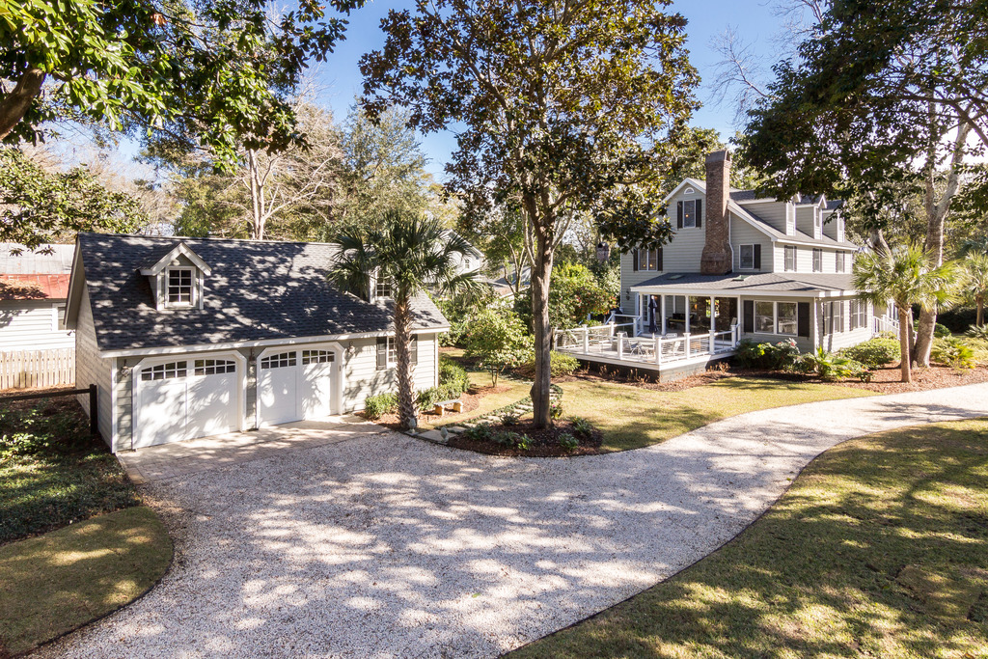
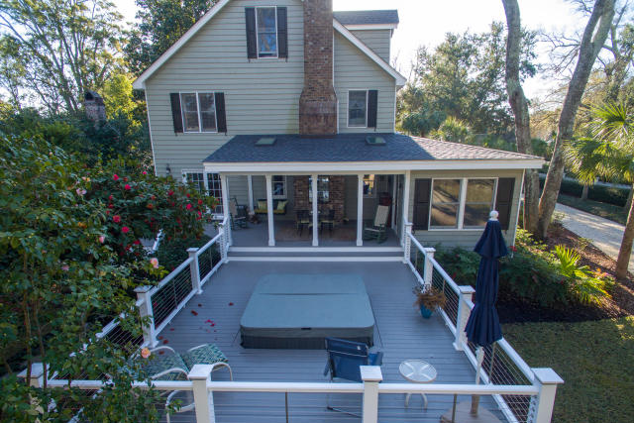
Price Reduced &
Below Appraised Value
308 McCormick Street
Mount Pleasant, SC 29464 ~ MLS# 17001214 ~ $1,795,000
Price Reduced - INSTANT EQUITY as this price is BELOW APPRAISED VALUE! Now is the time to arrange your tour! This is a very unique 4 bedroom 3.5 bath home on nearly a half acre lot in the coveted Old Village community in Mt. Pleasant. A block from Alhambra Hall and a short walk to Pitt Street Bridge, this home is in an ideal location. Upgrades and enhancements abound in this home that has been lovingly maintained and improved. Check out the 3D virtual walk through tour and call for your appointment today! Owners will consider renting back the home until early July so your buyers can buy now and move later.
Check out the 3D Walk Through Tour:
http://southcarolina3drentals.com/index.php/3d-model/308-mccormick/fullscreen/
Ellen O'Neil
Broker/Owner
Ellen O'Neil Realty
ABR, e-PRO, CNE
Charleston Realtor of Distinction
(843)300-8530
http://EllenONeilRealty.com

