Slide 1
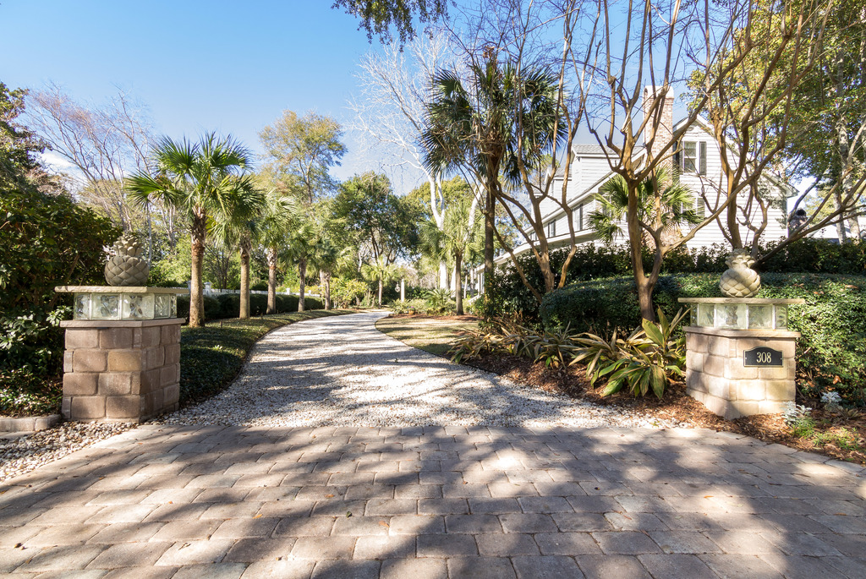
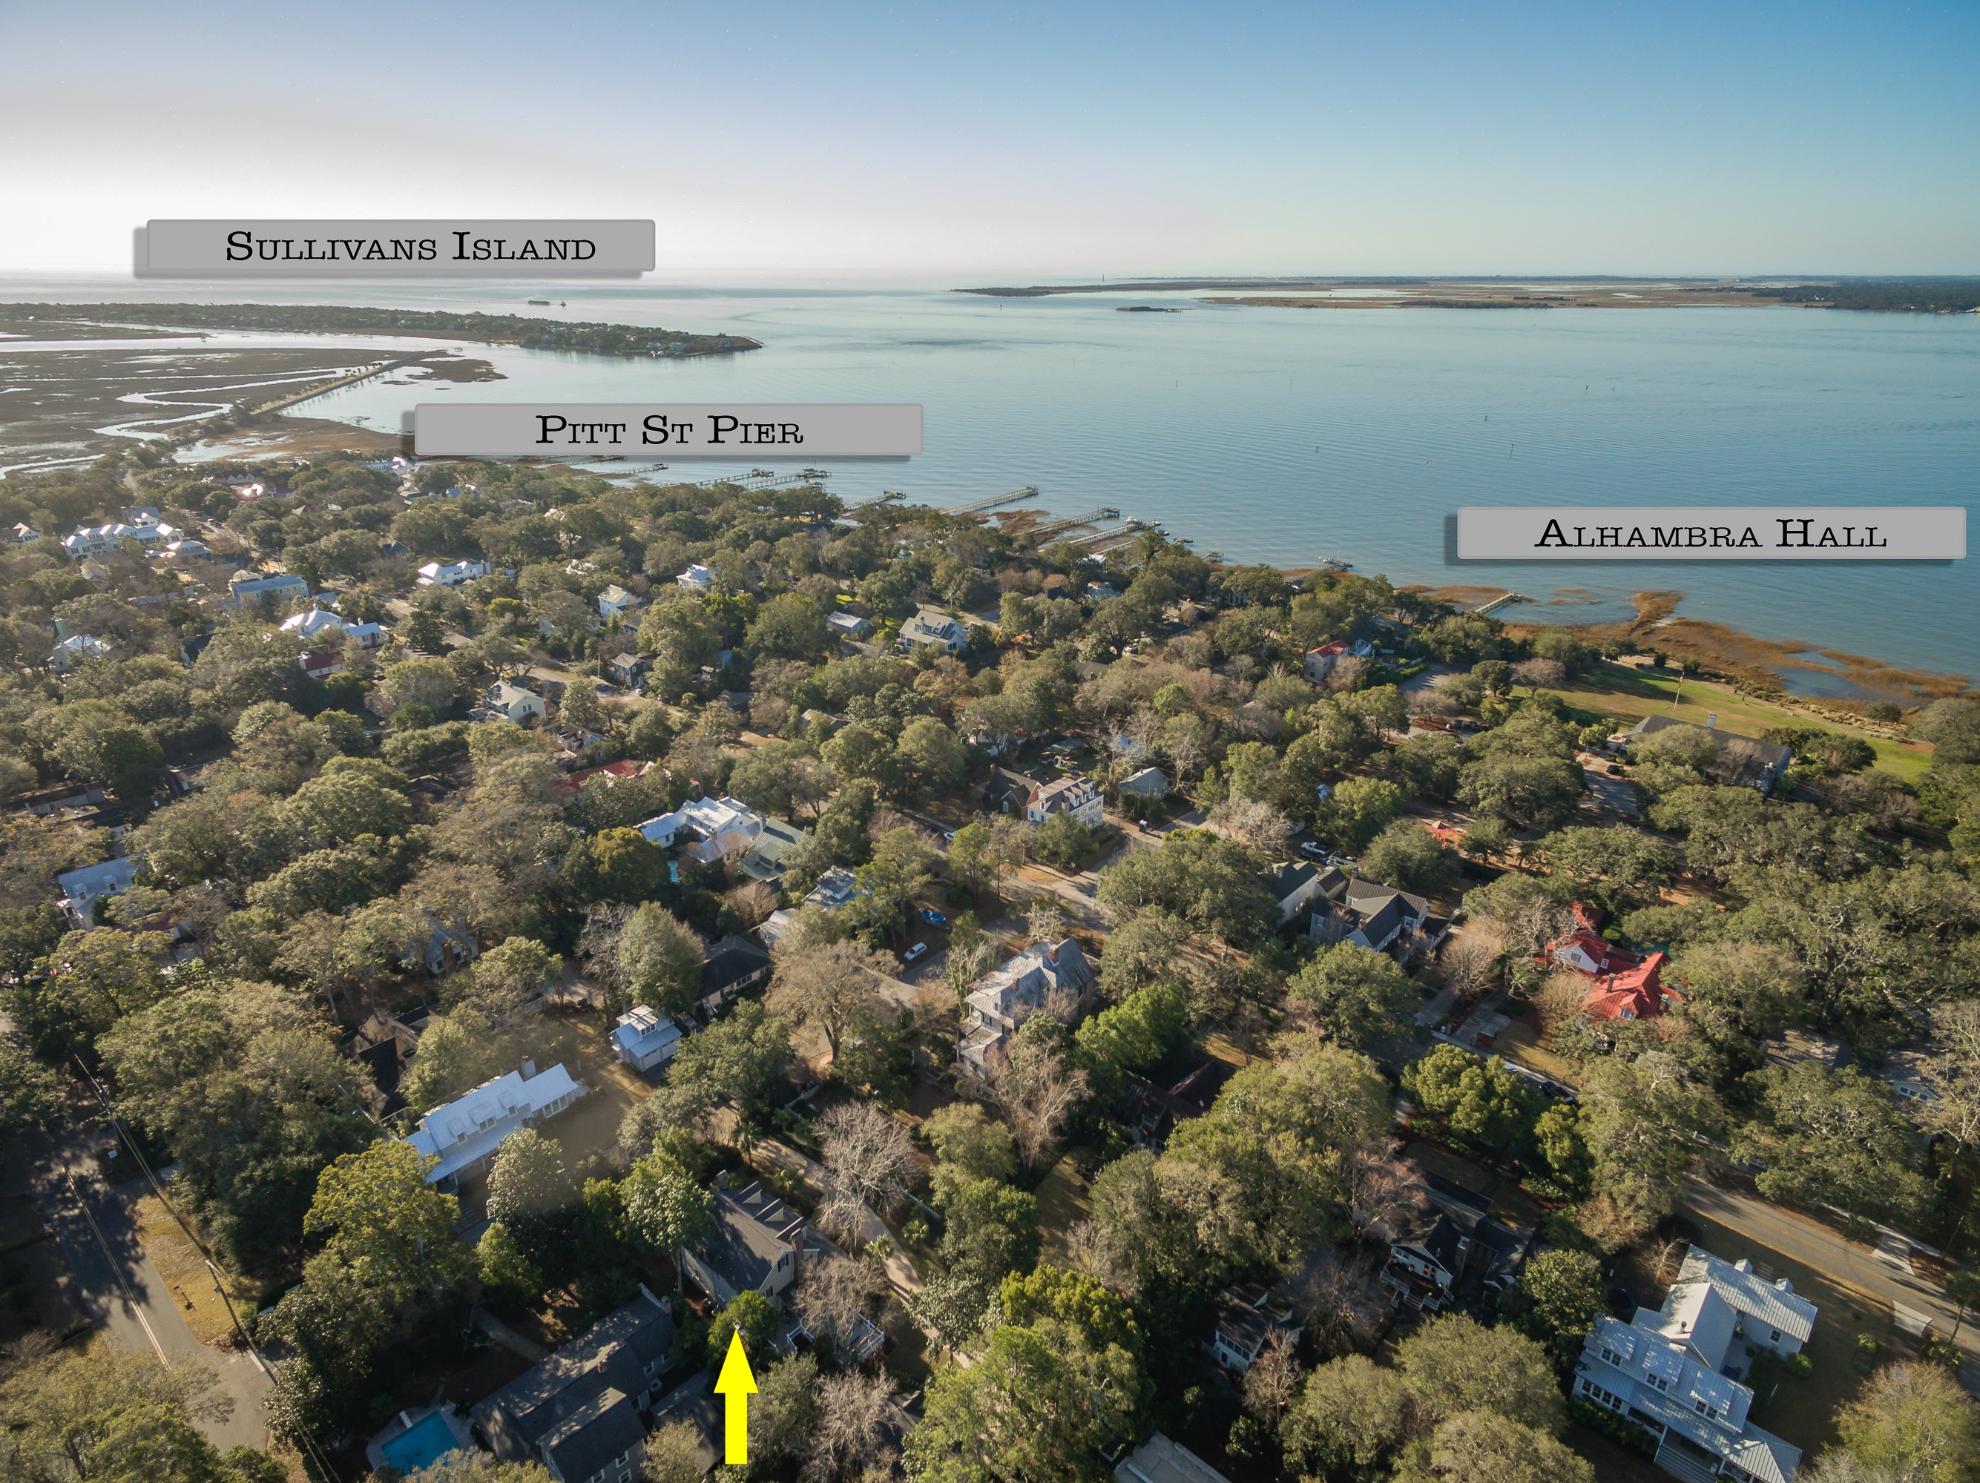
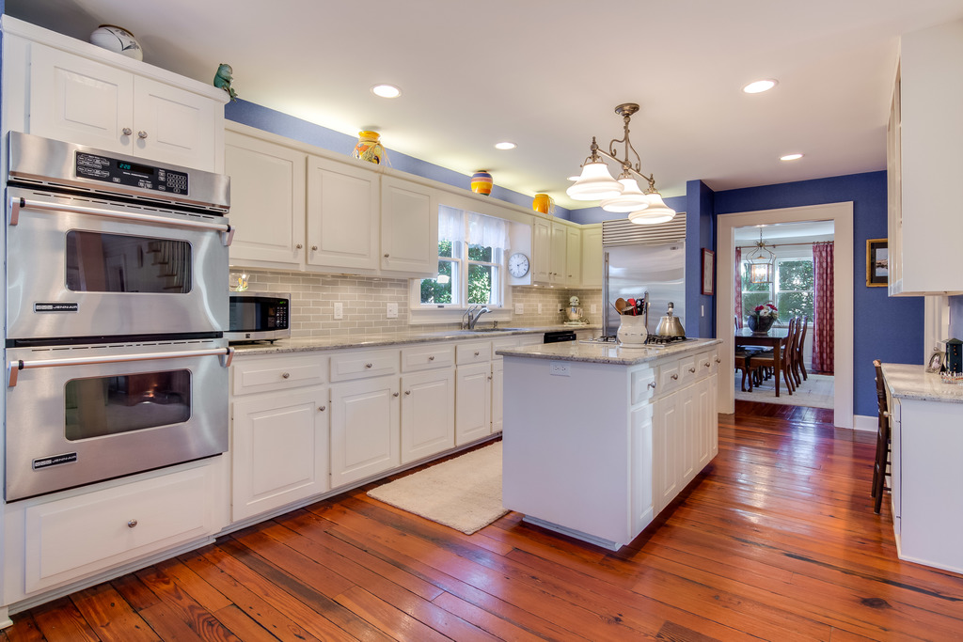
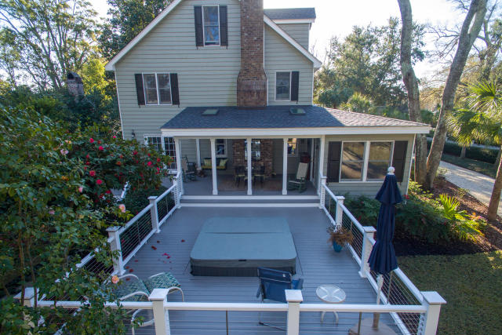
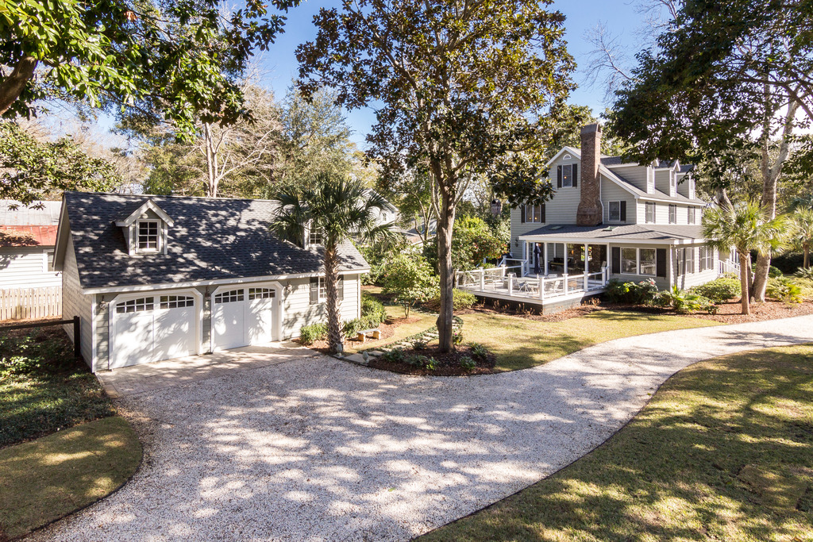
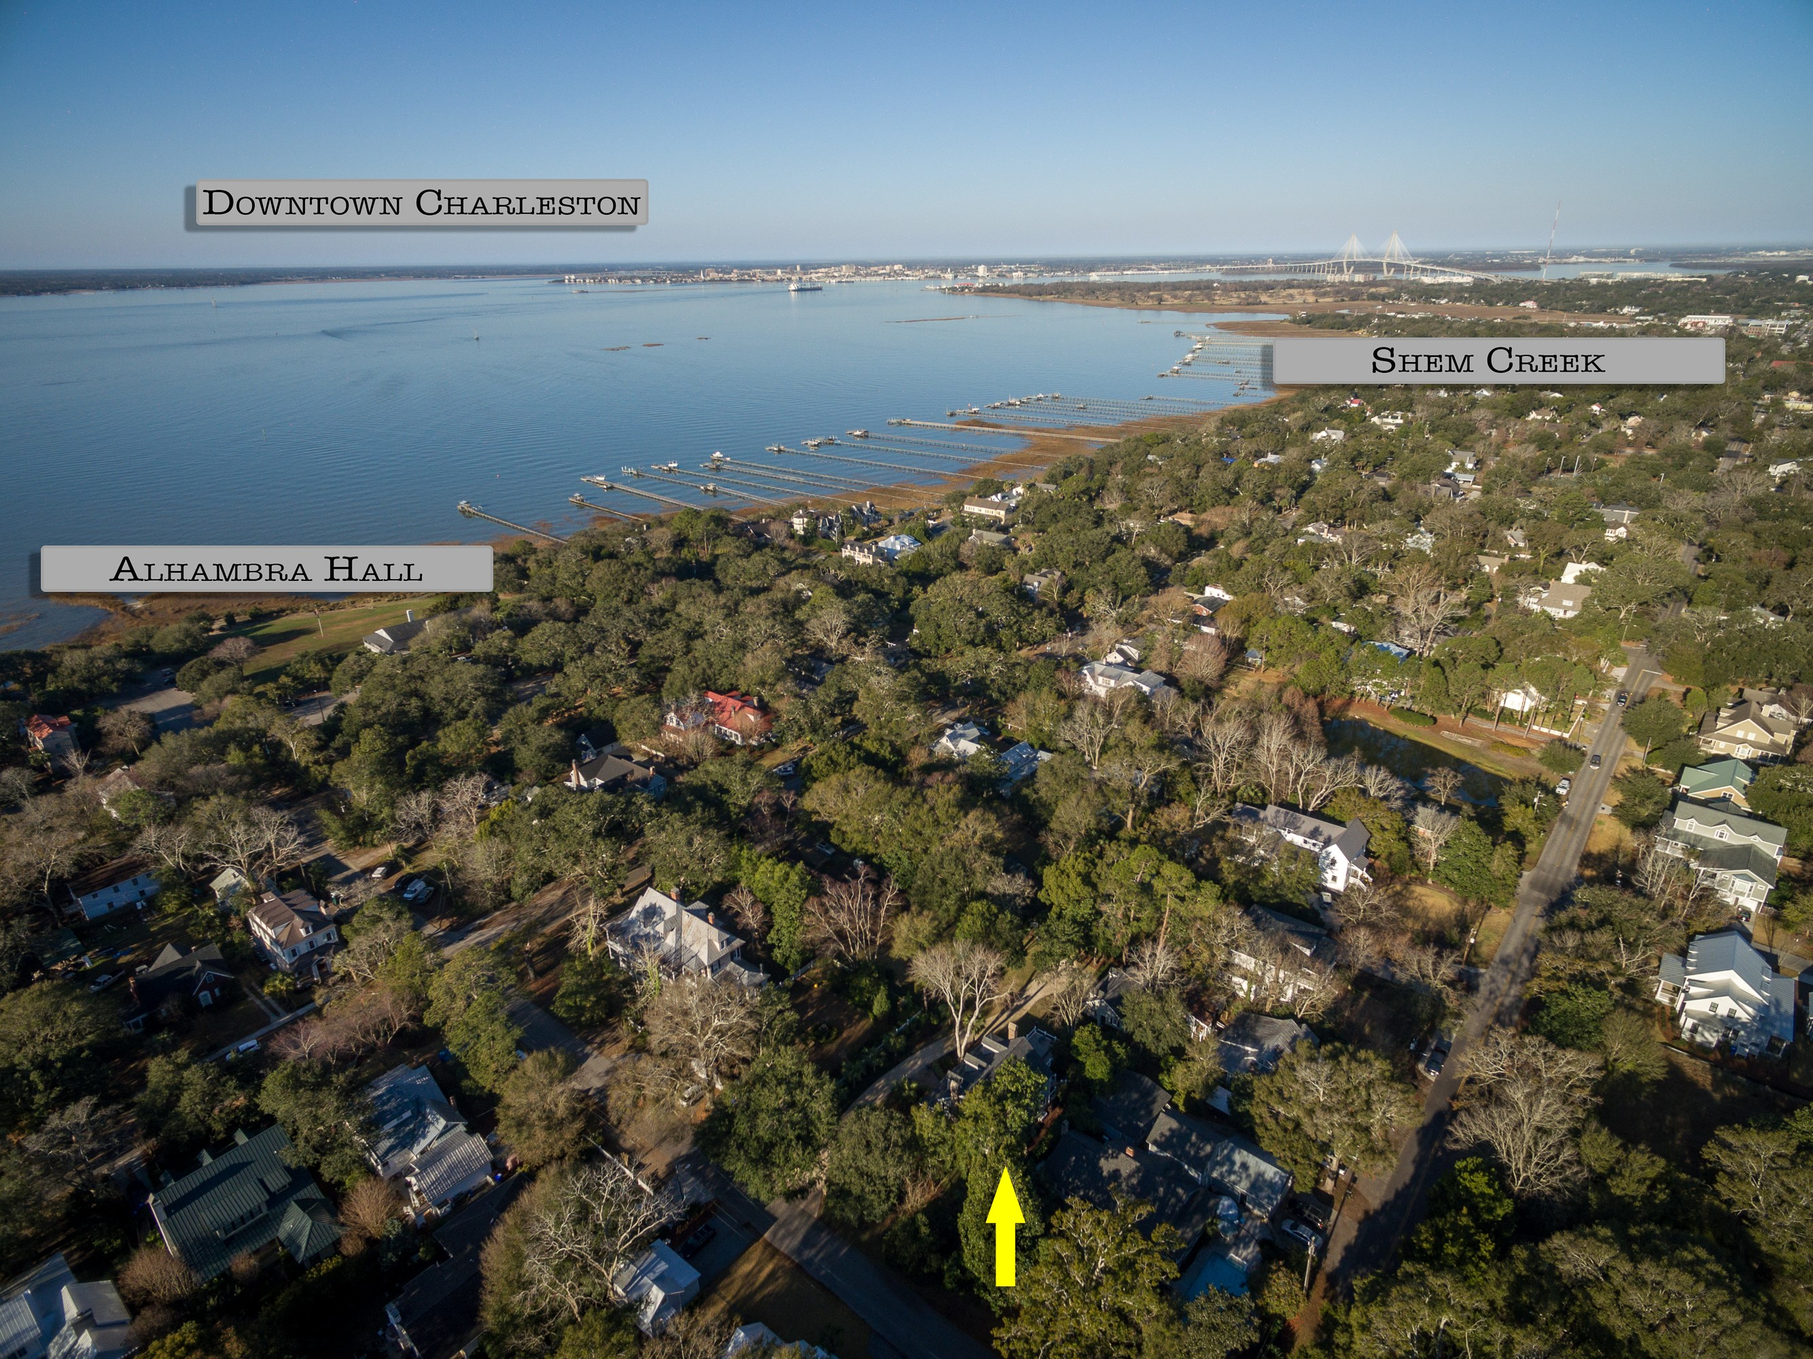

Old Village Living At Its Finest
308 McCormick Street
Mount Pleasant, SC 29464 ~ MLS# 17001214 ~ $1,585,000
This gorgeous home in the heart of the Old Village in Mt. Pleasant is the perfect home for a family who wants every benefit of living in the coveted Old Village neighborhood. Located a block from Alhambra Hall, you can take a leisurely stroll to the play park or to soak in the beautiful water views. Take the kids for a bike ride to the Pitt Street Bridge or exercise the family dog at Alhambra with other dog lovers. Hop in the car and drive a mere few miles over the Ben Sawyer Bridge to take a stroll on the beach at Sullivan’s Island or spend the afternoon building sand castles and enjoying a refreshing swim. The joys of walking and biking to school, parks, and the quaint shops in Old Village along Pitt Street will be reminiscent of times gone by, where people instinctively stop and savor all of the simple joys in life. Hop on the golf cart and cruise down the road to have lunch or dinner with a view on Shem Creek. 308 McCormick Street is perfectly situated on parklike grounds, nearly a half acre in size- a rare find in the neighborhood. The home has been lovingly maintained and enhanced through the years and is ready for its new family. As an added bonus, this is an instant equity opportunity - priced well below appraisal in hand. Don’t delay in scheduling your tour of this little slice of heaven in one of Mt. Pleasant most popular and sought after neighborhoods.
Check out the 3D Walk Through Tour:
http://southcarolina3drentals.com/index.php/3d-model/308-mccormick/fullscreen/
Ellen O'Neil
Broker/Owner
Ellen O'Neil Realty
ABR, e-PRO, CNE
Charleston Realtor of Distinction
(843)300-8530
http://EllenONeilRealty.com

