Slide 1
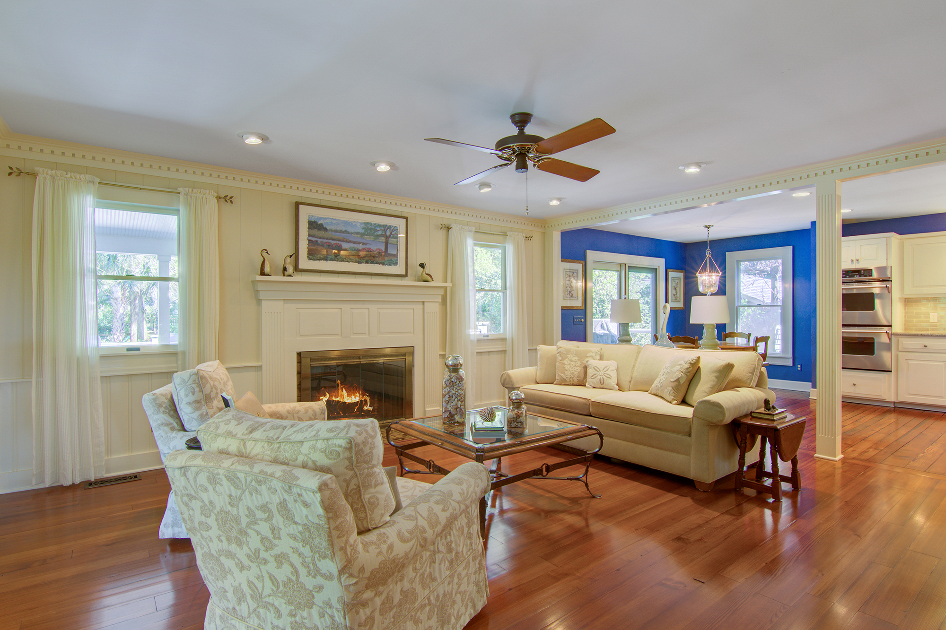
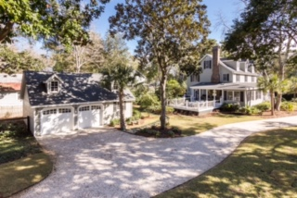
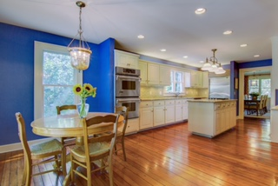
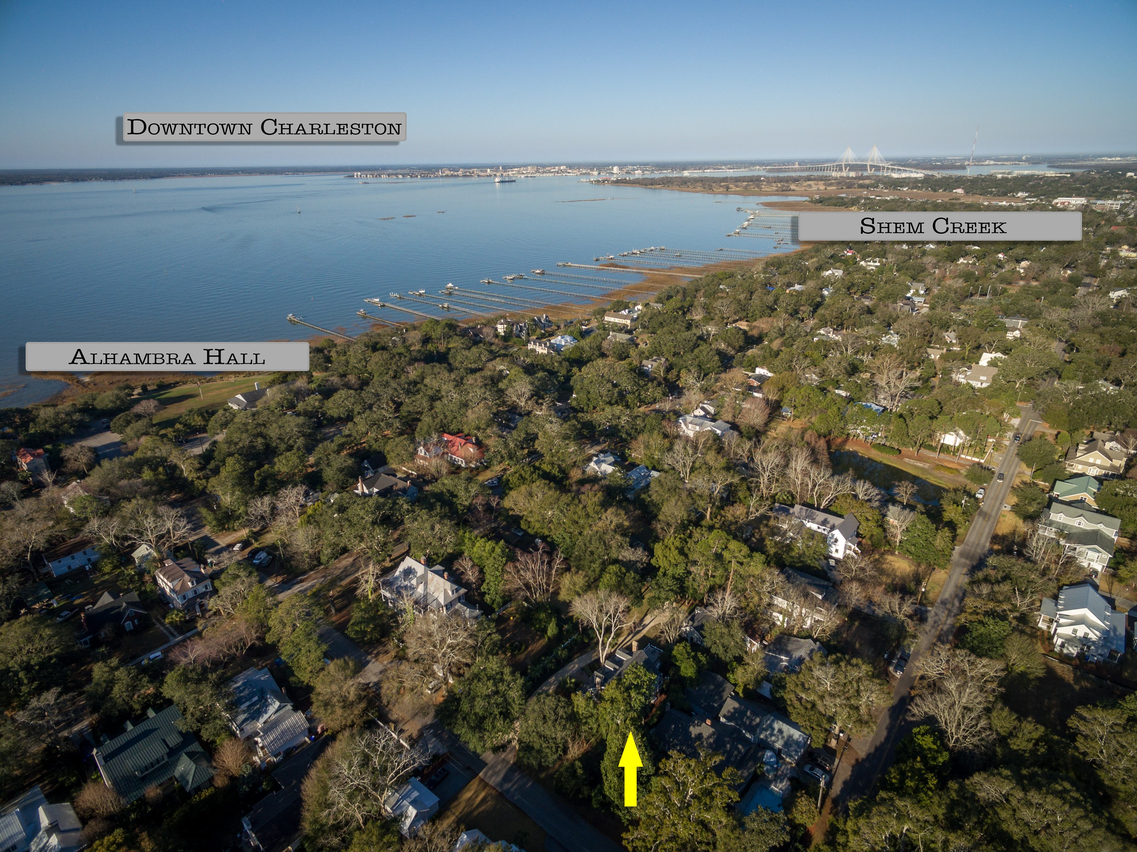
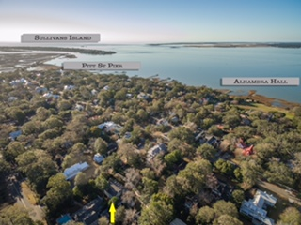

Better Than EVER… in Mt. Pleasant’s Old Village
308 McCormick Street
Mount Pleasant, SC 29464
MLS# 17001214 ~ $1,585,000
Check out the GORGEOUS new wood floors in this magnificent home at 308 McCormick Street. Buyers spoke and these sellers listened- Now the beautiful wood floors are continuous throughout the entire first floor and they look incredible! Come tour this amazing home that is set on nearly a HALF ACRE of professionally landscaped grounds in the coveted Old Village Community in Mt. Pleasant one block from Alhambra Hall. Walk to the Pitt Street Bridge, let the kids ride their bikes to the award winning schools, or play at the park one block away. Hop on the golf cart and head to Shem Creek for waterfront dining. Slow down and enjoy life in this sought after community which is literally close to everything- the beaches and historic Downtown Charleston included. This home is move in ready with too many improvements to list. Schedule your tour ASAP!
Check out the 3D Walk Through Tour:
http://southcarolina3drentals.com/index.php/3d-model/308-mccormick-st/fullscreen/
Ellen O'Neil
Broker/Owner
Ellen O'Neil Realty
ABR, e-PRO, CNE
Charleston Realtor of Distinction
(843)300-8530
http://EllenONeilRealty.com

