Slide 1
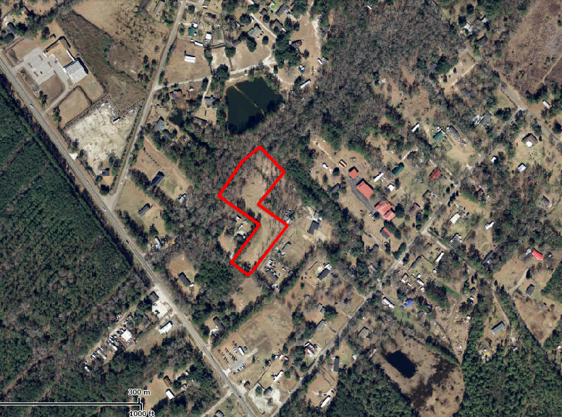
308 Pye Lane
Chaparral ~ Summerville, SC 29483
MLS# 1422398 ~ $115,000
3 Acres in Cane Bay Area
This property "may" be subdivided to sell 2 +/- acres.
Bob Glover & Zachary Glover
843-693-1837 (Bob) | 843-810-9891 (Zachary)
bobglover08@gmail.com | mrcrealestate1@gmail.com
Matthew Ryan Company, 104 Berkeley Square, PMB 59, Goose Creek, 29445

