Slide 1
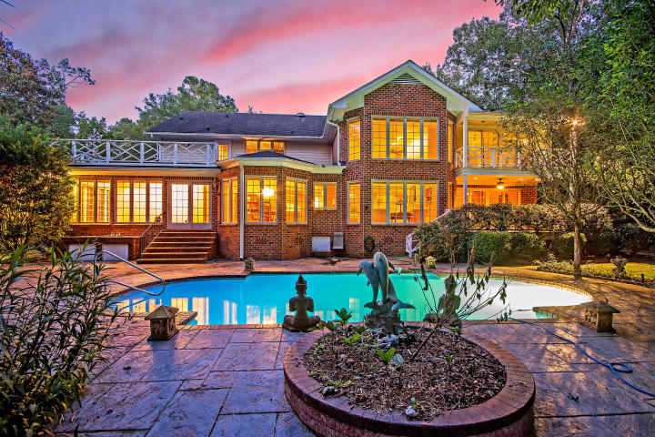



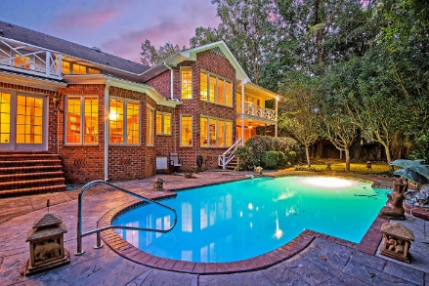
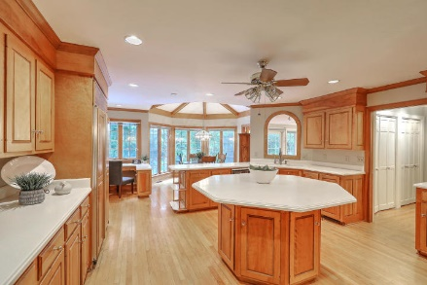
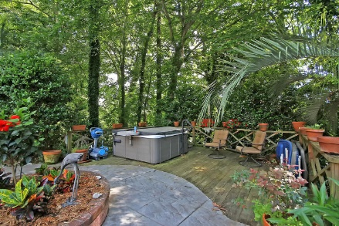



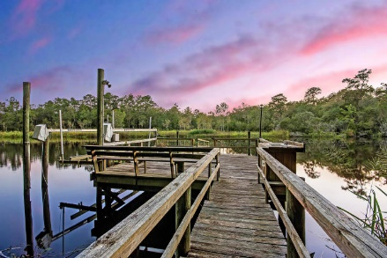

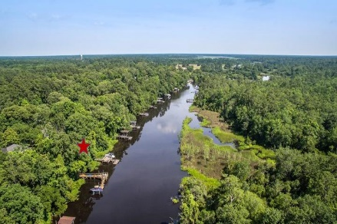
Parkshore Marshfront
Deep Water With Dock & Pool
Now Only $739,900
308 Shaftesbury Lane
Kings Grant ~ Summerville, SC 29485 ~ MLS# 18026295 ~ $739,900
Ashley River waterfront living with a dock awaits you in this beautiful, established Summerville neighborhood. A staircase from the grilling area and in-ground pool cuts through heavily wooded backyard and brings you down to your very own private dock with a sitting area, sink area to clean your fish that you caught, a boat lift to get you into the water in a jiffy and a floating dock to launch your kayak or do some fishing. This stunning home greets you with a circular driveway and beautifully landscaped hedges. Inside you'll find a dramatic two story great room with a fireplace, a library with a fireplace, a turret style ceiling in the eat-in portion of the kitchen a breathtaking sun room that looks out to the backyard. This sprawling home and amazing location is tough to beat!
Additional features include:
24 ft grand entry
Stunning kitchen with a gazebo island, Corian countertops, abundant cabinet space, 6 burner Jenn Air smooth burner, griddle, and grill, a Sub Zero refrigerator, built-in microwave with convection oven, water purifier, and an eat-in area
Great room with built-ins, a gas fireplace, electric blinds, and a wet bar with storage
The den/library features a gas fireplace with a marble hearth and custom book shelves
Spacious master suite with fireplace, 2 walk-in closets, and balcony with spiral staircase leading to deck and pool area overlooking the Ashley River
Lovely master bathroom with Jacuzzi tub, double sink, and walk-in shower
Large laundry room with 2 closets, a built-in ironing board and sewing table
Tankless water heater
5 inch crown moulding
All Baldwin brass hardware throughout the home
Gunite pool with gas heater and stamped concrete pool surround
Patio perfect for entertaining with a brick buffet by the grill area
Floating dock and boat lift for easy water access
40 foot bluff on river is all hardwood trees
Electric fence in place
Book your showing today!
Christopher Smith christopher@mattoneillteam.com 843-267-0735

