Slide 1
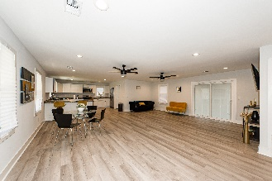
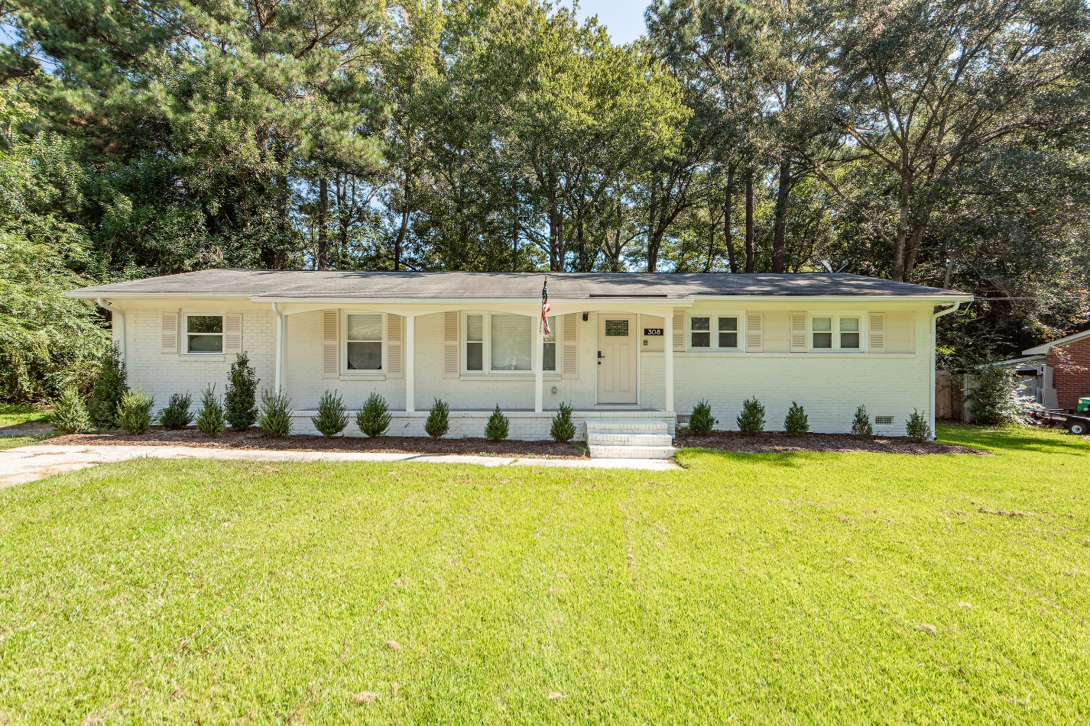
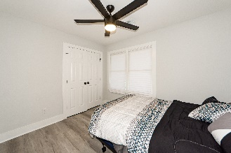
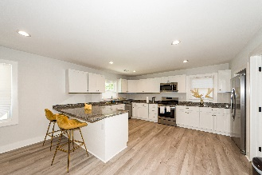
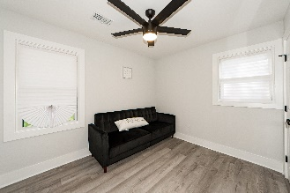
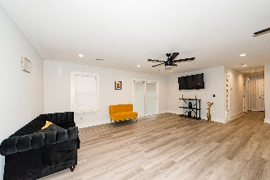
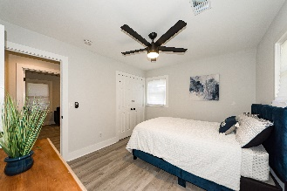
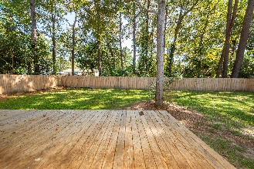
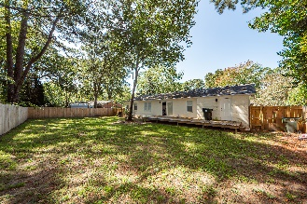
Oakdale Estates Open House Saturday 3/18/23 from 12-3
308 Forest Circle
Summerville, SC 29483 | MLS# 23002225 | $355,000
Stunning renovation! Looking for the perfect home on the perfect lot? Recent renovation with too many upgrades to list to include sun filled living room with spacious open concept kitchen, new HVAC 2021, new privacy fence, granite counters, stainless appliances, tankless hot water heater recessed lighting, flooring, oversized laundry/storage room...everything looks amazing. This home offers carefree low maintenance for many years. Large front porch to enjoy the scenery and a private fenced backyard for entertaining. Spend your mornings on the front or back porch and your evenings in the oversized yard with a new privacy fence providing a quiet place to rest and the privacy you need. Plenty of room for a boat, RV and more and there is no HOA for the neighborhood. Don't miss this opportunity!
Take a Virtual Tour
Johnny Crosby
jcrosby@propertyadvisorsinc.com | 843-270-9407 | www.charlestonhomeproviders.com
Brand Name Real Estate | 4 Carriage Lane, Suite 106 | Charleston, SC 29407

