Slide 1

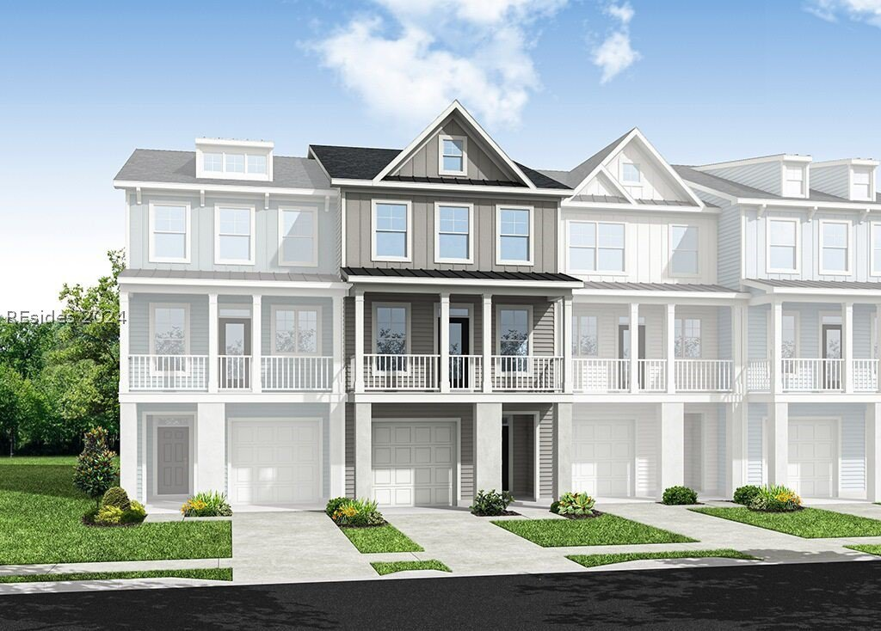
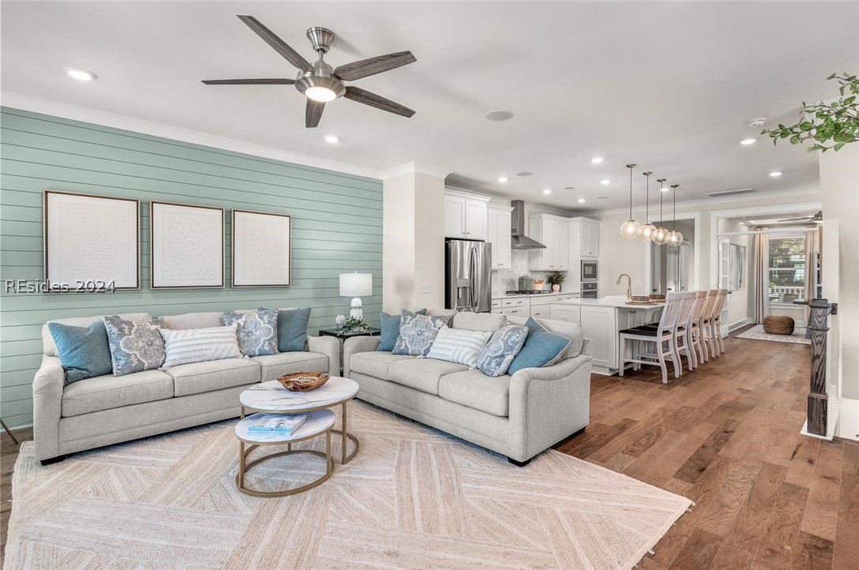
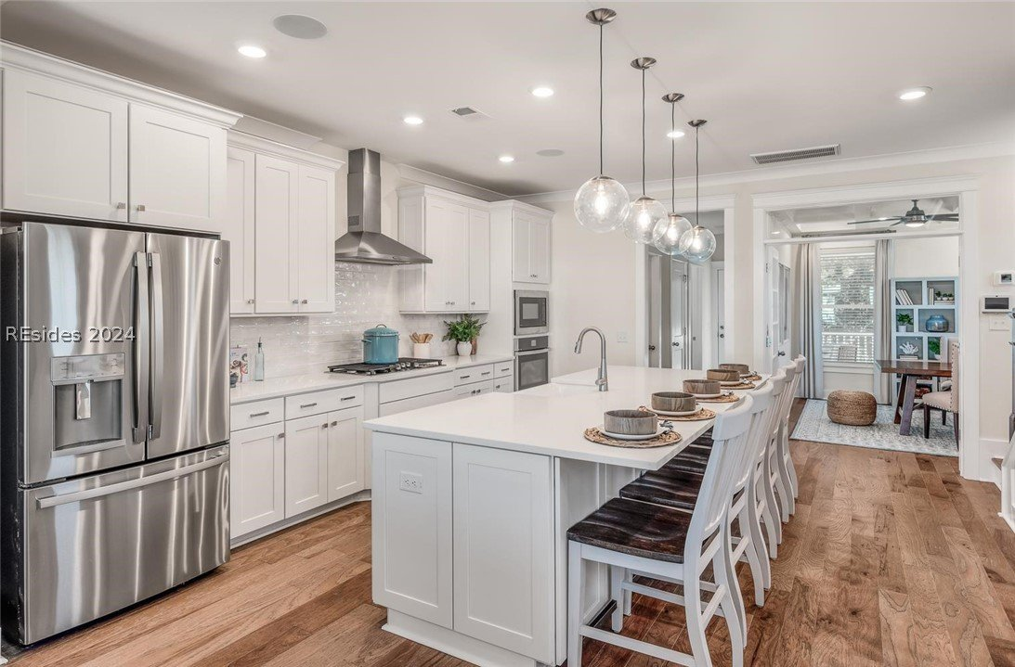
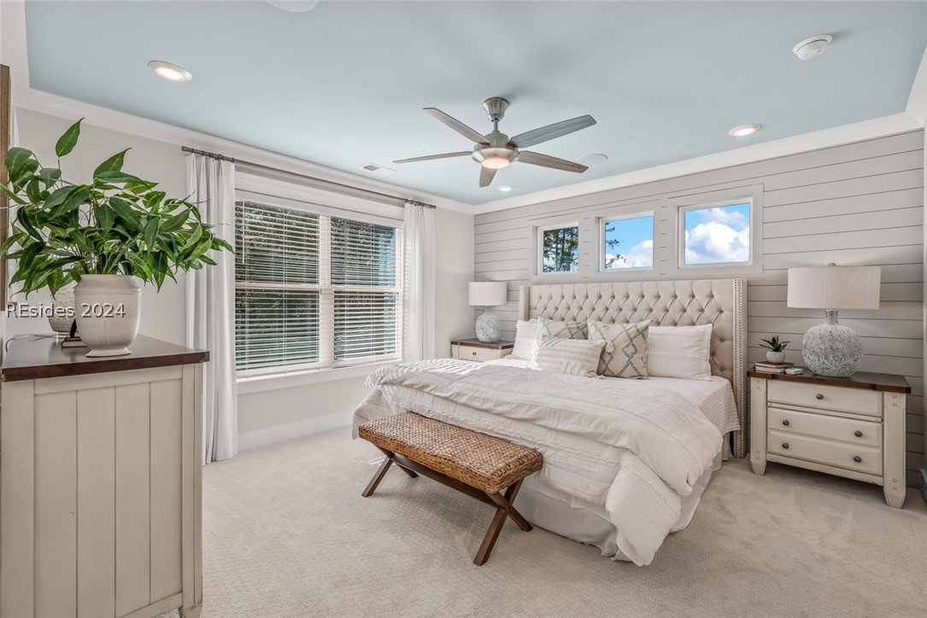
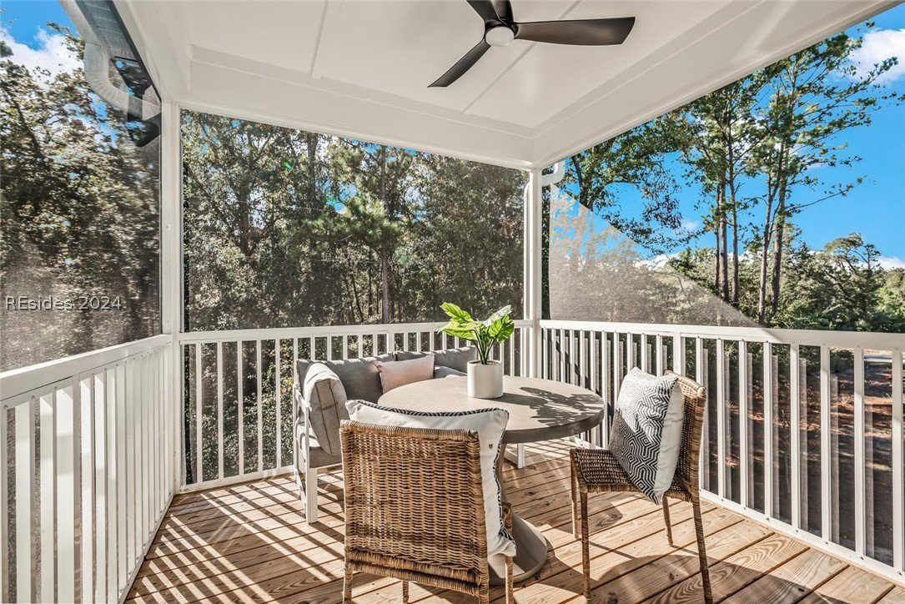
Quick Move-In Available
308 Forest Trace
New Riverside Village | Bluffton, SC 29910
MLS# 443133 | $509,045
This Georgetown floor plan is READY TO CLOSE NOW!
The first floor has a one car garage, garage entry with drop zone, a bedroom with walkout patio, walk-in closet and private bathroom, and several closets for storage. The second floor features a front balcony, spacious family room, upgraded kitchen with large pantry, dedicated office, powder room, and a screened porch. The third floor is where you will find the laundry room, dual primary suites; both with walk-in closets and spacious bathrooms.
Jean Rettig
843-813-7410
jrettig@eastwoodhomes.com

