Slide 1
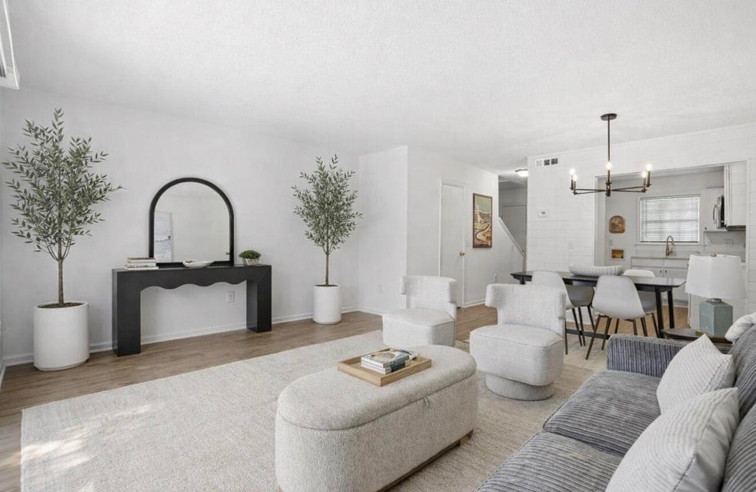
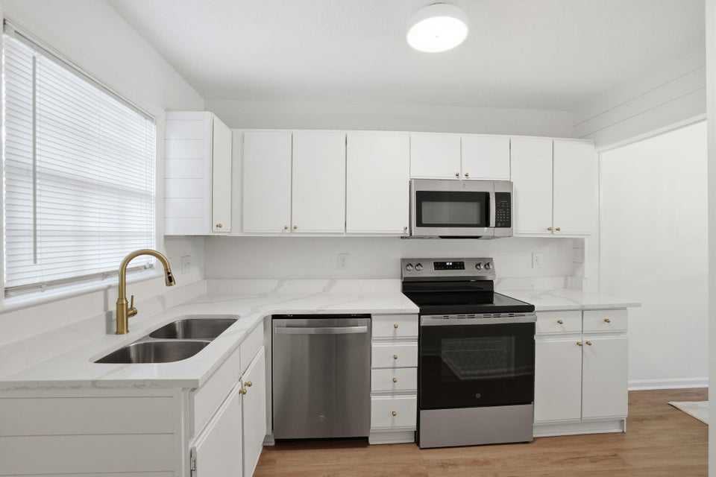


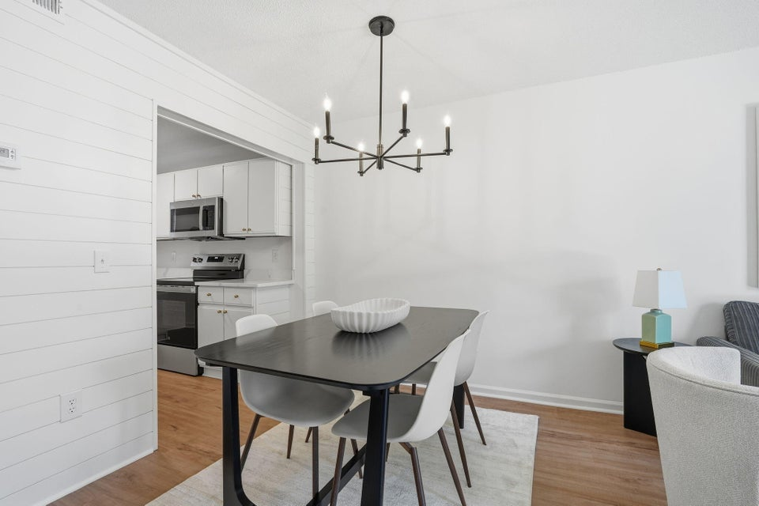
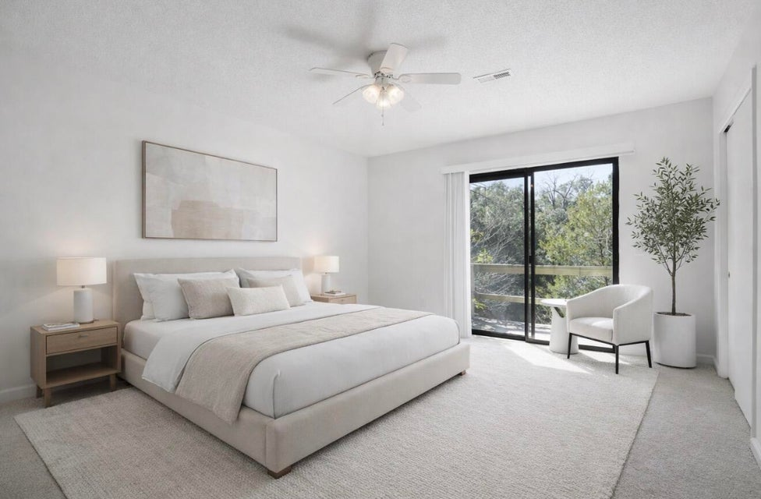
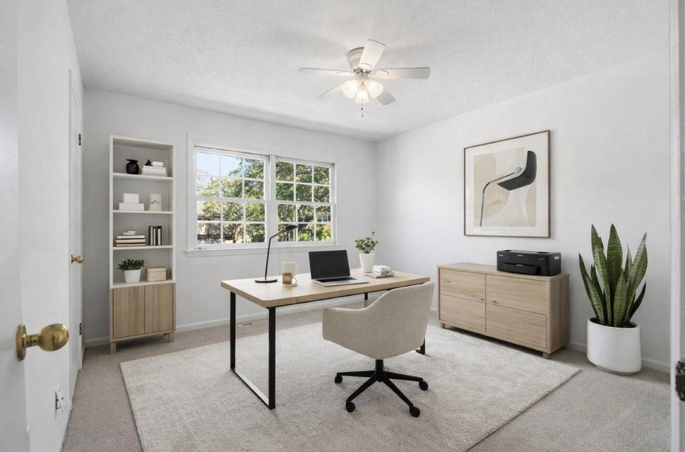
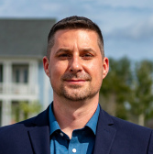
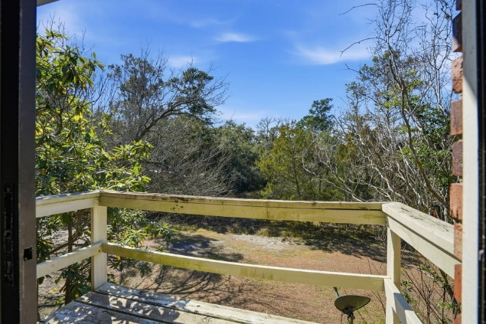
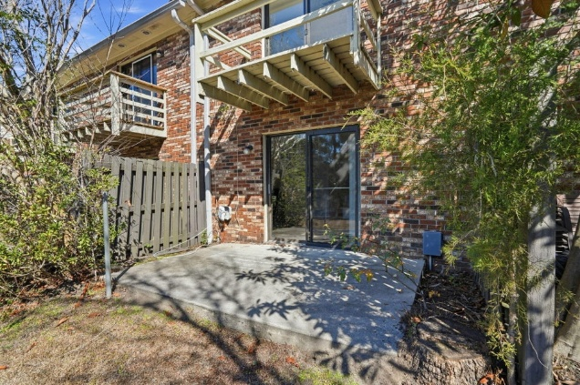
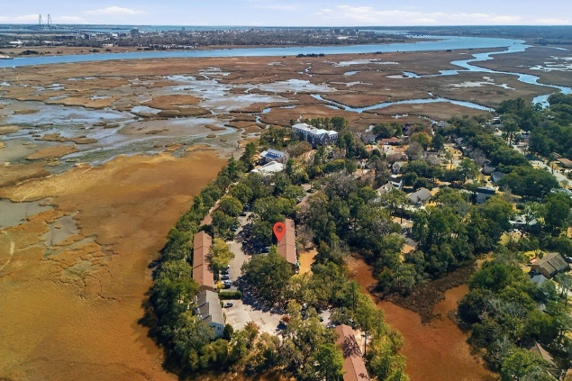
#26004363
Renovated in West Ashley
308 Saint Charles Court
Perreyclear Pointe
Charleston, SC 29407
Open House
Sat 10-12 & Sun 10-12
2 BED
1½ BATH
1,054 SF
$264,999
Discover this hidden gem in the heart of West Ashley! Welcome to this charming 2 bedroom, 1.5 bath marshview townhome. This breathtaking community is unique with ancient oaks and draping moss and is surrounded by the Ashley River, all tucked away in a private alcove just moments from Downtown Charleston! This awesome townhome has been entirely updated with a new roof, HVAC (2024), all new LVP on the first floor and the full bathroom upstairs, brand new carpet and pad, brand new stainless steel appliances, brand new quartz counter tops in the kitchen and baths, brand new plumbing fixtures, brand new lighting, brand new mirrors, brand new receptacles, brand new shiplap accents and the home has fresh paint throughout! The community has picnic tables and a hammock to enjoy the amazing views!
enjoy the privacy Perreyclear Pointe has to offer, and you'll really love the picture perfect views throughout the neighborhood. Community amenities include lawn maintenance, trash service, and park access.
Meg H. Kandik
843-814-5137
Meg@HolyCityRE.com
www.holycityre.com
Brand Name Real Estate
4 Carriage Ln
Charleston 29407
Matt Kimes
843-860-1669 | mattkimeshomes@gmail.com
www.mattkimeshomes.com
Some images AI modified

