Slide 1
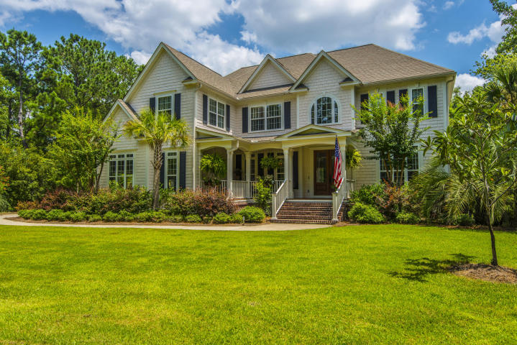
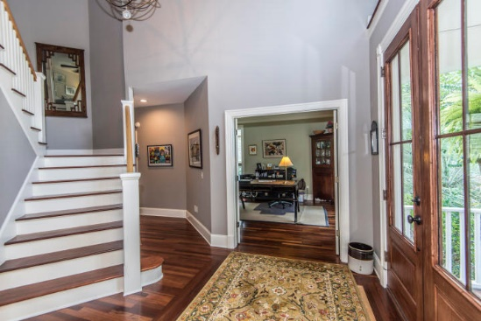
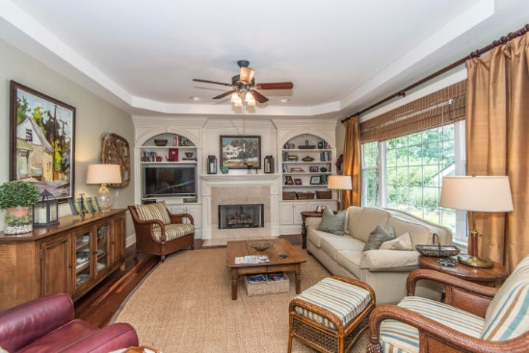
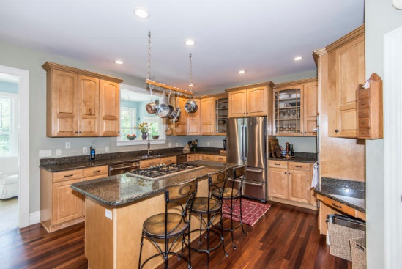
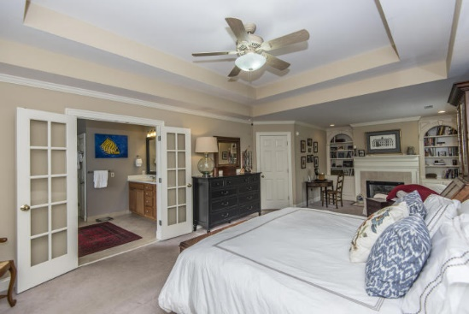
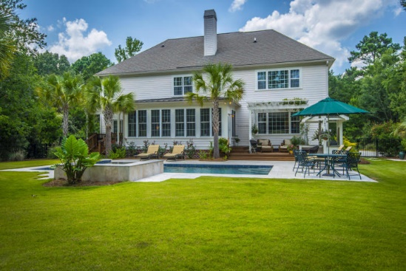


3095 Pignatelli Crescent Dunes West ~ Mount Pleasant, SC 29466 MLS# 17019097 ~ $849,000
New Price For This Beautiful Home In Dunes West!
Beautiful custom built, meticulously maintained home on a large beautifully landscaped 1.2-acre lot in Dunes West. The home sits between the 15th green and 16th tee to ensure your privacy while enjoying the view and the 14x32 pebble tec-surfaced heated saltwater pool with waterfall, hot tub and lighting all controlled by remote. The travertine tile decking surrounding the pool offers a great look, but, more importantly, cool feet during the hot low-country summers. Decks with jasmine covered pergolas off of the first floor bedroom and sunroom provide easy access to the pool, garden and covered lit grill area. If not outside, you can still enjoy it while sitting in a sun-room off the back of the house.
Too many other features to mention here… check out this wonderful home!
$550,000
Linda Ett M (843) 729-8718 | O (843) 884-1800
lett@carolinaone.com
www.lindaett.com
Carolina One Real Estate
195 W Coleman Blvd
Mt Pleasant, SC 29464-3495

