Slide 1
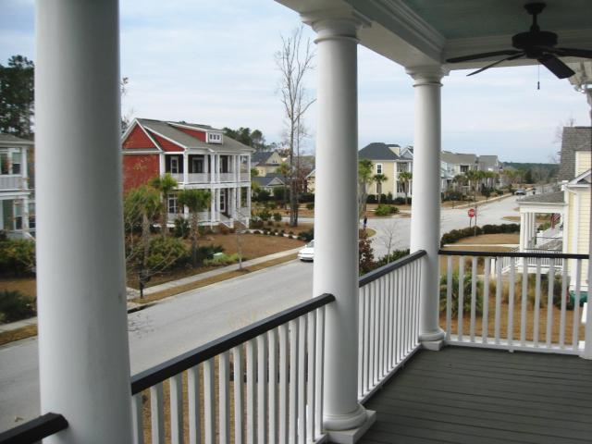
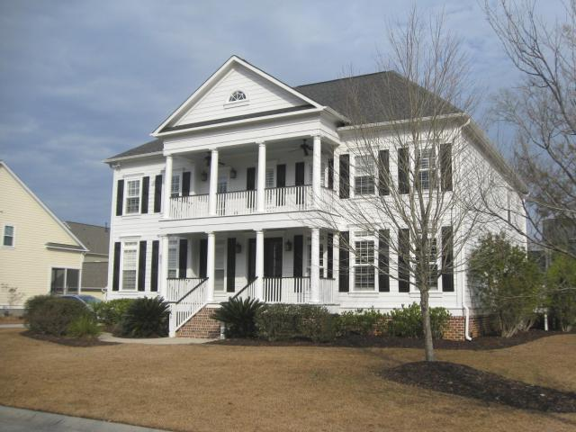
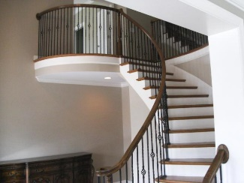
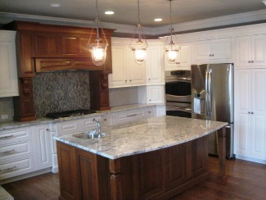
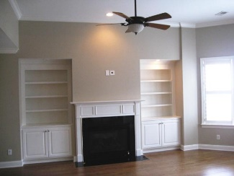
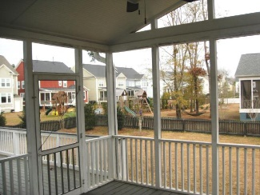
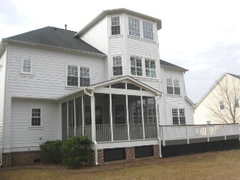

Price Improvement
3098 Yachtsman
Dunes West, Mt Pleasant
MLS# 16002233
$769,000
5 Bedrooms | 4½ Baths | 5,246 sf
BEAUTIFUL home in highly desirable section of the Harbour in Dunes West neighborhood!! This 5 bedroom and 4.5 bath home is complete with a lot of upgrades with no expense spared. Gleaming hardwoods throughout the main floor, Foyer area with curved staircase, Formal Dining/Living Room, beautiful updated kitchen with Profile appliances and Signature cabinets and Large Family room with built in bookshelves and fireplace. Mother in-law suite is also located on the main floor with its own full bath. The owners suite has it's on PRIVATE RETREAT with sitting area/office, Balcony, Spa bath and Glass Shower! Extra large screened in porch with deck that leads out to your back yard. The yard is nicely landscaped with an irrigation system... Extremely spacious and open with 3 car garage
Kitty LaTorre, ABR
cblatorre@outlook.com 843-830-1900 {M}
ERA Wilder Realty, 125-F Wappoo Creek, Charleston, SC 29412

