Slide 1
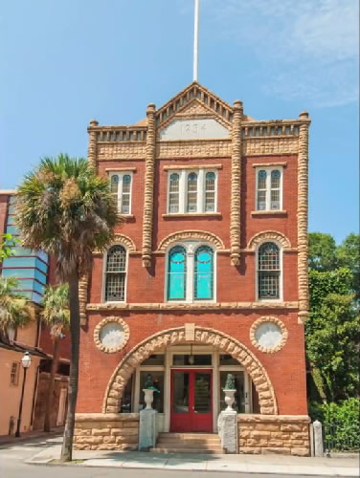
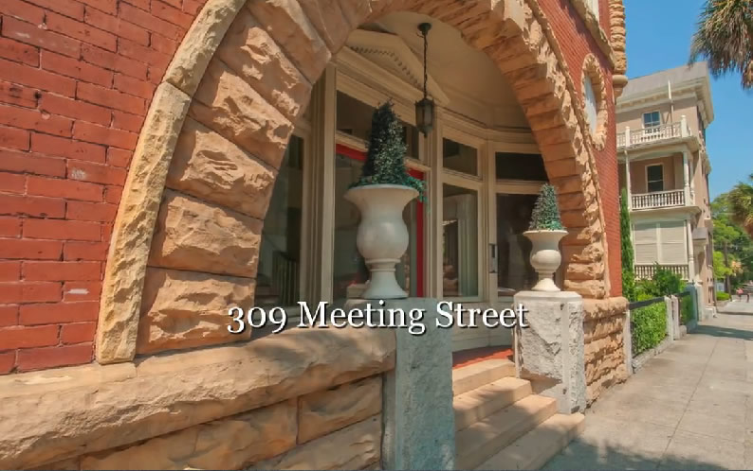
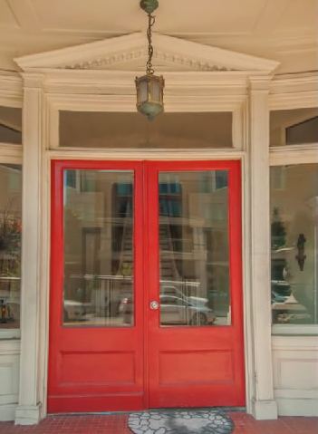
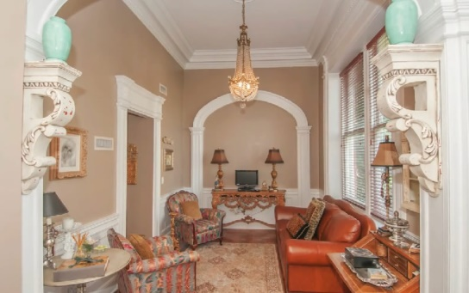
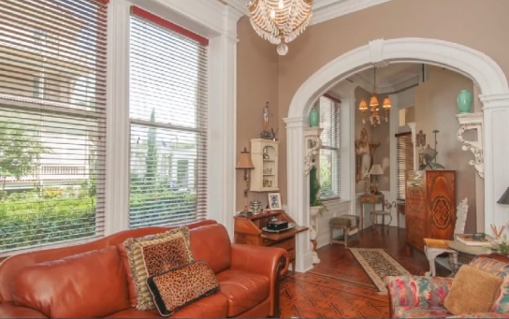
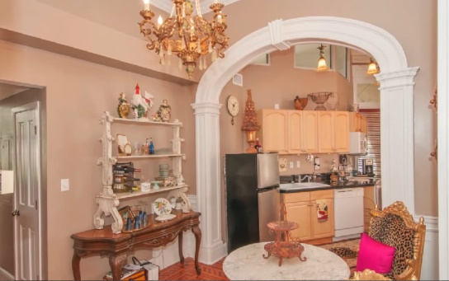
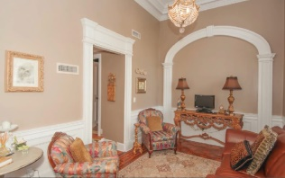
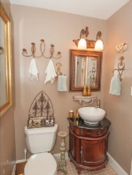
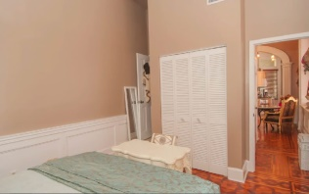
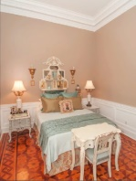
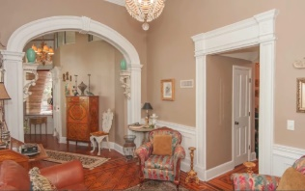
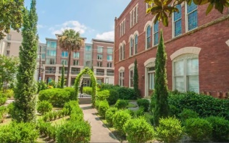
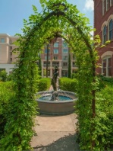
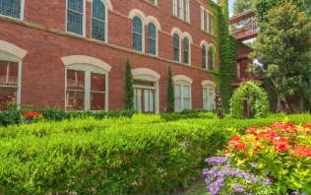
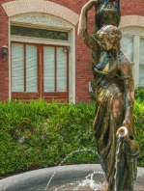
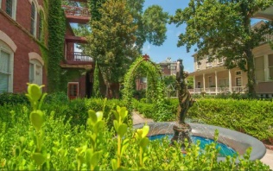

Waterfront with Dock on Tidal Creek
Reduced by $52,000!
Charleston, SC
MLS# 1420140
Just Reduced to $425,000
Building is an example of Romanesque Architecture and originally built in 1894. A complete renovation was done in 1984 to the configuration of the current condos, all electric and plumbing was redone at that time- Unit 1 has an entrance from Meeting Street and is street level unit-As you enter the grand foyer you will notice the original parquet floors from 1894 are placed in a interlocking Victorian design, 1/4" thick and a different design in each room-13' ceilings and bank of 8' windows with beautiful wood trim overlooking the beautiful gated courtyard, more 8' windows in kitchen/eat in area and 6' windows in bedroom along with curved archways from room to room make the unit bright plus appearing larger than the square footage noted-extensive dental crown molding throughout the unit, original from1894 along with wainscoting in every room -nice size living room, kitchen is large with a dining area and more 8' windows for plenty of light-This condo is truly in the middle of everything with one off street parking space in a secure gated lot, one block to King, two blocks to College Of Charleston, across the street from Marion Square-If you want to be in downtown Charleston this is a must see unit-Sold Unfurnished-Chandeliers do not convey but are negotiable
Rob Sturm
M 843-478-2404
rsturm@century21properties.com
Bud Poston
M 843-697-3786
bposton@century21properties.com
Century 21 Properties Plus | 3301 Salterbeck St Suite 100 | Mt. Pleasant, SC 29466

