Slide 1
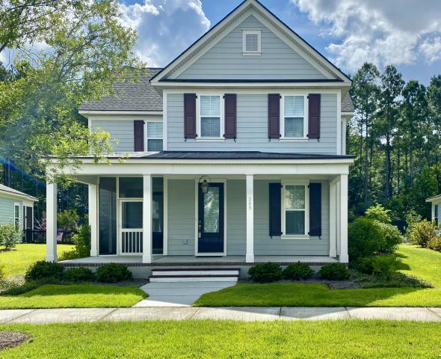
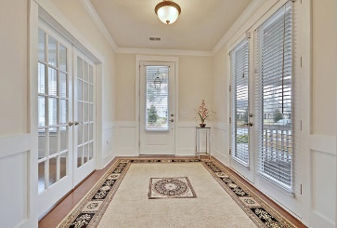
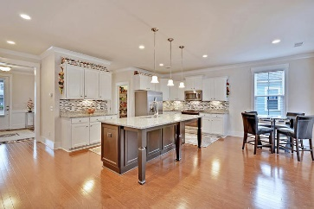
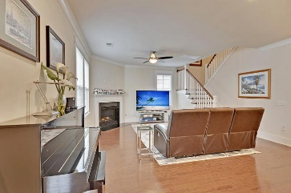
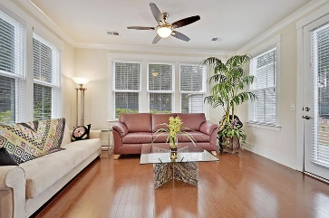
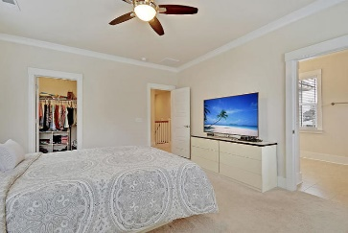
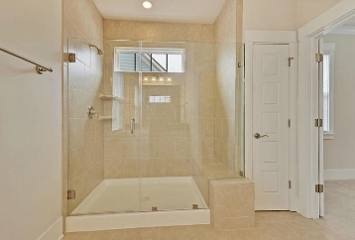
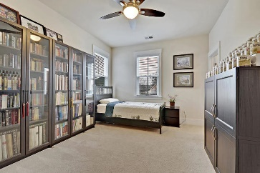
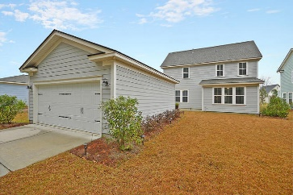

309 Scholar Way
Nexton · Summerville · MLS# 20005269 · $360,000
Ashborough on Lake w/Dock only $375,000
Fantastic Deal in Nexton
Seller will pay buyer's agent $5,000 at closing
with accepted offer by noon June 7, 2019!
VACANT-SAFE AND EASY TO SHOW! STUNNING home in desirable Nexton has it all! This TURNKEY home is better than new and has numerous upgrades included that you do not get with new construction! The home boasts STUNNING CURB APPEAL with a beautiful covered full front porch, screen porch and gas lantern. Entering you are greeted with handsome hardwood floors and an abundance of natural light in the beautiful formal foyer. A large dining room/office/flex room with glass French doors is to the right. Continuing in is the GORGEOUS CHEF-INSPIRED GOURMET kitchen with gas stainless steel stove, granite countertops, HUGE island w/breakfast bar seating, tons of custom staggered cabinets, eat-in area, massive walk-in pantry and desk area. This kitchen is large enough to have multiple cooks in the kitchen at once while entertaining family and friends. The kitchen is OPEN to the generous sized family room w/fireplace and also, the light filled sunroom. Oak wood tread stairs lead to the second floor. The master bedroom suite w/massive walk-in closet is on the second floor with a SPA-LIKE master bathroom featuring a LUXURIOUS 5 FOOT SPA SHOWER W/SEMI-FRAMELESS GLASS door, and granite counter dual sink vanity. The master bath has plenty of space for two people to get ready at the same time! There are two additional large bedrooms that share a large full bath with granite dual sink vanity. Finishing off the second floor is the laundry room. The backyard has a grilling patio area and a nicely sized 2 car detached finished (drywalled and painted) garage. Nexton in Summerville is a wonderfully landscaped community with a play park, community pool, and walking trails! The neighborhood is close to local shopping and grocery stores and is a short drive to downtown Charleston with 5-star restaurants, world class shopping and iconic history as well as a short drive to the beaches, the airport, Boeing, Volvo, and Daniel Island. Come take a look because you will not find another home that offers as much as this one!
Stan Huff
843-670-2835
stan.huff@agentowned.com
Jill Marcacci
843-297-5590
jill@agentowned.com
www.agentownedrealty.com
AgentOwned Realty Co. Preferred Group, Inc. | 824 Johnnie Dodds Blvd | Mt Pleasant, SC 29464

