Slide 1
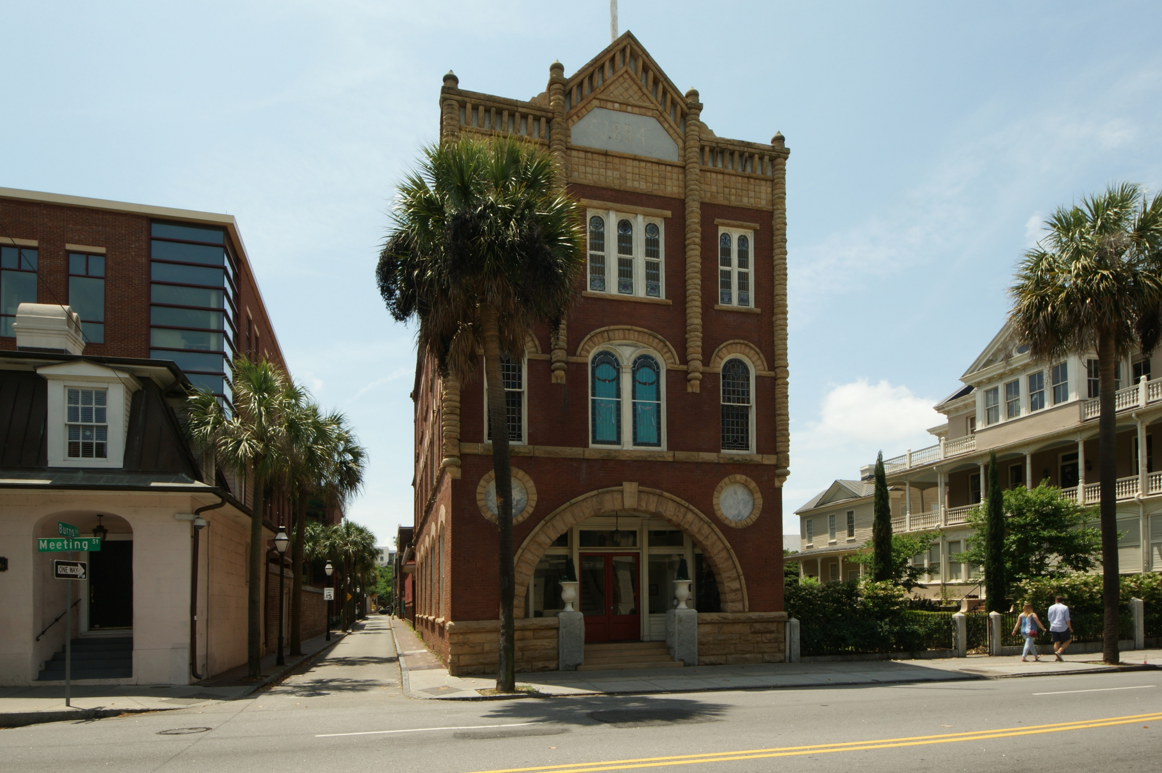
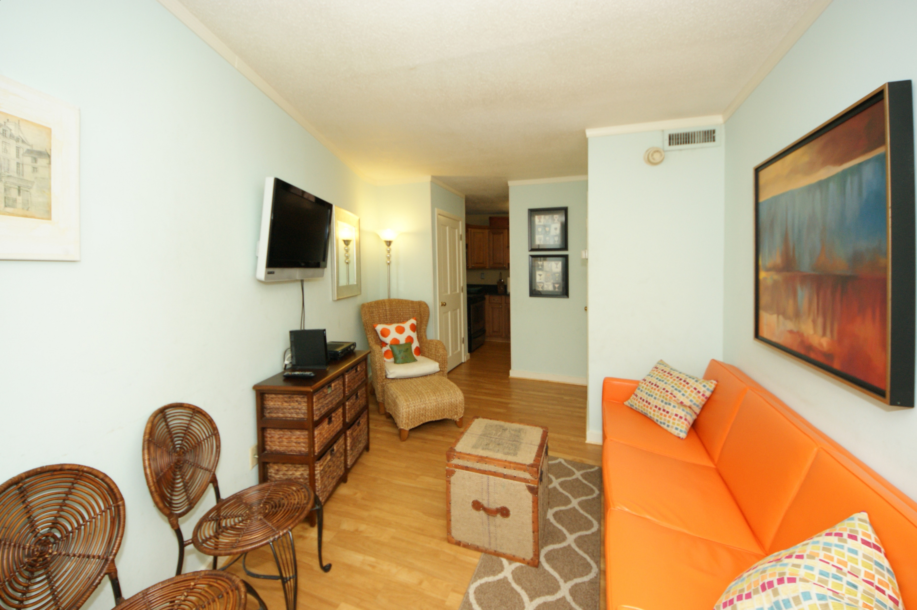
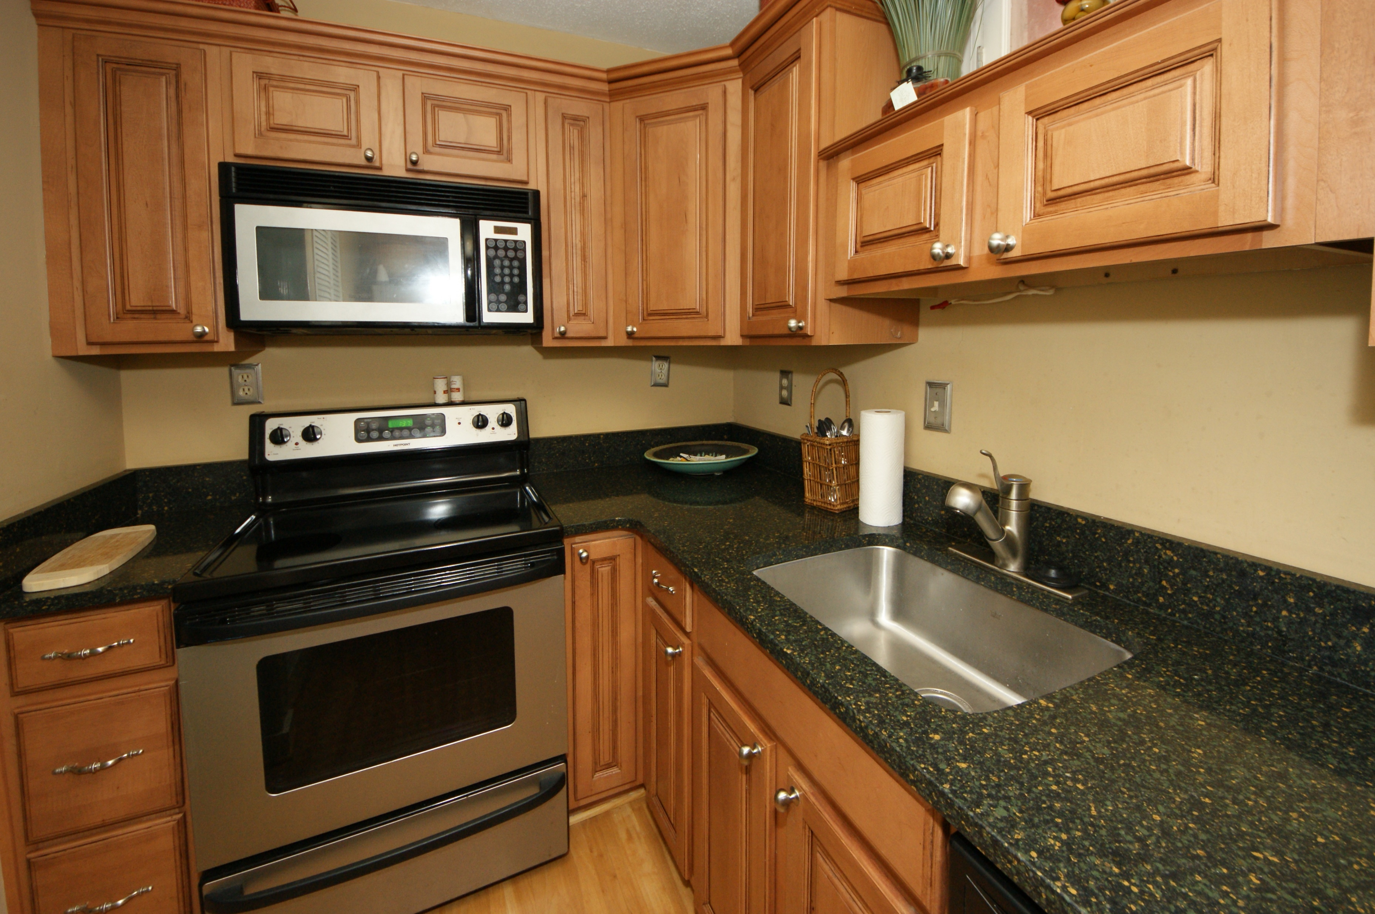
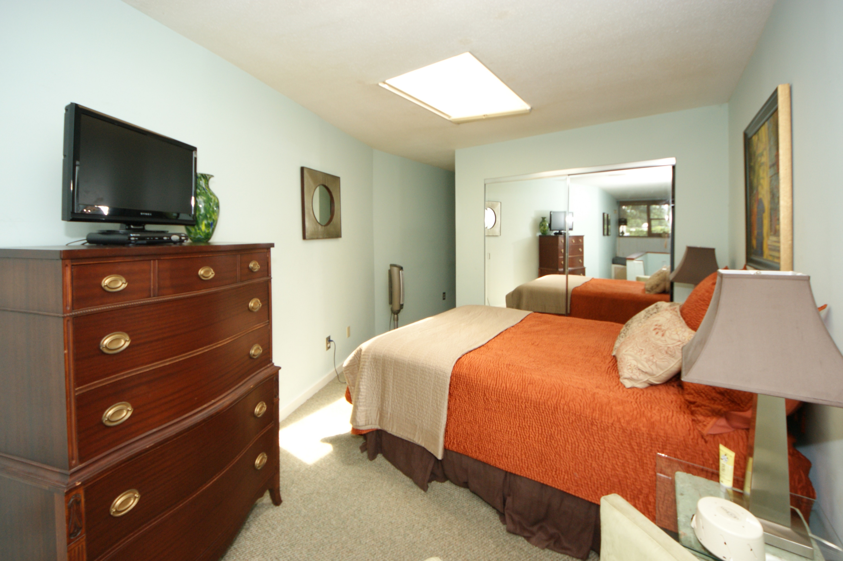
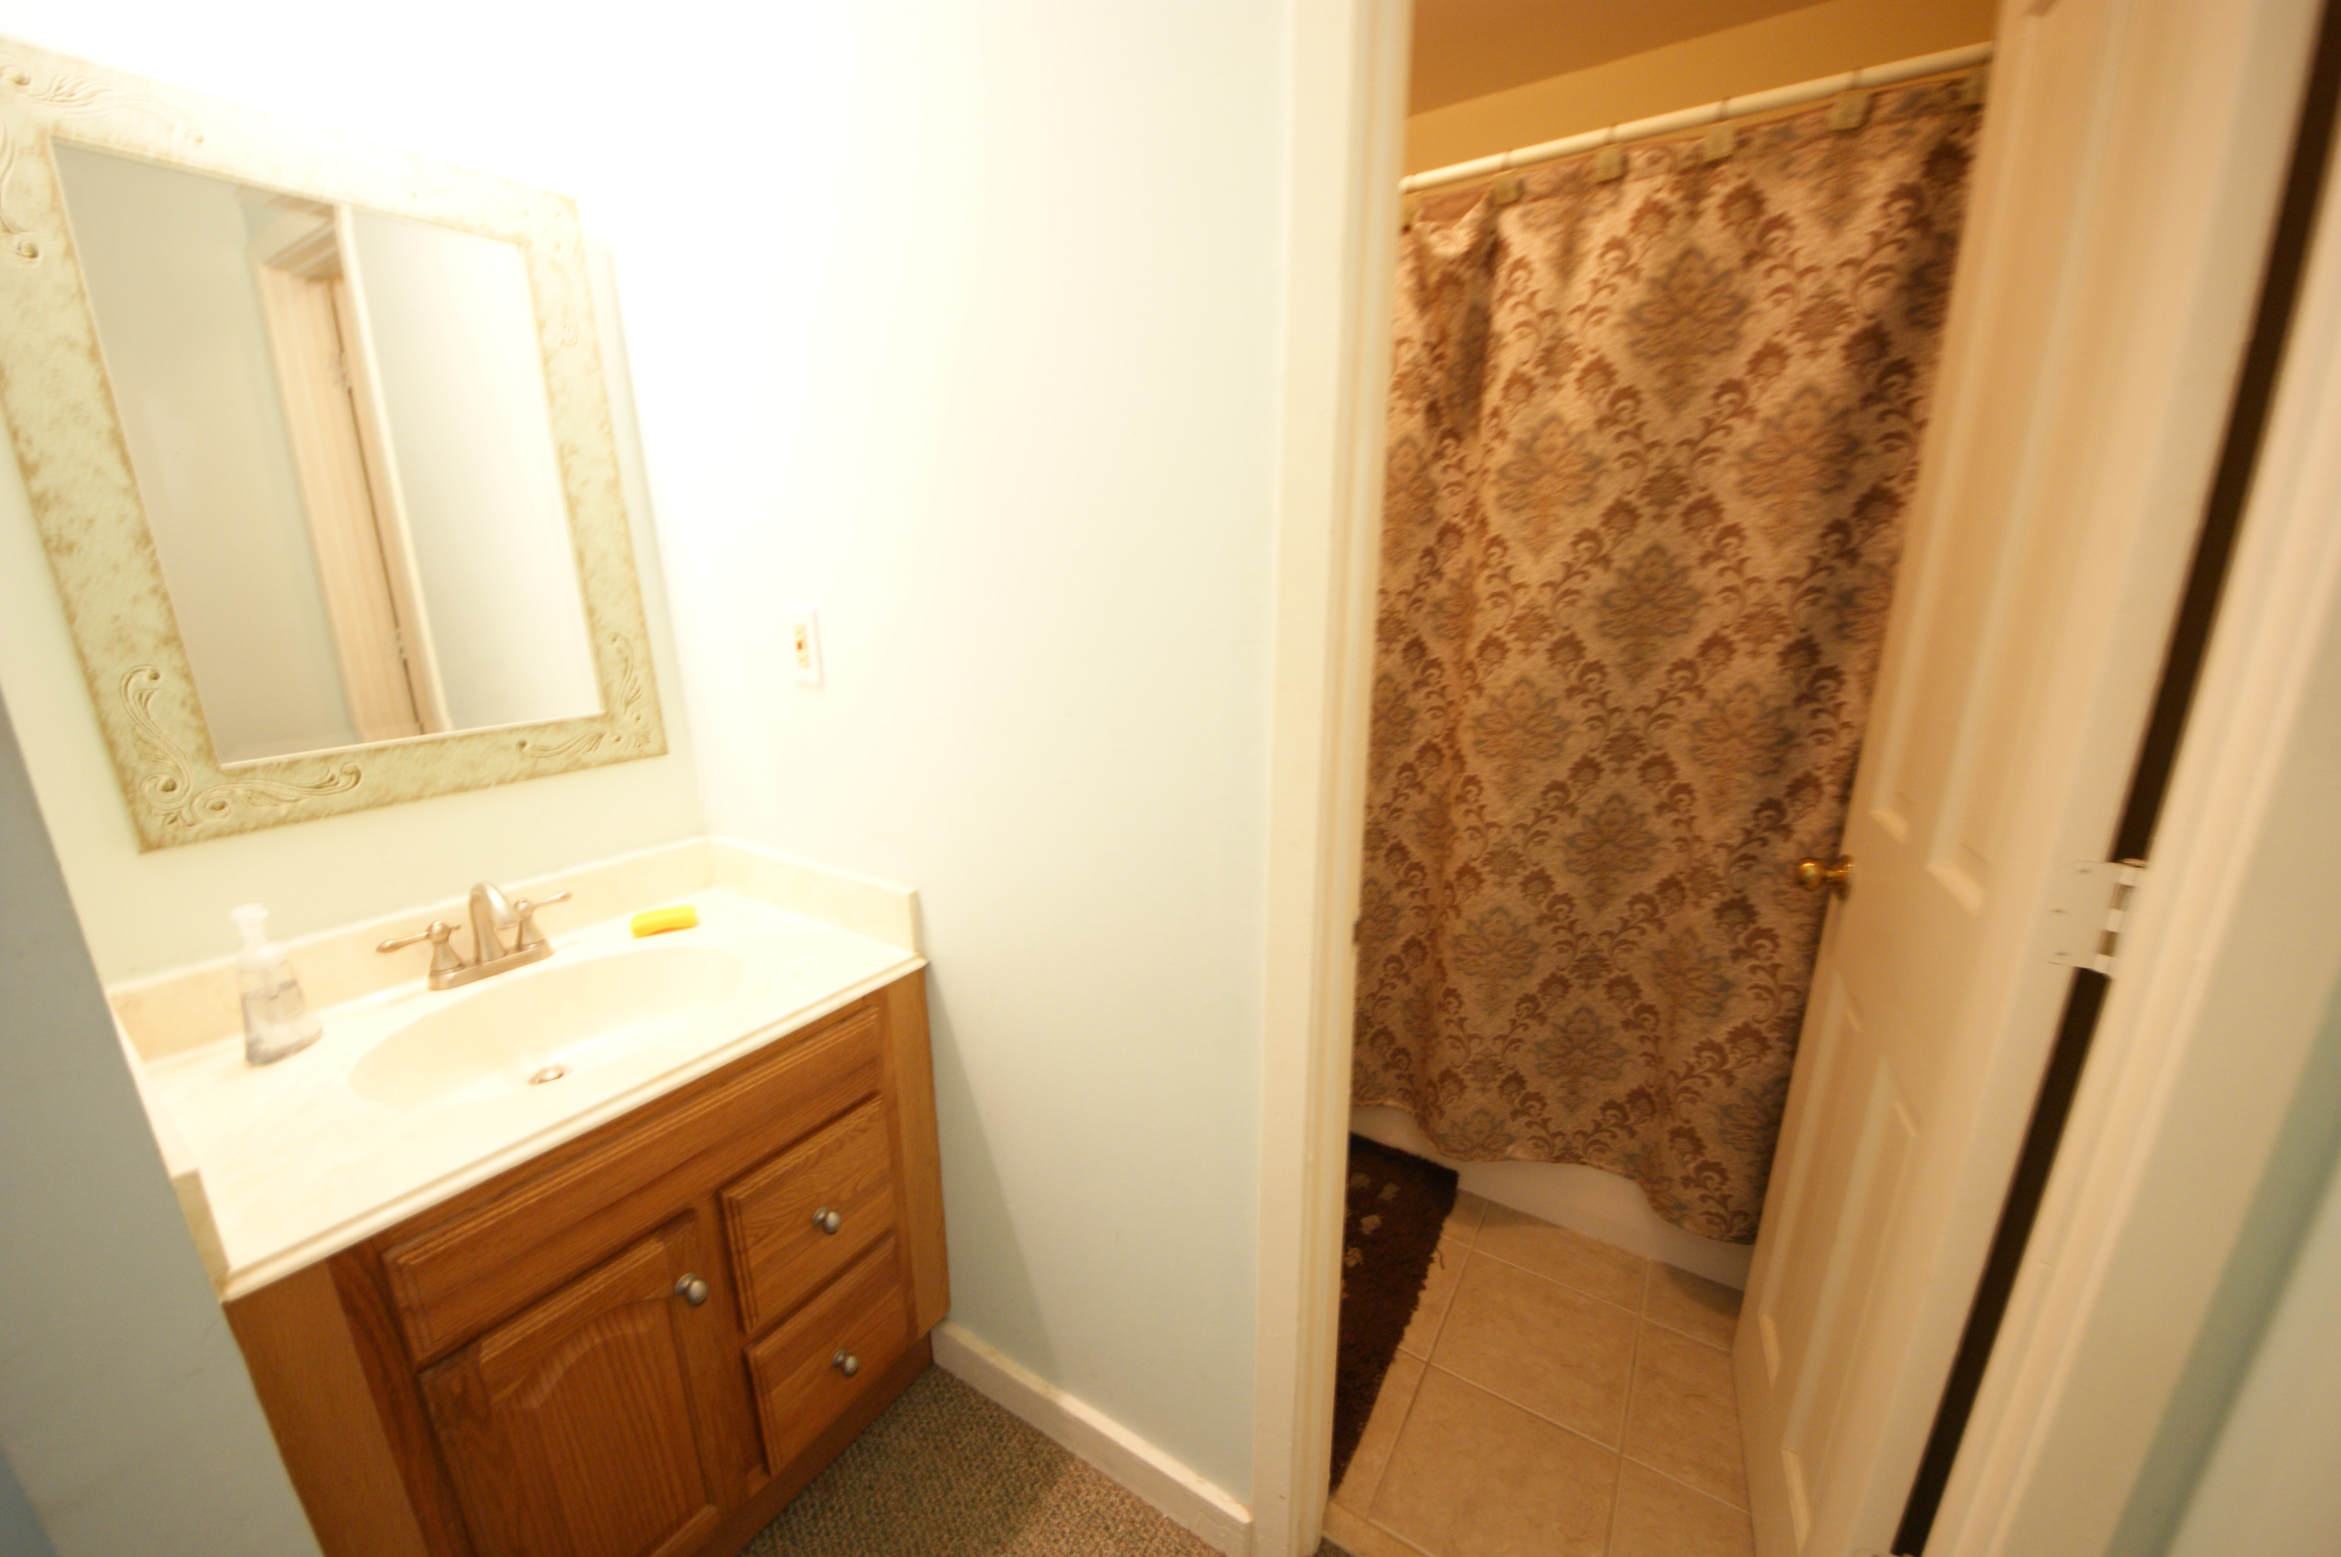
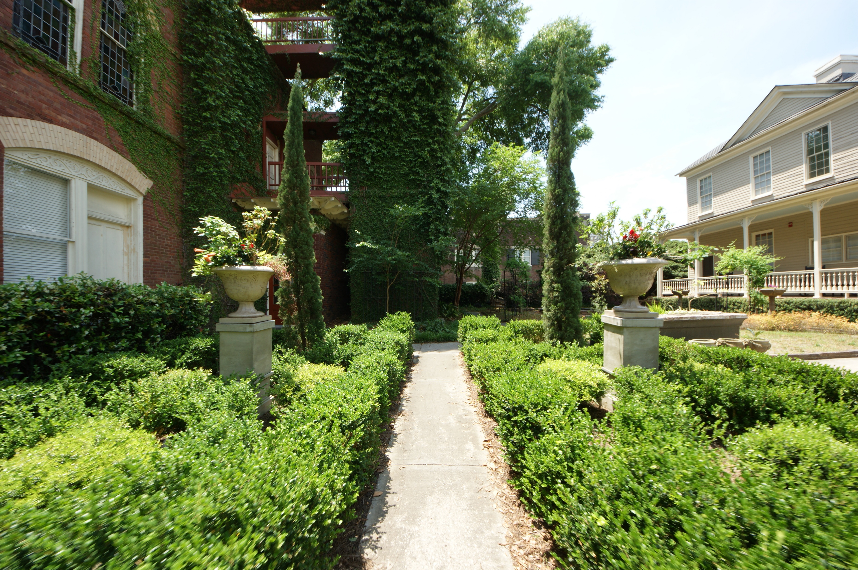
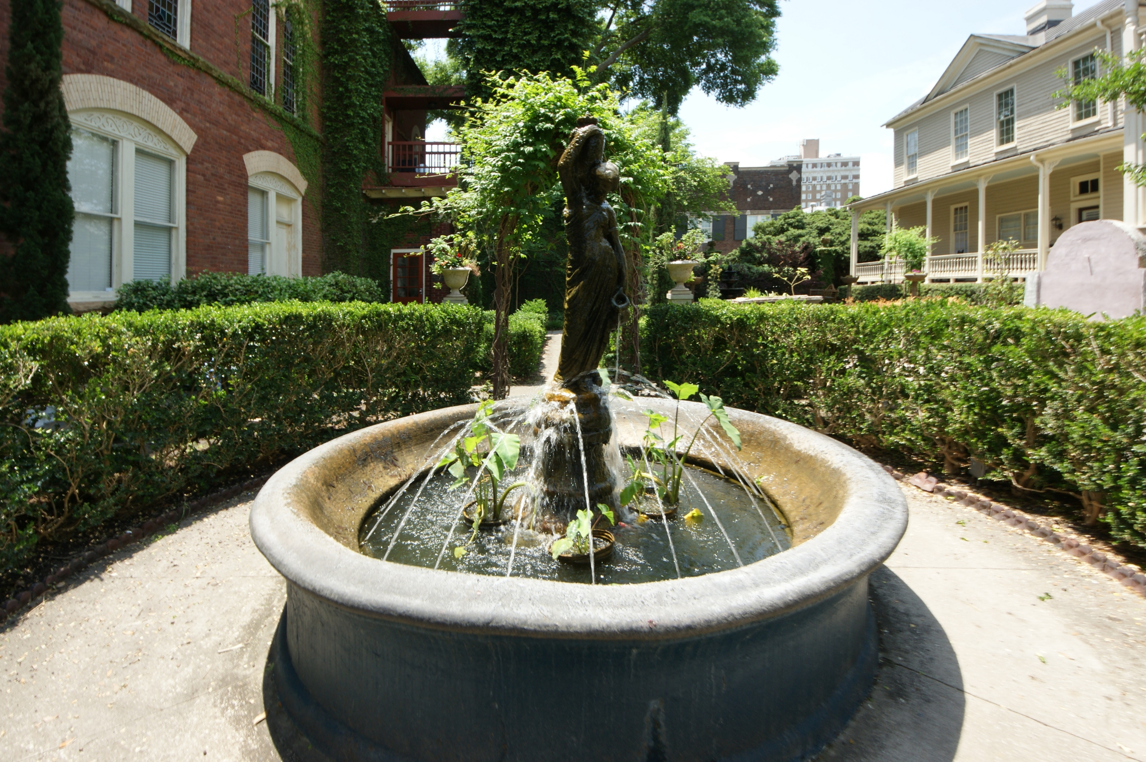
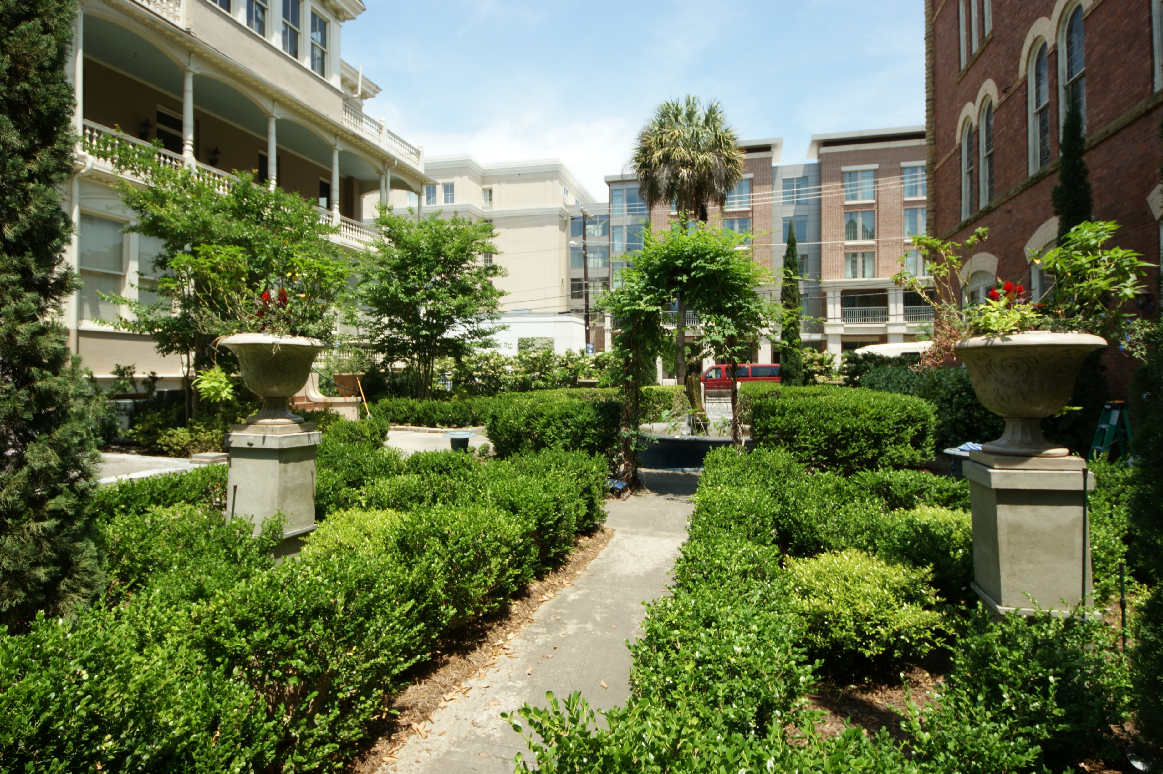
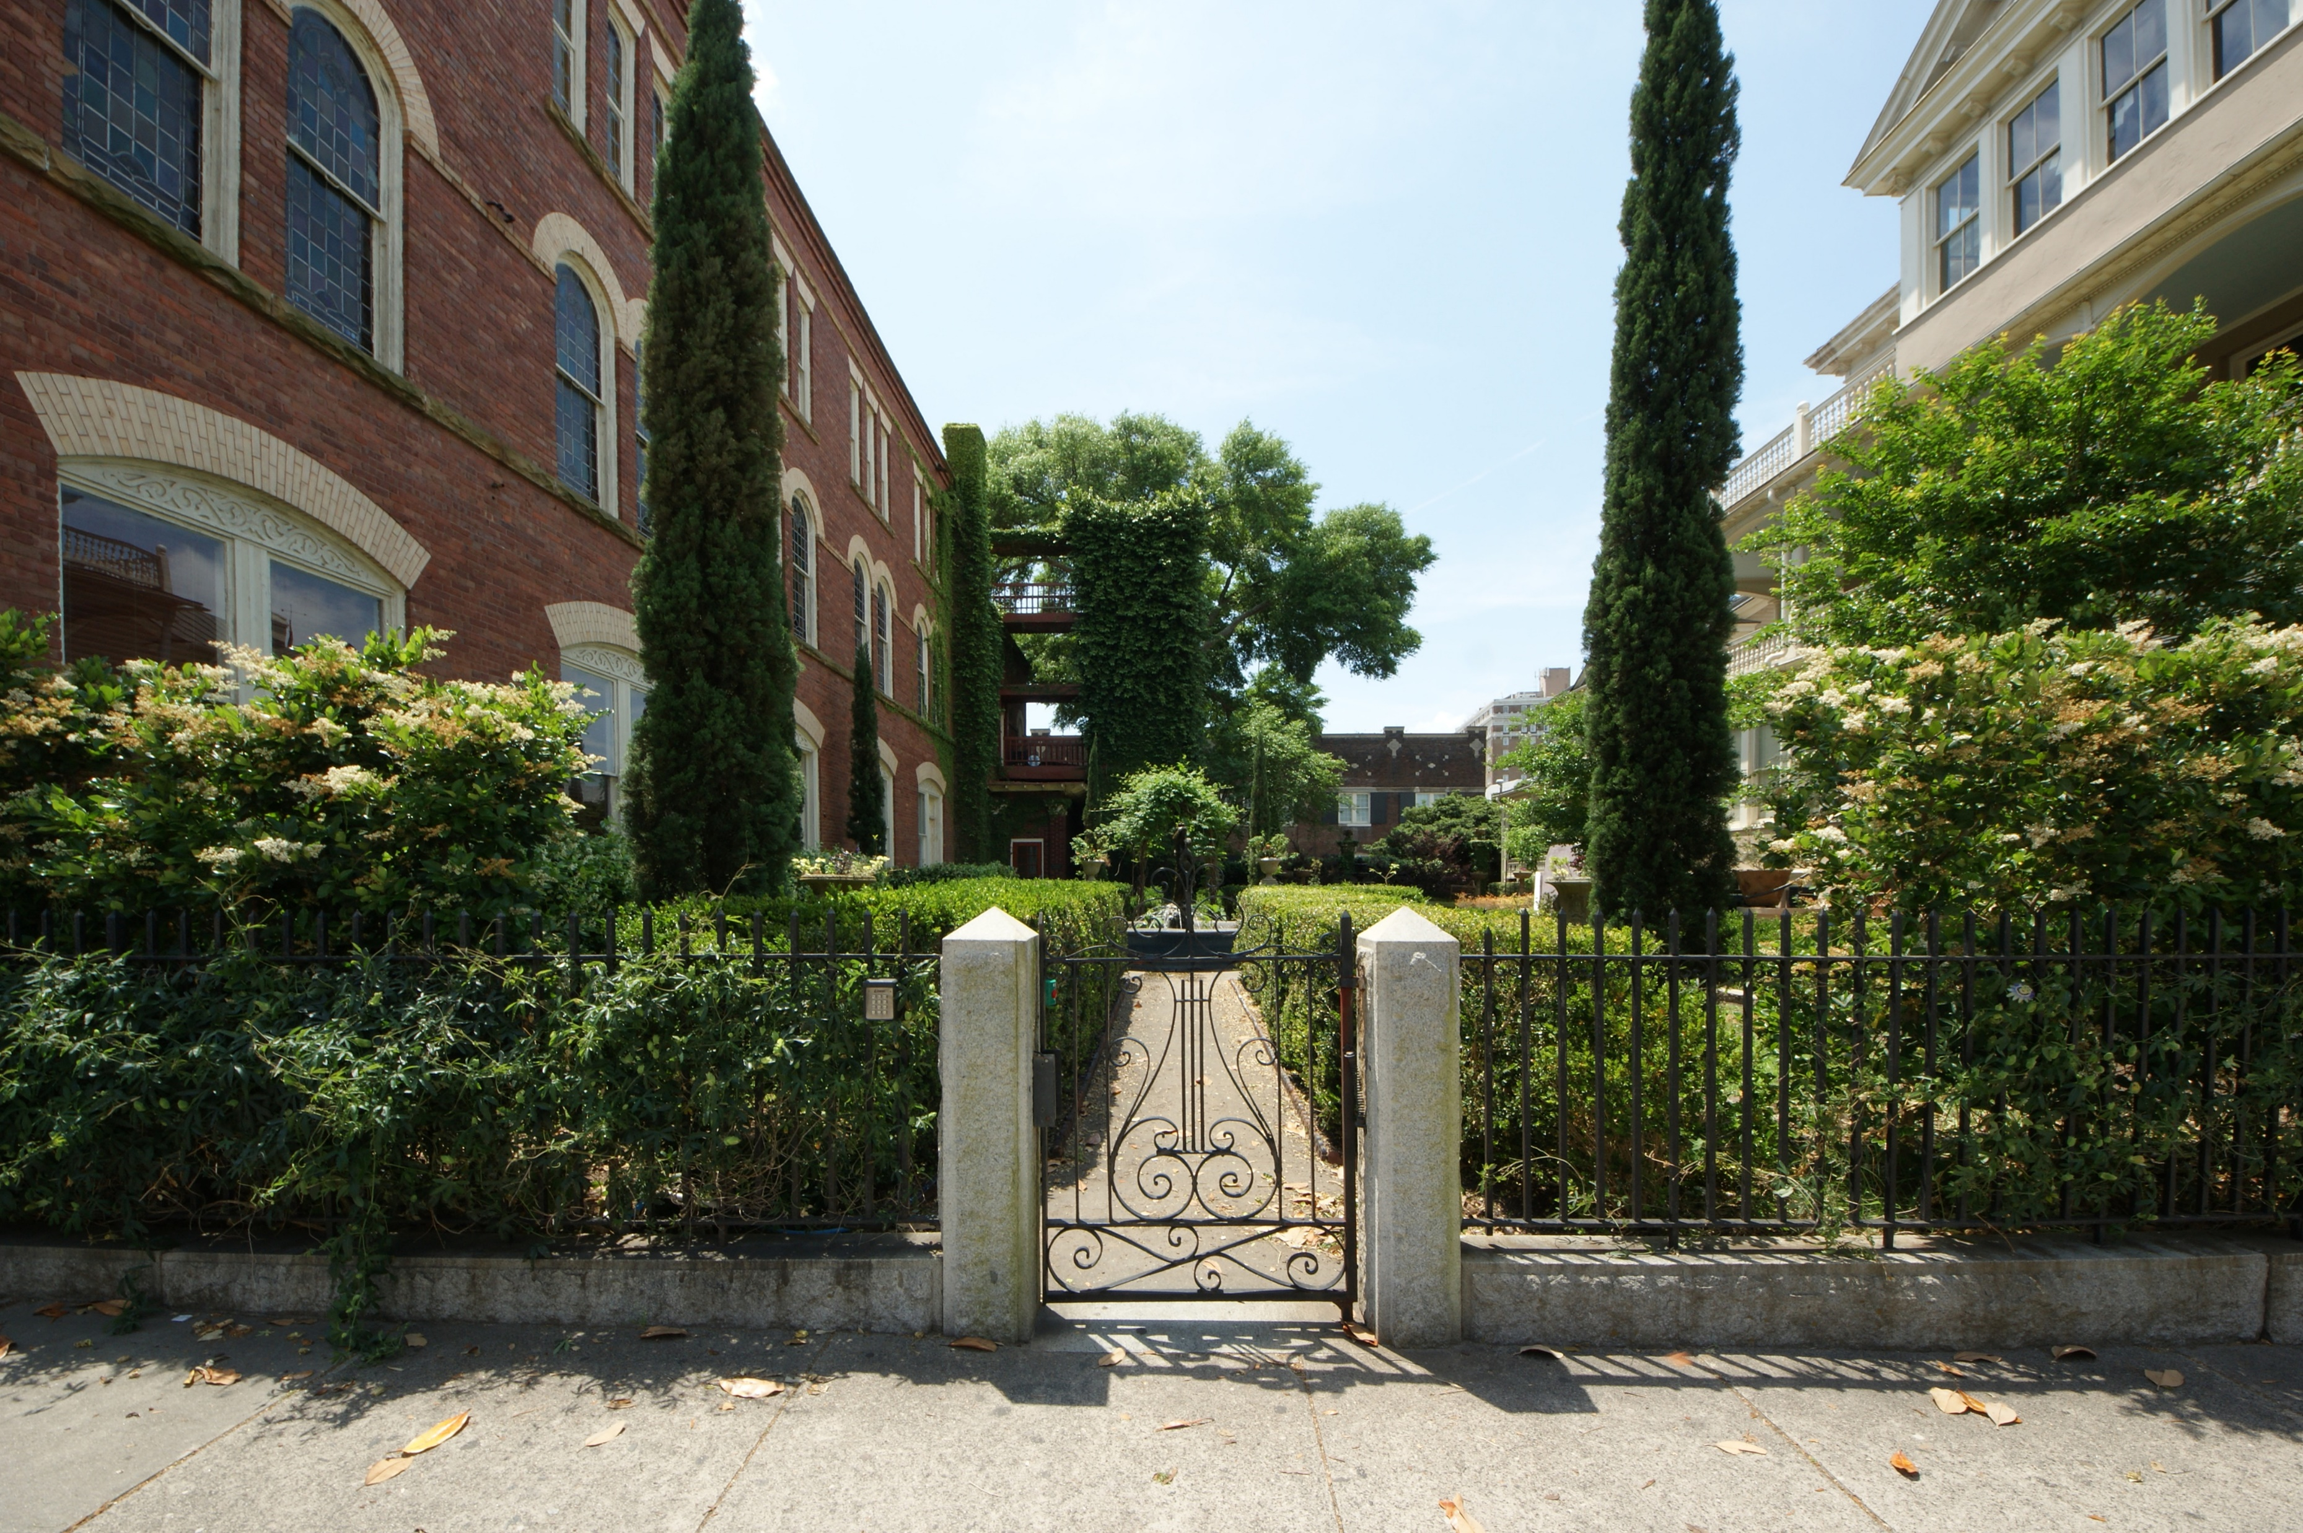
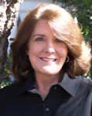

309 Meeting Street #13 Ansonborough Charleston MLS# 16011368 $315,000
Open House
Sunday from 2-5
Lovely furnished townhouse-style condominium in the heart of downtown Charleston. Walk to Marion Square, the Market, King Street. Peaceful coastal colors surround you in a freshly decorated chic living area with small bar. The kitchen has been completely renovated w/new cabinets, granite countertops, and ss appliances. A half-bath completes the first floor. Upstairs you will find a nice-sized bedroom and full bath with plenty of light from a skylight. An additional sleep loft area is an added bonus. A deeded parking space conveys with the property. You can relax after a busy day in the afternoons in the beautiful courtyard while everyone else sits in traffic!
Kimberly Roberts
(843) 687-1246
kimberlyroberts@kw.com
www.charlestonforever.com
Keller Williams Realty Charleston | 496 Bramson Ct Ste 200 | Mt. Pleasant, SC 29464

