Slide 1
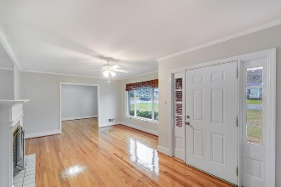
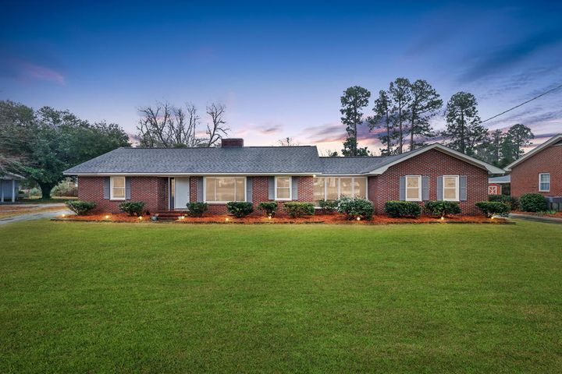
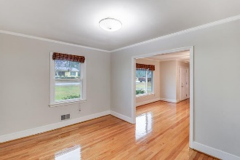
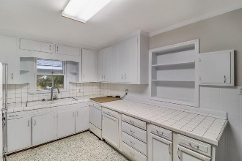
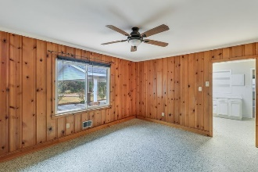
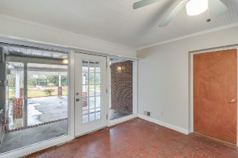
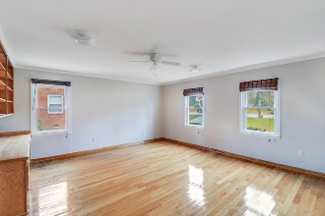
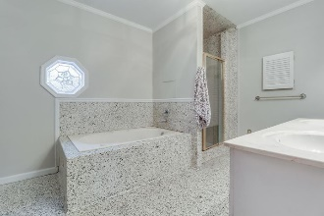
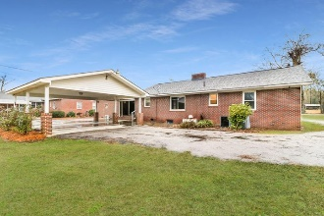


309 Hampton Street Elloree, SC 29047 | MLS# 21001280 | $199,900
Don’t Overlook This One!
SCHEDULE YOUR SHOWING TODAY!
Gorgeous brick ranch home located in Elloree! Conveniently located less than 10 minutes from Lake Marion and just over an hours drive from Charleston or Columbia! This home is ready for you to move in and make it your own! The home offers 3 bedrooms, 2 full baths, over 2000 sq. ft. of living space, gleaming hard wood floors, a large master bedroom, and more! When entering through the inviting front door take notice of the beautiful hardwood floors and the wonderful fireplace located in the formal living area. The fireplace is a great addition on those cold winter days and nights. The large windows facing the front of the home offer plenty of natural light. The kitchen has white cabinets and ample amounts of counter space to prep your favorite meals. Off the kitchen and formal living area is a room that can be used as a generous size dining area or the family room, whichever suites your lifestyle. The large master has an en-suite with dual sinks, a soaker tub and a walk in separate shower. Two more spacious bedrooms and a full bathroom with a tub/shower combo are offered in the beautiful home. This home has plenty of space to park your vehicles, either on the long driveway or under the large carport that is connected to the back of the house. An entry door and covered large patio off the carport offer a place to sit and relax in your rocking chairs while admiring nature and a convenient entry into the home while unloading your vehicle. Schedule your exclusive showing today! This one will not last long! Gorgeous brick ranch home located in Elloree! Conveniently located less than 10 minutes from Lake Marion and just over an hours drive from Charleston or Columbia! This home is ready for you to move in and make it your own! The home offers 3 bedrooms, 2 full baths, over 2000 sq. ft. of living space, gleaming hard wood floors, a large master bedroom, and more! When entering through the inviting front door take notice of the beautiful hardwood floors and the wonderful fireplace located in the formal living area. The fireplace is a great addition on those cold winter days and nights. The large windows facing the front of the home offer plenty of natural light. The kitchen has white cabinets and ample amounts of counter space to prep your favorite meals. Off the kitchen and formal living area is a room that can be used as a generous size dining area or the family room, whichever suites your lifestyle. The large master has an en-suite with dual sinks, a soaker tub and a walk in separate shower. Two more spacious bedrooms and a full bathroom with a tub/shower combo are offered in the beautiful home. This home has plenty of space to park your vehicles, either on the long driveway or under the large carport that is connected to the back of the house. An entry door and covered large patio off the carport offer a place to sit and relax in your rocking chairs while admiring nature and a convenient entry into the home while unloading your vehicle. Schedule your exclusive showing today! This one will not last long!
Brandon Ray
(843) 499-1928
brandon.ray@carolinaone.com
www.therightrayhome.com
Carolina One Real Estate
900 N Main St
Summerville, SC 29483

