Slide 1
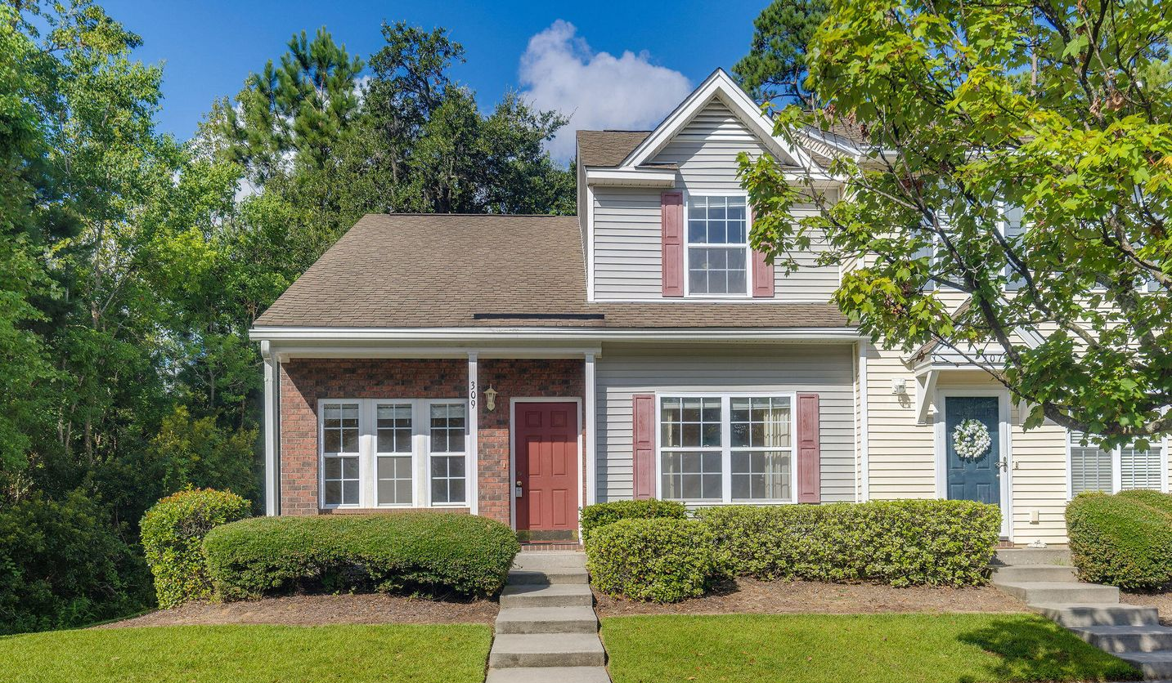
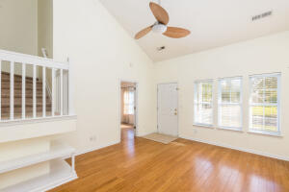
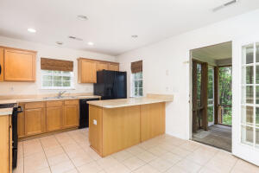
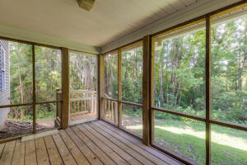

Back on Market!
309 Kelsey Boulevard
Beresford Commons
Wando, SC 29492
MLS# 22021067
$339,000
Welcome to Beresford Commons, a small community located right off of Clements Ferry Road! This neighborhood is the perfect location between Mt Pleasant, Daniel Island, Park Circle, and Downtown Charleston. This townhouse is a highly-desireable end unit, surrounded by wooded areas and offering maximum privacy & natural beauty. Upon entering, you will be met with the large living area featuring a vaulted ceiling, wood floors, and built-in bookshelves. The eat-in kitchen has a pantry, back porch access, and hidden guest bathroom. The owner suite is on the ground level and boasts a large window, dual vanity, and laundry room. Up the stairs, you will find two spacious bedrooms with plenty of storage and another full bathroom.
You'll love spending evenings relaxing in your new screened-in porch after an enjoyable day at the neighborhood pool!
Kelly Snyder
843-457-5951
kelly.snyder@agentownedrealty.com
Greg Gelber
843-494-2354
greg.gelber@agentownedrealty.com
AgentOwned Charleston Group | 902 Savannah Hwy | Charleston, SC 29407-7802

