Slide 1
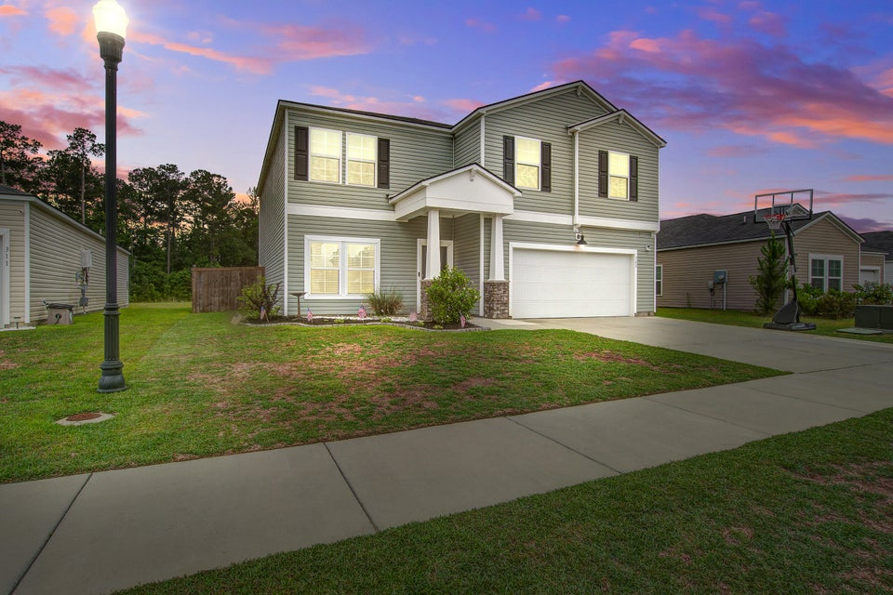
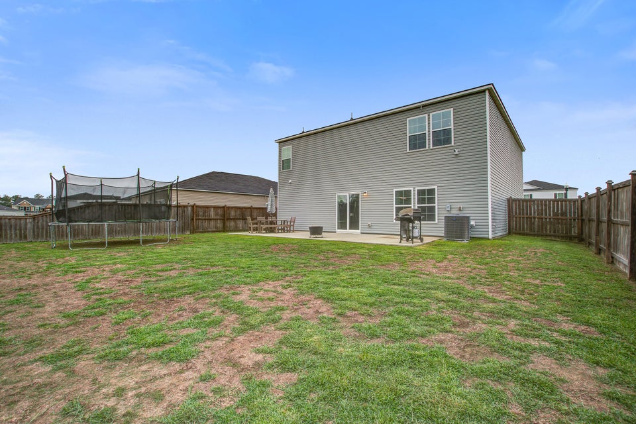
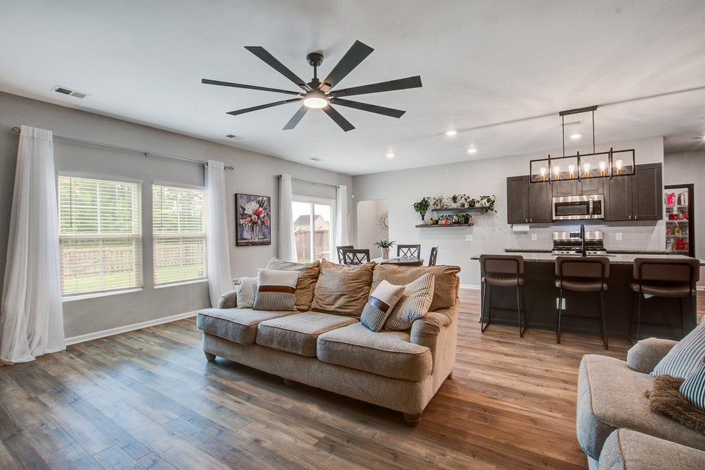
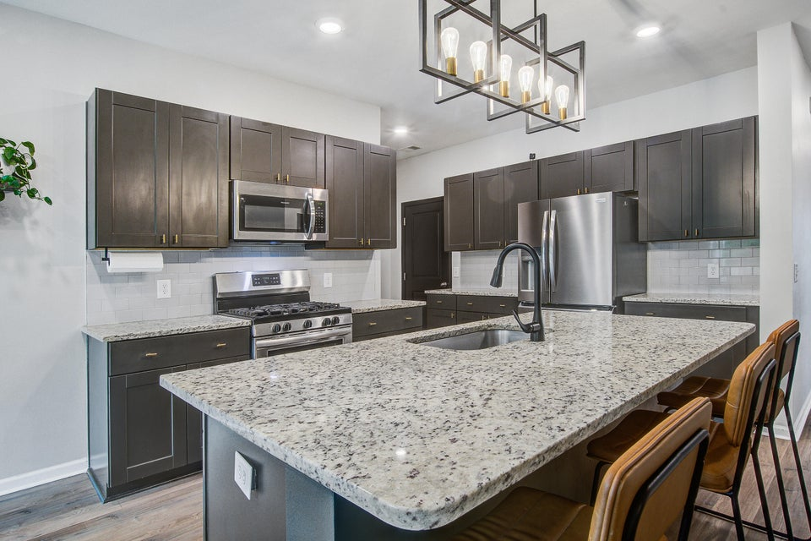
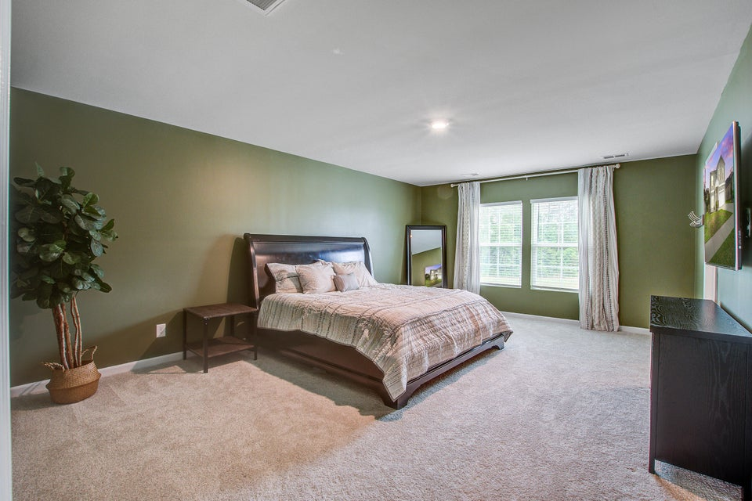
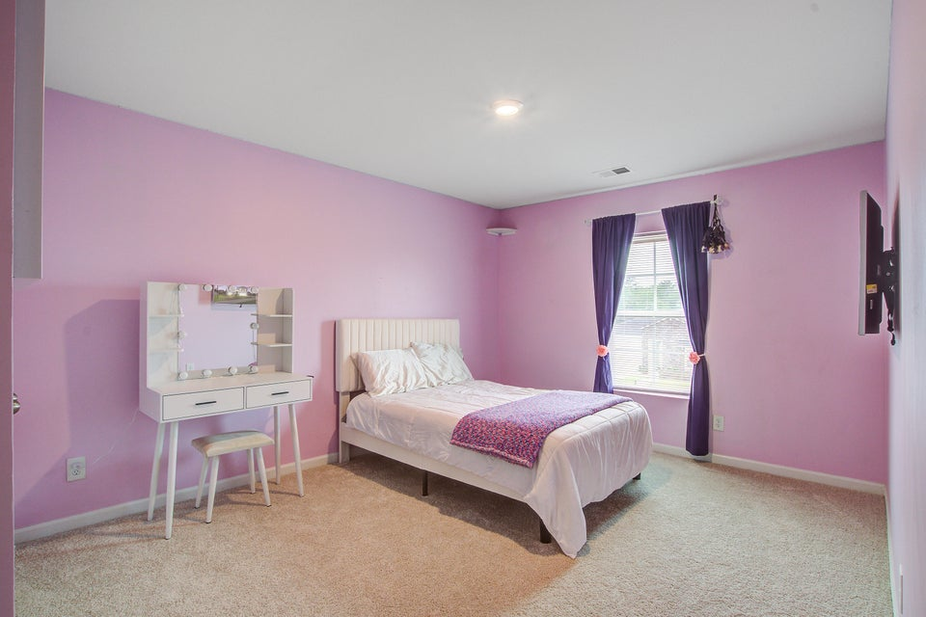


THIS IS THE ONE - COME SEE!
309 Squire Pope Road
Cane Bay Plantation | Summerville, SC 29486 | MLS# 25014928 | $470,000
This home is perfect for multigenerational living or remote work—you truly can have your cake and eat it too! You have an In-laws suite on the main level, upstairs you have a spacious loft that's ideal for a kids' retreat or additional living space, plus 5 bedrooms or turn one of the bedrooms into an office if needed.
There is definitely room for everyone here.
Enjoy privacy in your fenced backyard with a pond view, an extended back patio for entertaining, and a large driveway for extra parking. The highly desirable Cane Bay living offers over 20 miles of walking and golf cart trails, perfect for outdoor living. Located just steps from the community pool and minutes from YMCA. Military bases, the new Volvo plant, and interstate 26 are within convenient access. This home offers both!
Teresa Ross
843-356-9128
tgross.realtor@gmail.com
teresaross.erawilderrealty.com
ERA Wilder Realty | 1282 State Rd | Summerville, SC 29486

