Slide 1
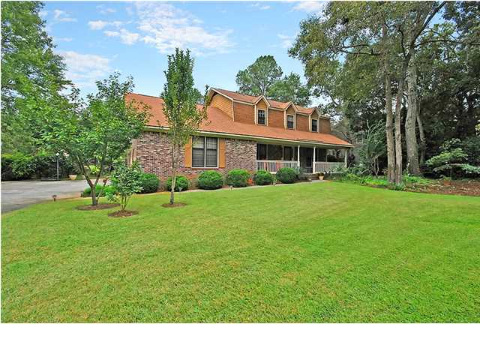

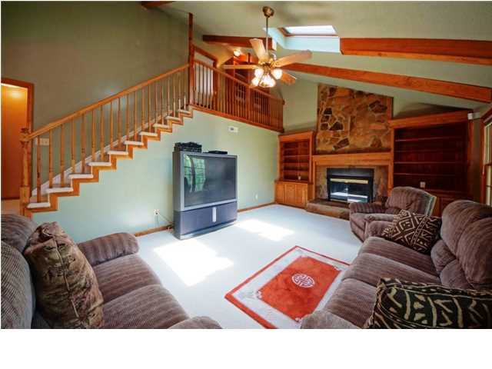
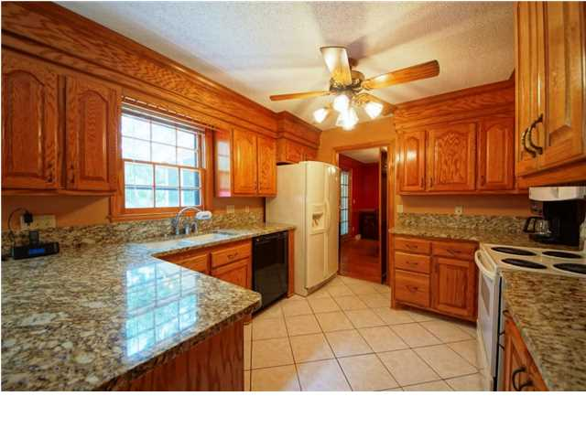
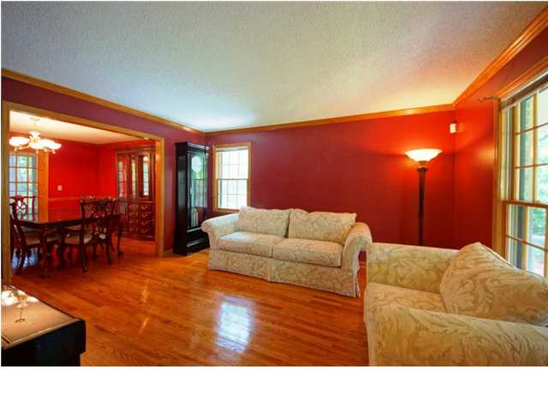
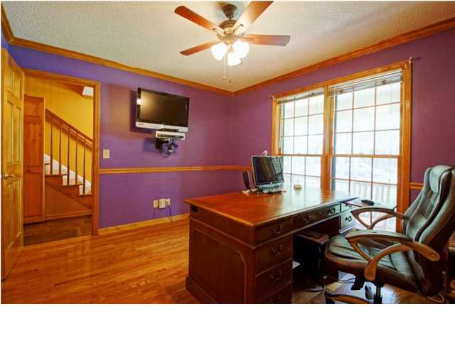
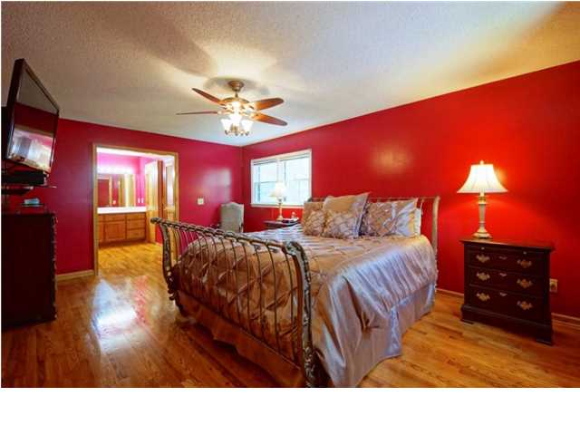
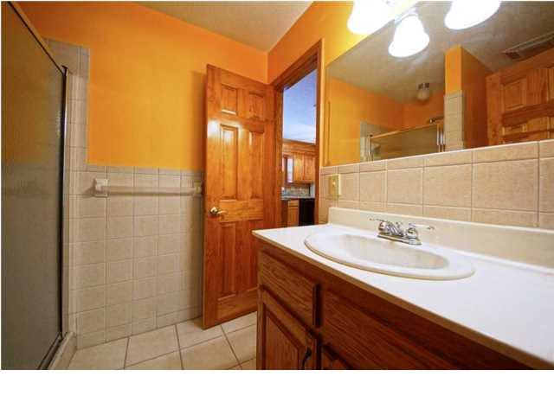
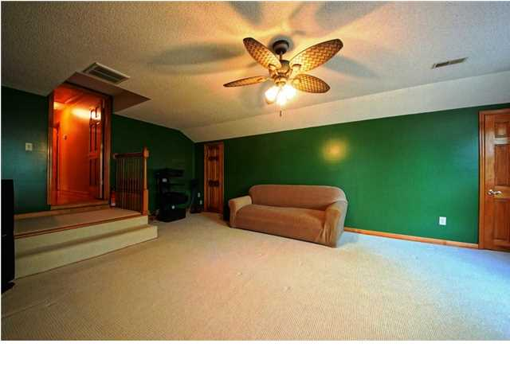
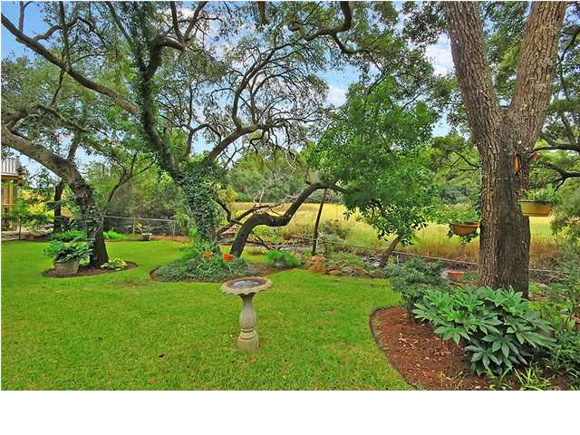

Parkshore Marshfront
Parkshore Marshfront
30 Brisbane Dr ~ Charleston ~ MLS# 1419437 ~ $419,000
Prepare to experience the comfort and charm found in this four bedroom, three full bath, brick home in Parkshore. Take a seat on a rocking chair on the front porch and feel the relaxation begin. This open floor plan offers 3,034 square feet of living area that will make entertaining a joy and everyday living a delight. You'll love cooking in this gourmet kitchen which boasts granite counters, custom cabinets, a breakfast bar and a lovely eat-in area. The step down family room is breathtaking with a cozy fireplace with gorgeous floor to ceiling stone work, built-ins and a vaulted ceiling with exposed wood beams and skylights that allow the sun to pour in. The living room and dining room flow into each other and have gleaming hardwood floors. The dining room has chair rail molding and access to the screened in porch where you can kick back, feel the breeze and enjoy the privacy afforded by the mature trees. Step down to the patio which is another great option when it comes to enjoying the outdoors. The owner's retreat is extremely spacious and has an en-suite bathroom. This home has been lovingly cared for and is move in ready. Located in the desirable Parkshore area, you'll love the convenience to shopping, dining and all that Charleston has to offer. Come by today!
Call or email for details: (843) 654-7777 or Ben@MattOneillTeam.com

