Slide 1

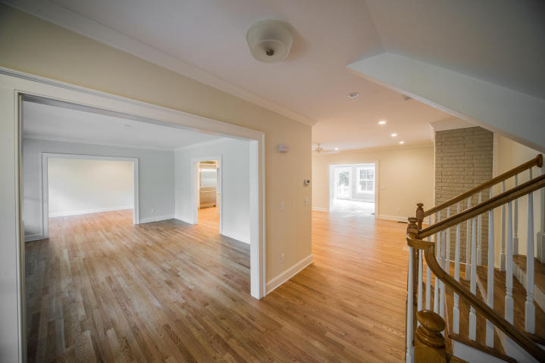
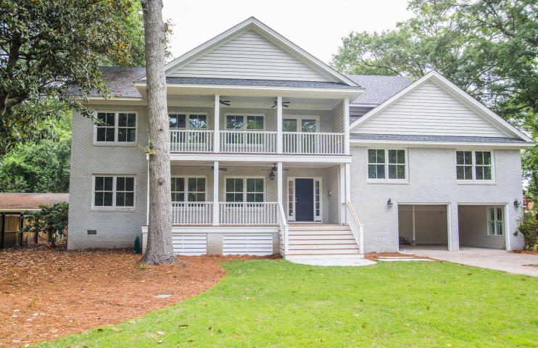
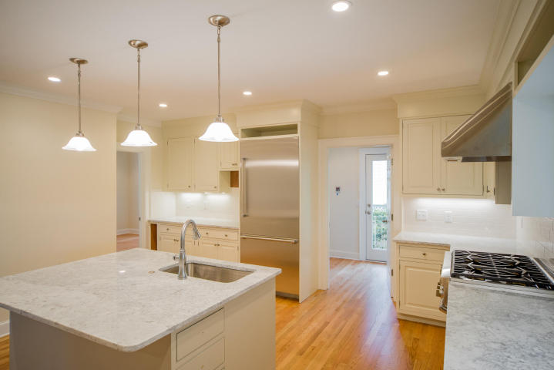
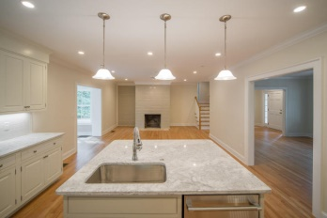
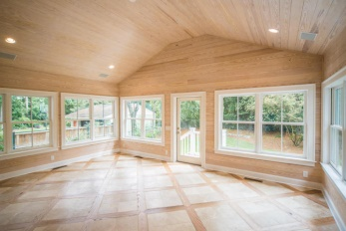
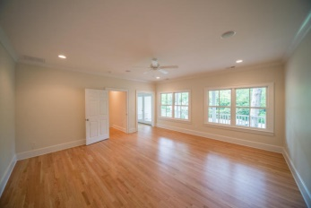
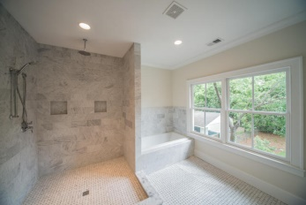
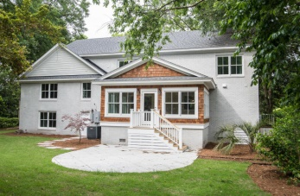


Just Listed in The Crescent!
30 Jamestown Road
Charleston - MLS# 15011193 - $1,595,000
This home is a complete renovation. It was taken back to the studs. New electrical wiring, plumbing and spray foam insulated. Heating and air system is zone controlled. All hot water is delivered through tank less rinnai system. New Thermador stainless appliances installed in kitchen. Custom cabinets in kitchen and pantry. Carrara marble in all full baths. Hardwood floors and tile throughout home except for media room. Home is located in a X flood zone no flood insurance required.
Visit www.1609poinsettaroad.com for more info and photos
Edmund Major
843-343-6666 C
edmund@flywaysc.com
www.flywaysc.com
Flyway Real Estate, LLC
1630 Meeting St.
Bldg 1
Ste 302
Charleston, SC 29405

