Slide 1
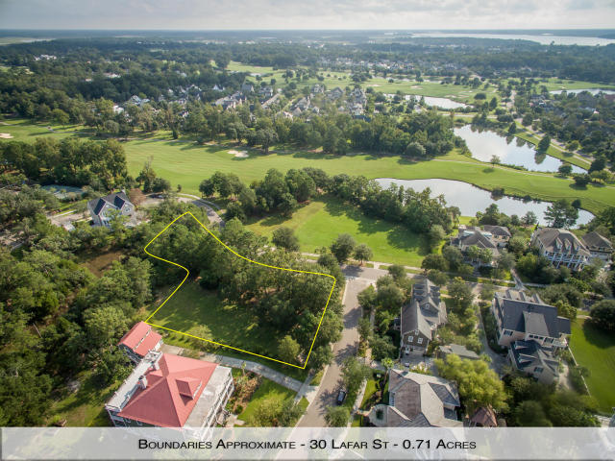
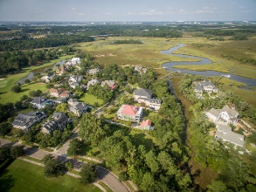
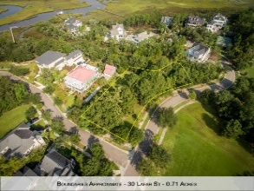
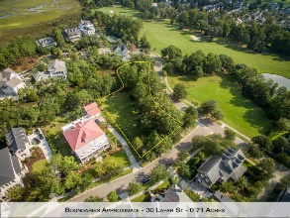
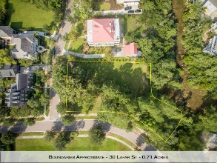
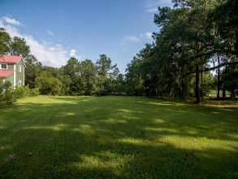


30 Lafar Street
Daniel Island | Charleston | MLS# 16026358 | $595,000
One Of The Two Largest Lots Available
In Daniel Island Park
This spectacular home site is truly one of a kind. It boasts expansive views of the Tom Fazio designed golf course and a rear wetland view, while set amongst beautiful grand oaks in ''old'' Daniel island Park. Enjoy the privacy of this .71 acre lot set on two cul-de-sacs with a NO BUILD REQUIREMENT. Seize the opportunity to build a home that gives membership to Daniel Island Club including access to two pools, tennis facilities, state of the art gym & fitness center, & clubhouse dining privileges. This is an amazing location for your dream home where you can build at your leisure and enjoy the island life! Buyer pays a one time transfer fee of .5% of sales price to Daniel Island Community Fund. Buyer to verify information in listing, such as, but not limited to, lot size, schools, and taxes.
Billy D'Elia
Mobile - (843) 568-1767
billy@charlestonpropertyexperts.com
billy.findhomesincharlestonarea.com

