Slide 1
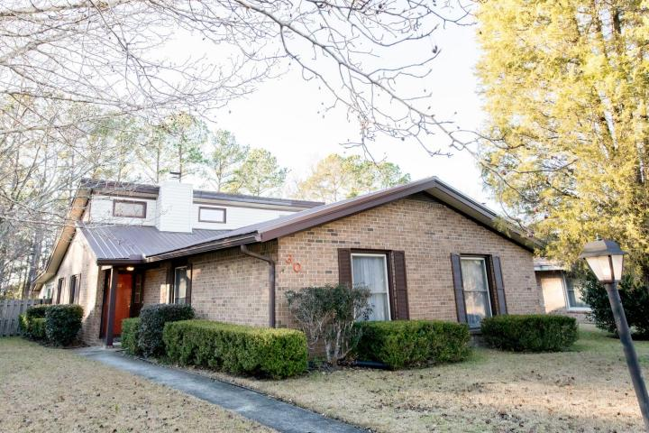
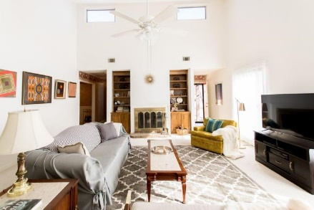
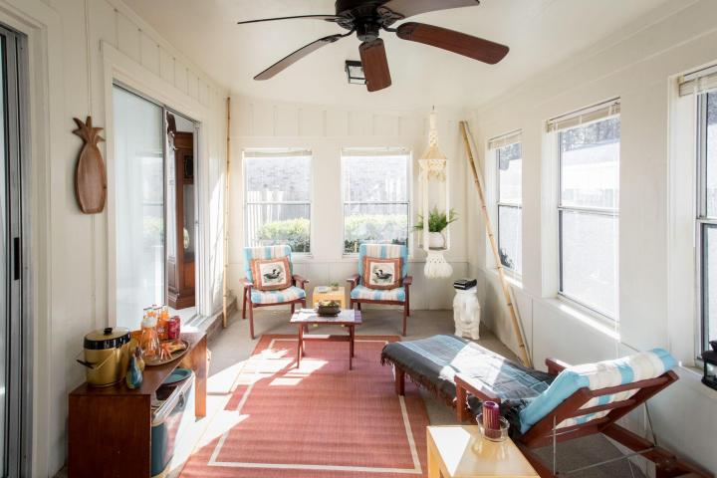
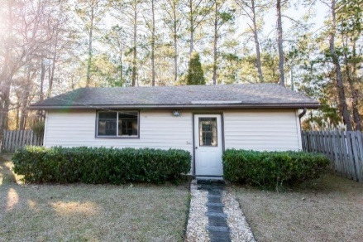


30 Milano Street Otranto :: Hanahan, SC 29410 MLS# 18001293 :: $225,000 3 Bed / 2 Bath
Hidden Gem in Otranto!
Priced To Sell!!
Priced Right!
This exquisite 3 bedroom 2 bath home is clean, well maintained and ready for the next home owner.
Vaulted ceilings and over sized windows bring natural sunlight to an oversized family room with fireplace for winter and a three season sunroom.
Fenced yard and detached 2 car garage make this home a must see and a must own!
New roof installed 2012 and new condenser installed 2017.
Connie White, Broker
843-532-3356
conniesyouragent@gmail.com
Charleston Homes · 597 Old Mt. Holly Road · Suite 301 · Goose Creek, SC 29445

