Slide 1
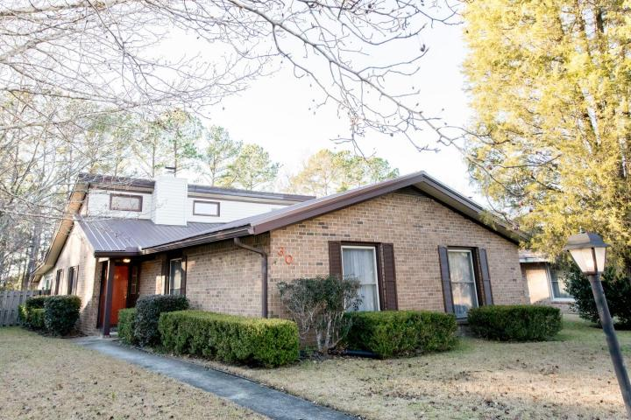
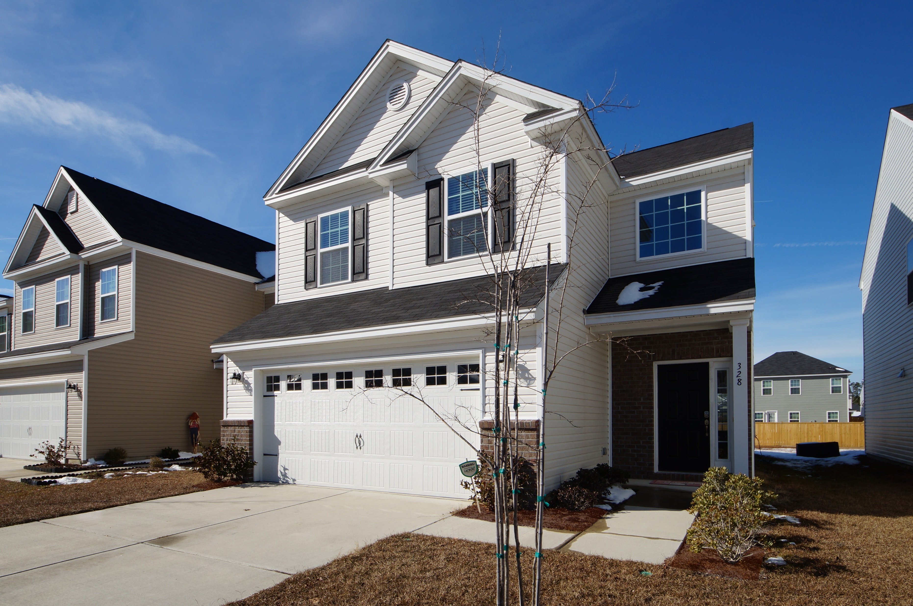


New Lower Price Just Reduced! 30 Milano Street Otranto in Hanahan MLS# 18001293 NOW at $229,900! Single story 3 Bed, 2 bath with a 2 car garage.
Double the Savings!
Two Properties Recently Reduced
Just Reduced
Priced to sell
Out in Lindera Preserve!
328 Beautyberry Road
Cane Bay Plantation
MLS# 18000459
NOW at $225,000!
3 bed, 2.5 bath, 2 car garage
Large back yard!
Connie White, Broker
843-532-3356
conniesyouragent@gmail.com
Charleston Homes · 597 Old Mt. Holly Road · Suite 301 · Goose Creek, SC 29445

