Slide 1
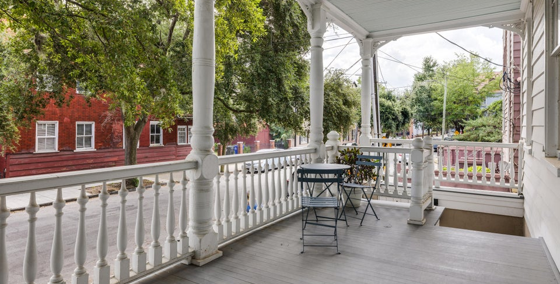
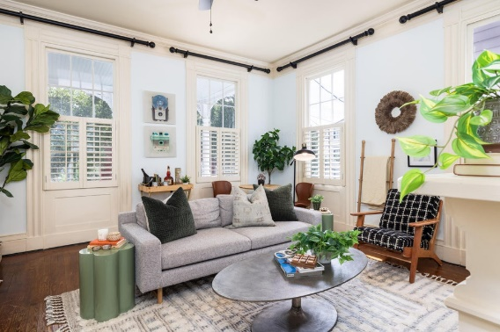
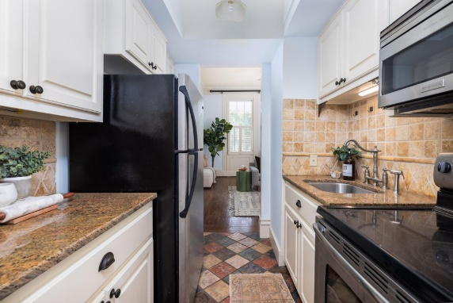
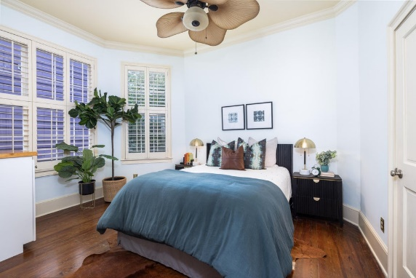

3% BAC - Schedule Your Showing Today!
30 Mary Street 1
Wraggborough | Charleston, SC 29403 | MLS# 24024296 | $449,000
Don't miss this rare opportunity to own a stunning 1-bedroom, 1-bath apartment in the heart of one of Charleston's most vibrant neighborhoods. Nestled on a quiet street yet just a short walk from the shopping and dining of Upper King Street, this charming 565 sq ft residence offers the perfect blend of history, convenience, and comfort. Built in 1885, this home boasts beautiful hardwood floors, elegant built-in interior shutters, and soaring high ceilings that create a sense of spaciousness throughout. Relax in the cozy living room by the fireplace or enjoy Charleston's breezy evenings from the front porch. The galley-style kitchen makes efficient use of space, while the European-style bathroom is fully tiled and the ultimate comfort.
The in-unit washer/dryer is located in the bedroom for convenience. Plus, this condo features an assigned off-street parking spot located directly behind the property.
This is downtown living at its best: historic charm, modern convenience, and an unbeatable location. This home is a must-see!
Kelly Snyder
843-457-5951
kelly.snyder@agentownedrealty.com
Greg Gelber
843-494-2354
greg.gelber@agentownedrealty.com
AgentOwned Charleston Group | 902 Savannah Hwy | Charleston, SC 29407-7802

