Slide 1
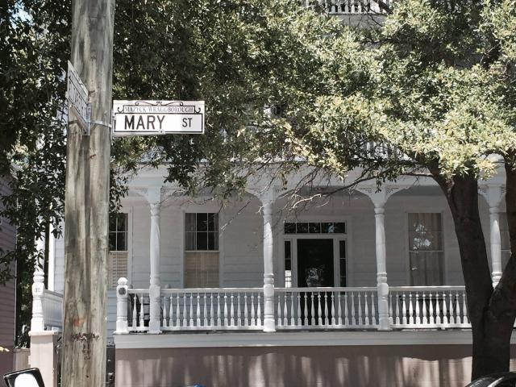
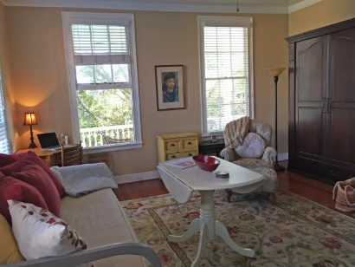
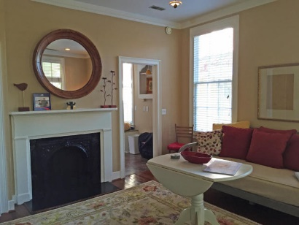
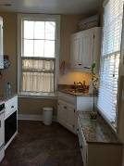
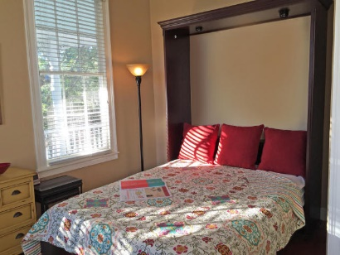
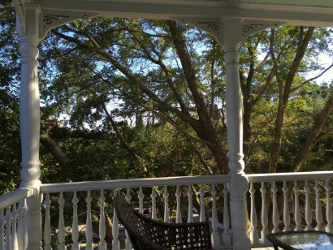

30 Mary Street #4 Wraggborough ~ Charleston ~ MLS# 16007015 ~ $299,900
Downtown Charleston Pied-à-terre
Designated off-street parking
Full kitchen including dishwasher
Front porch & Full bath
485 SF lives large and comfortable
Great views from the porch
Charleston free trolley 1 block away
Walk to restaurants, shopping, College of Charleston & Charleston School of Law
Bring your buyers. This won’t last long.
Donna Landry
Mobile - (225) 921-2111
donna.landry@cbunited.com
Betsy Sarsfield
Mobile - (843) 608-1048
betsysarsfield23@gmail.com
Coldwell Banker United of Charleston | 35 Broad St | Charleston, SC 29401 | www.thebestincharleston.com

