Slide 1
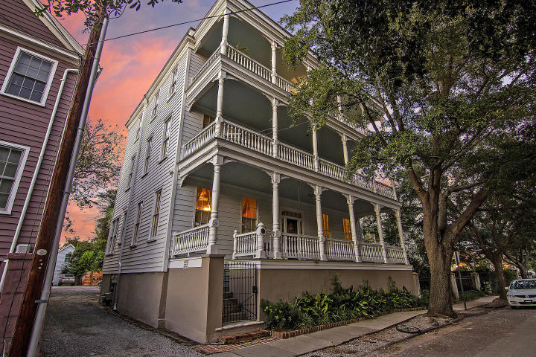

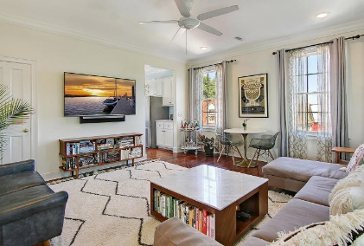
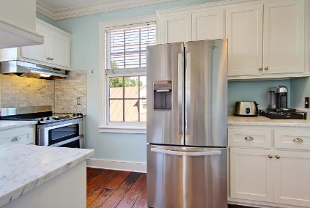
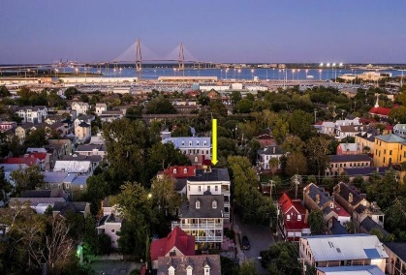
Downtown Charm
30 Mary Street 5
Charleston, SC 29403 ~ Wraggborough ~ MLS# 20027243 ~ $575,000
Surrounded by beauty, history and with views of the Ravenel Bridge, this penthouse in downtown Charleston is a must see! Historic charm and modern conveniences collide with this sun drenched two bedroom, one bath that has gorgeous, original hardwood floors, tall ceilings, crown molding and a completely renovated kitchen with tile backsplash, glass front cabinets and SS appliances. The full front balcony is the ultimate in outdoor living spaces with plenty of space to spread out & enjoy the view of the Ravenel Bridge. From this great location you can walk to Wragg Mall Park, The Charleston Museum, Marion Square and all the shopping and dining found on King Street. With off street parking, easy access to 26 and no yard work to worry about, this is an opportunity you don't want to miss!
Additional features include:
Open floorplan with spacious rooms
Unobstructed views through 15 6 ft windows
Amazing views from the piazza of historic church steeples, the Ravenel Bridge, and downtown Charleston
9 ft ceiling
Two private parking spots in rear lot
Historic charm - this home housed a bakery from approx 1918-1958 and a storefront sweet shop from approx 1968-1978
Book your showings at this incredible property today!
Nate Gainey 843-513-2038
nate@mattoneillteam.com
Christopher Smith 843-267-0735
christopher@mattoneillteam.com

