Slide 1
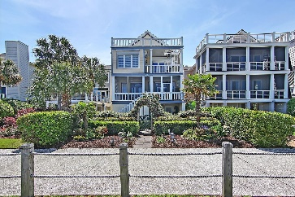
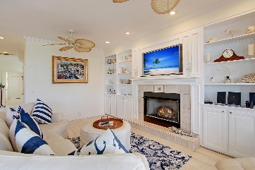
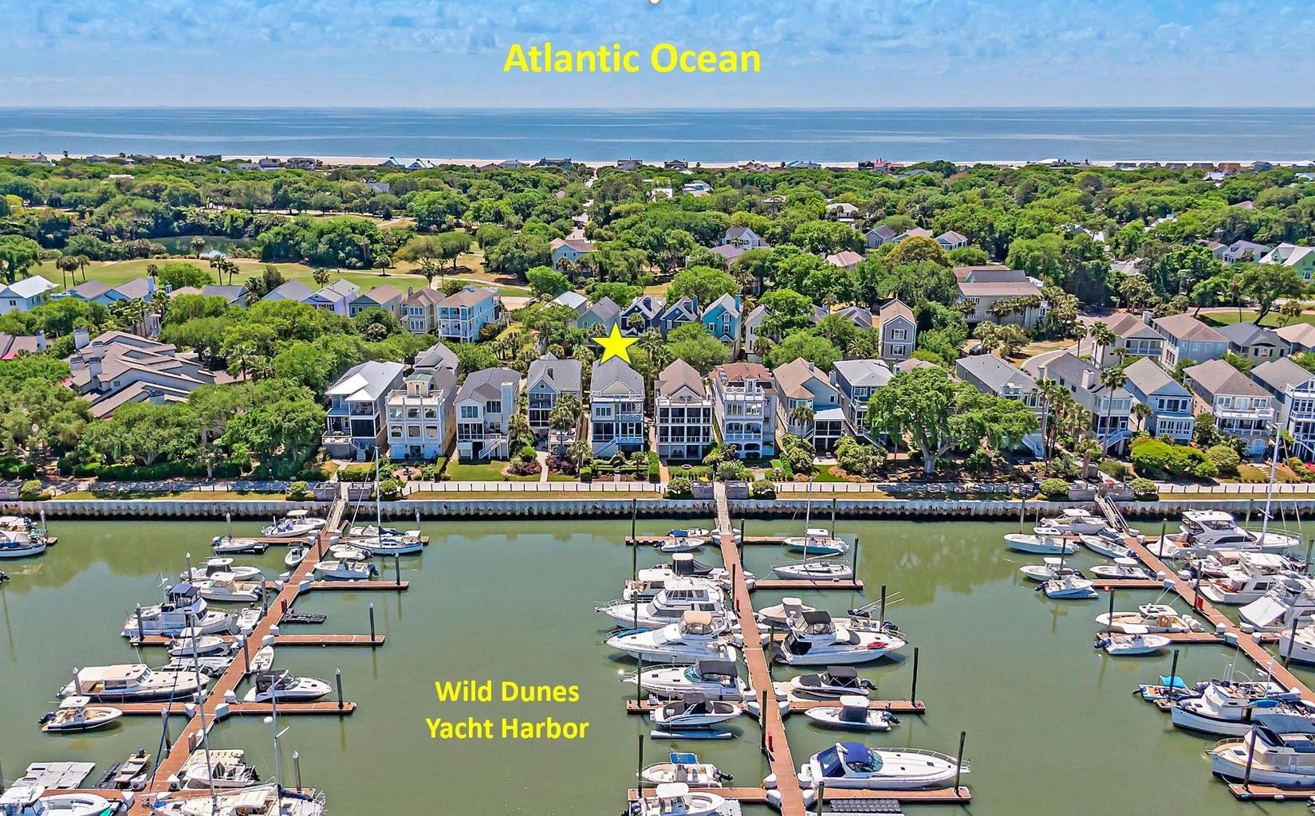
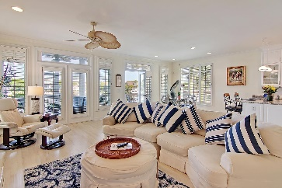
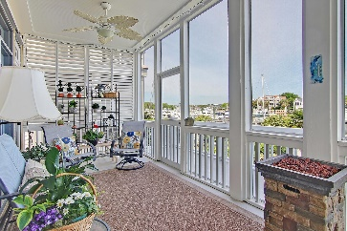
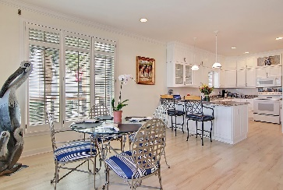
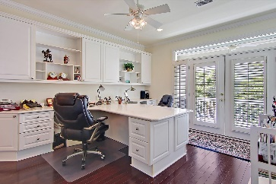
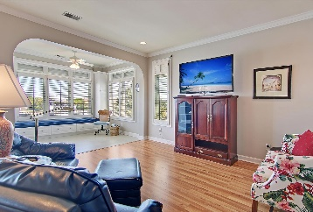
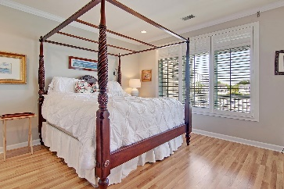
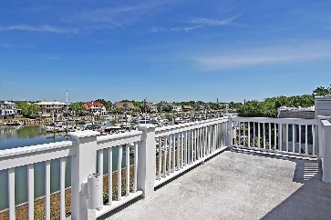
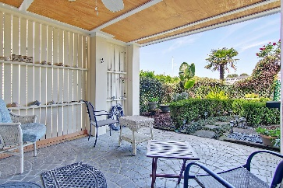
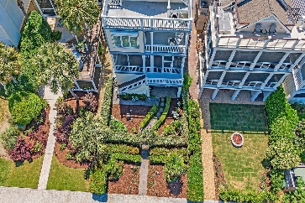



Waterfront Home With Option For Adjacent Boat Slip
30 Yacht Harbor Court Isle of Palms, SC 29451 | MLS# 21011896 | $2,000,000
Welcome to 30 Yacht Harbor Court, a waterfront oasis that is calling your name! Situated within the private gated community of Wild Dunes Resort and a 10 minute walk to the beach, this one owner custom home is in pristine condition, has never been rented and offers views of Morgan Creek from every level. Whether you are sitting on the shaded patio working on a puzzle, enjoying an early cup of coffee on the 2nd level screened porch, reading a book on the 3rd level owner's suite porch or taking in some vitamin C on the 4th level sun deck, you will never be more than a few steps from the water. In addition to amazing waterfront views, there is an adjacent 40' boat slip available for purchase separately which will allow you to be on the water within minutes! Upon entering the home, you will immediately notice how the rooms are filled with natural daylight. Neutral colors throughout give a sense of serenity and provide the perfect backdrop for the resort views. On the main level, the living room, dining and kitchen area create a wonderfully flexible space where family and friends can gather to enjoy meals, play games and relax. Down the hall, you will find a full sized laundry room, two full bathrooms and two bedrooms, one of which has a balcony overlooking the front of the home.
On the top level, there is a spacious office with built in desks, shelving, a full bathroom ensuite and another balcony overlooking the front of the home. (this could easily be a 5th bedroom if built-ins are removed). Situated between the office and the owner's suite is a third bedroom, also with a full ensuite bathroom. The spacious owner's suite spans the entire back portion of the top floor. It features two walk-in closets, a large bathroom with two vanities, a jetted tub, separate shower and water closet. The suite also includes a sitting area, an enclosed sunroom with a built-in window seat and a private porch that overlooks the water. From the 3rd level porch, there is a spiral staircase that leads up to a 4th level sundeck. This is an ideal spot to relax and reflect on the day while watching the sun set.
On the ground level, there is a long garage that can easily park several cars and/or golf carts in tandem, a dry storage room with a dehumidifier, a covered patio and a large outdoor shower room. From the patio, you can pass through the beautifully landscaped yard to take an evening stroll along the water.
Other noteworthy features and updates include an elevator that runs to all floors, custom plantation shutters throughout, storm shutters on all doors and windows, updated laminate flooring on main level, a built-in wall safe, granite countertops in the kitchen, alarm system, irrigation system, landscape lighting, a new roof in 2019, a new split-zone HVAC unit in front rooms and new water heater in 2018.
The lifestyle that is offered in Wild Dunes Resort is truly unparalleled. (Club Memberships are optional). There are neighborhood pools, tennis courts, two golf courses, workout facilities, a new spa, biking and walking paths, beach access and everything is accessible via golf cart! Envision what life would be like if you spent the day on the water, parked your boat in the marina adjacent to your home and then took your golf cart to a restaurant for dinner. A resort lifestyle that is only a short drive from downtown Charleston. Schedule your private showing soon!
Whitley Boyd
(843) 324-4761
WBoyd@CarolinaOne.com
www.PropertiesofCHS.com
Carolina One Real Estate | 628 Long Point Rd. | Mt Pleasant, SC 29464-3032

