Slide 1
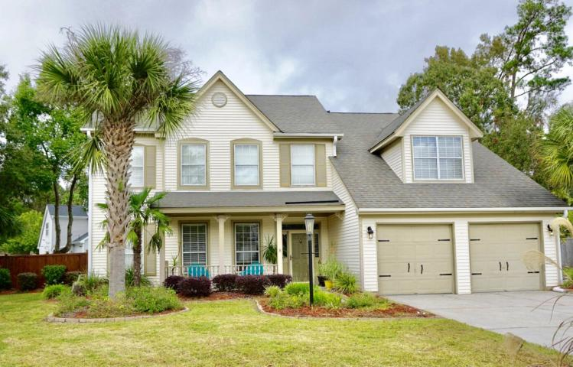
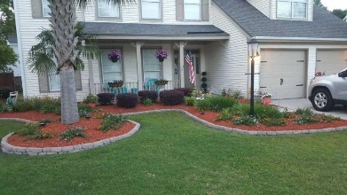

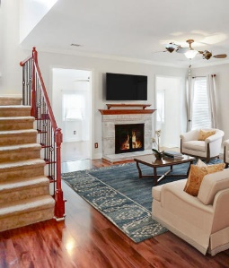
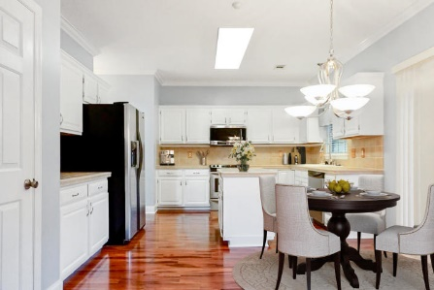
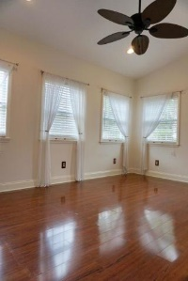
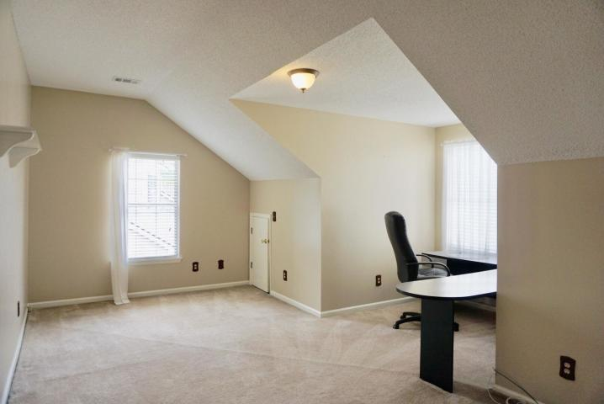
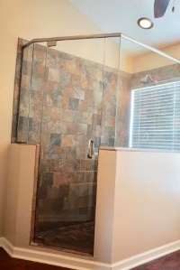
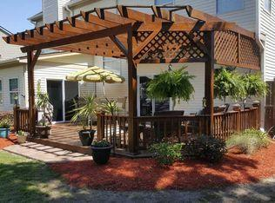


Motivated Seller ~ Needs to Sell as soon as possible!
Starbucks card to first 10 agents
3102 Waterville Place
Village Green ~ Charleston ~ MLS# 19030632 ~ $319,000
4 Bedrooms | 3 Bathrooms | 2,340sf
SHORT SALE APPROVAL IN HAND
This beautiful, updated four bedroom home is located in desirable Village Green Subdivision, located at the end of a very quiet cul-de-sac, just minutes from plantations, gardens, restaurants, and shopping. As you enter the home you will be greeted by Beautiful Hardwood floors throughout downstairs, with a cozy family room with wood burning fireplace. The eat in kitchen has beautiful white cabinets, tile back splash and tile counter tops that leads to a separate dining room. Sunroom. Upstairs, boasts three spacious size bedrooms and a large frog that could be used as 4th bedroom, playroom or office. Home Security. System. The backyard is a true Oasis with a beautiful Pergola that is perfect for entertaining 13 lighted Palms trees, Irrigation and so much more.
Laura McLain
(843) 509-7647 | laura@lauramclainrealty.com
www.theblvdcompany.com
The Boulevard Company, LLC | 806 Johnnie Dodds Blvd Ste 100 | Mt Pleasant, SC 29464

