Slide 1
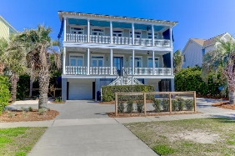
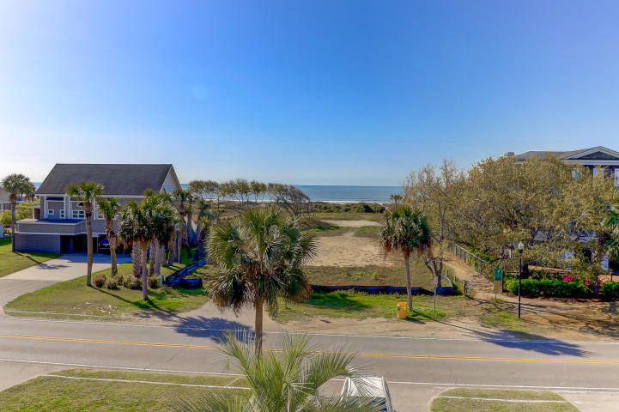
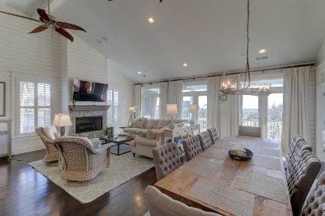
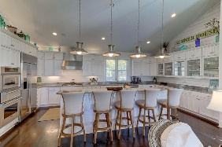
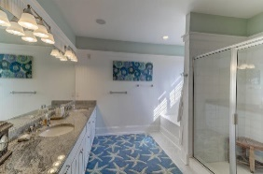
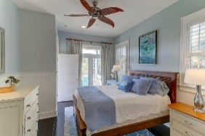
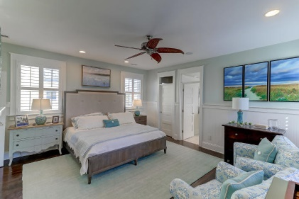
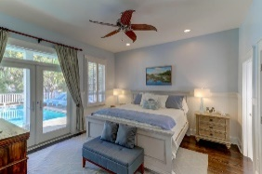
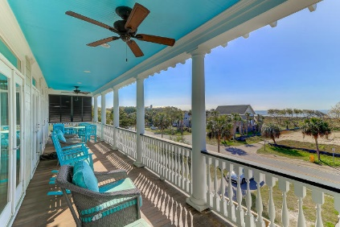
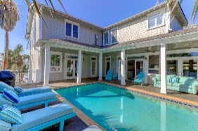
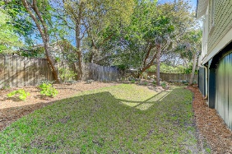


3103 Palm Boulevard
Isle of Palms, SC 29451
MLS# 19002523
$2,399,000
Just Listed
2nd Row ~ Pool ~ Ocean Views
Stunning Inside and Outside
Open House This Weekend
1:00 - 3:00 Both Days
A spectacular island home filled with floor to ceiling Shiplap, high ceilings, ocean views, wood floors, double front porches and an expansive kitchen with all new high end appliances all open to living and dining areas. Open the double doors along an entire living room wall for ocean breezes and stunning ocean views. This furnished home is loaded with magnificent interior design and furnishings. Enjoy direct access to the refreshing and private, saltwater pool from the game room and guest room. The pool features LED lighting and has the heating and cooling feature. The game room offers a bar sink, wine cooler, a Home Theater system and a pool table. Elevator to all floors. This home offers plenty of space and relaxation. We easy direct access to the beach across the street.
Outstanding exterior landscaping, lighting and fencing with a new turn around parking area in the front and new high end hardscape. A live fence surrounds this home. Some special features in this 5 bedroom 4 bath and 2 half bath home include the central vacuum system, Ipe Decking, gas grill directly connected to a gas line, 2 fireplaces with gas logs, 2 water heaters in the attic plus 1 tank less. Glass transom windows above most of the interior and exterior doors. A gutter system protects this home along with Anderson windows and doors. A room off the main living room has it's own fireplace and could be an office, reading room or whatever you want to make it. A new powder room has recently been added to this home for easy access to the pool along with many, many special additions and attention to every detail. 3103 Palm Boulevard is truly jaw dropping and you won't want to miss it!
Darlene Smith
Office - (843) 886-8110
Mobile - (843) 696-7824
darlenesmith@carolinaone.com
DarleneSmithTeam.com
Carolina One Real Estate
1503 Palm Blvd Ste
Isle of Palms, SC 29451

