Slide 1
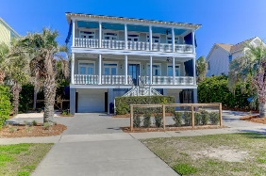
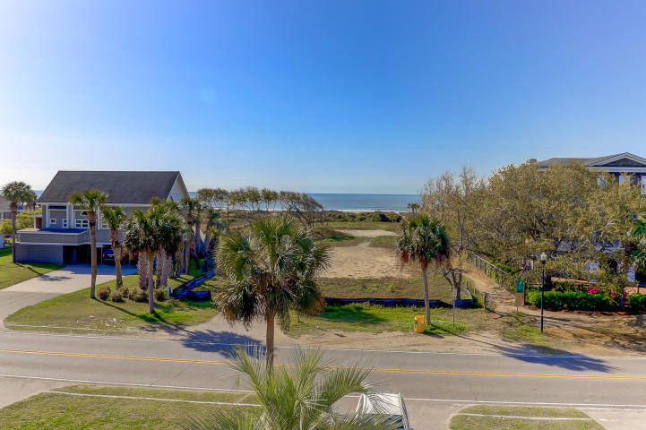
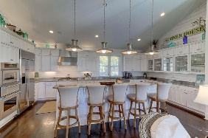
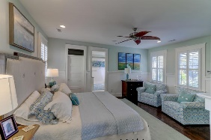
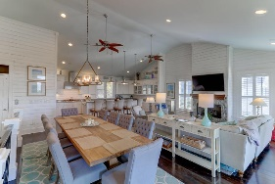
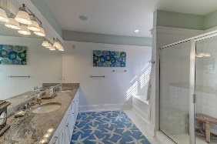
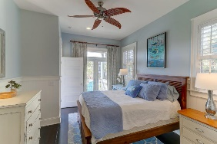
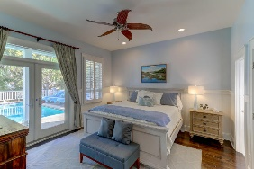
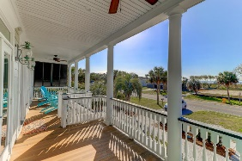
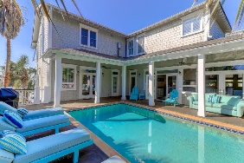
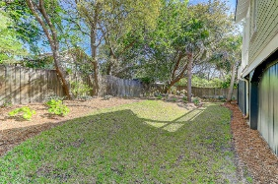


3103 Palm Boulevard
Isle of Palms, SC 29451
MLS# 18009328
$2,489,000
Stunning In and Out
Ocean Views & Pool
A true 2nd row beach house feel and look in this spectacular island home filled with floor to ceiling Shiplap, high ceilings, ocean views, wood floors, double front porches, and an expansive high end kitchen that is open to the farm table dining room and living space with front porch ocean breezes and views. High end kitchen appliances including a 5 burner gas stove, GE Monogram fridge, wall oven w/warmer and microwave. This furnished home is loaded with stunning interior design furnishings. Enjoy direct access to the refreshing and private, saltwater pool from the game room and guest bedroom. The pool has been resurfaced, and LED light added and has the heating and cooling feature. The game room offers a bar sink, wine cooler, a Home Theater system and a pool table. Elevator to all floors. Outstanding exterior landscaping, French drains, lighting and fencing with a new turn around parking area in the front with high end hardscape. A live fence surrounds this home. Some special features in this 5 bedroom 4 bath and 2 half bath home include the central vacuum system, Ipe Decking, a gas grill directly connected to a gas line, 2 fireplaces with gas logs, 2 water heaters in the attic plus 1 tank less. Glass transom windows above most of the interior and exterior doors. A gutter system protects this home along with Anderson windows and doors. A room off the main family room has its own fire place and could be an office, reading room or whatever you want to make it. A new powder room has recently been added to this home for easy access to the pool along with many, many special additions and attention to every detail. Direct access to the beach bath is directly across the street. 3103 Palm Boulevard is truly jaw dropping and you won't want to miss it!
Darlene Smith
Office - (843) 886-8110
Mobile - (843) 696-7824
darlenesmith@carolinaone.com
DarleneSmithTeam.com
Carolina One Real Estate
1503 Palm Blvd Ste
Isle of Palms, SC 29451

