Slide 1
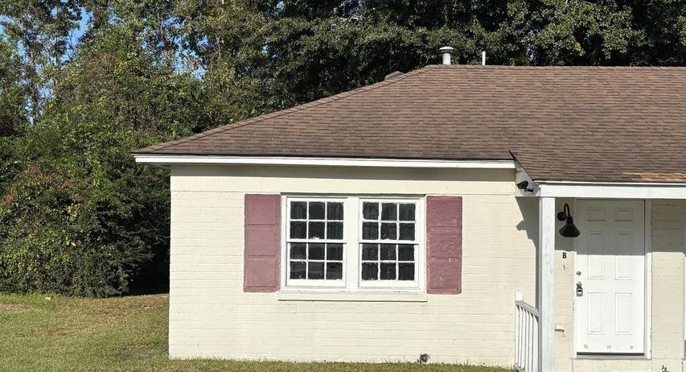
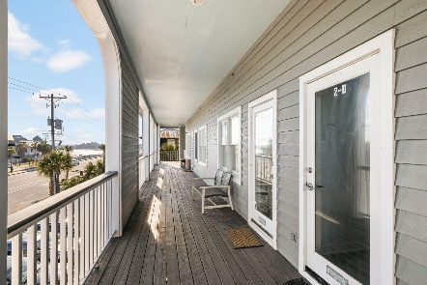
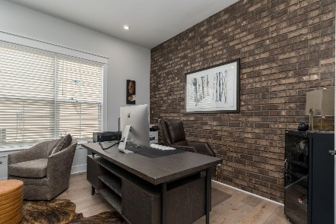
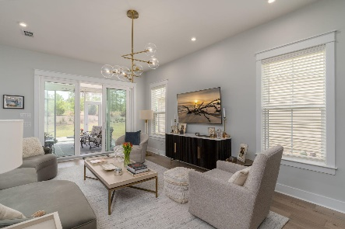

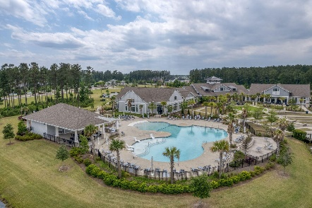
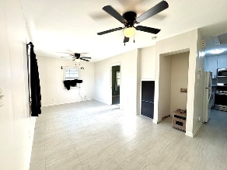
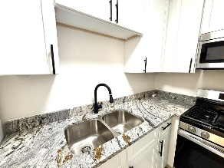
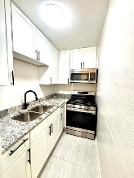
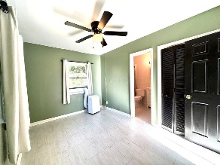
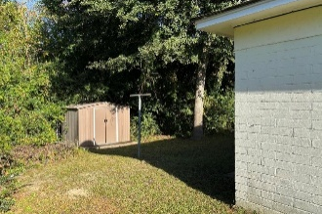
3104 Azalea Drive B
Dorchester Terrace | North Charleston, SC 29405 | MLS# 25029719 | $159,000
Darrell Creek Elevated Home With Elevator & Salt Pool
Starter Home or Investment Special
Co-sponsored by
This 1-bedroom, 1-bathroom unit located in Dorchester Terrace offers a great opportunity for first-time homebuyers or investors alike. The inviting open-concept living and dining area, perfect for entertaining or unwinding after a long day, is just inside your front door. Off to the side is a newly remodeled kitchen with all new cabinets, gas range with griddle cooktop and burners, and new granite countertops.
The 1 bedroom is cozy and located at the back of the home to give more privacy. The full bath includes a convenient shower/bath combo, adding to the functionality of the space. This home is conveniently located close to I-26, making it a great jumping off point to W Ashley, Charleston, the bases and more.
Offering $3000
Lender Credit
Rochelle Rennert
843-847-9694 | rochellesellscharleston@gmail.com | www.theunlockingdreamsteam.com
AgentOwned Premiere Group, Inc. | 219 N Highway 52 Ste A | Moncks Corner, SC 29461-3926

