Slide 1
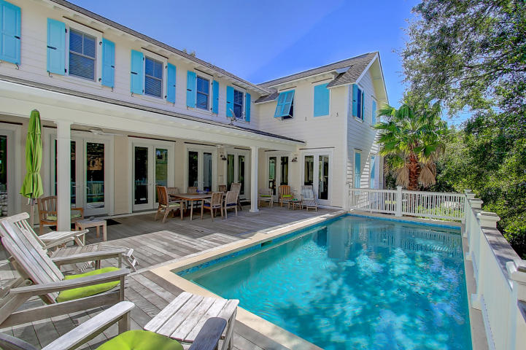
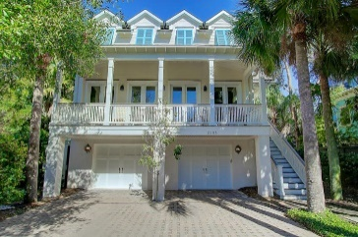
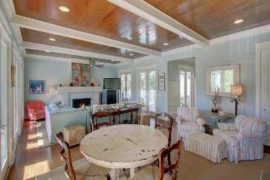
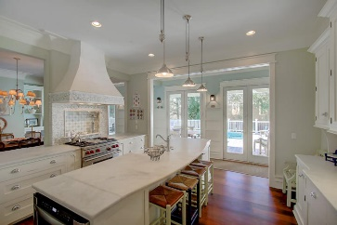
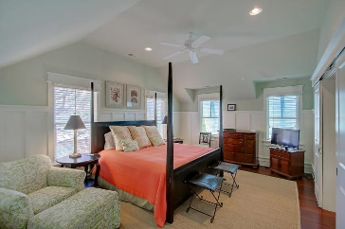
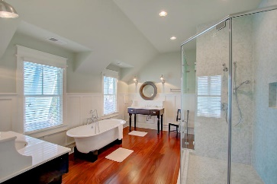
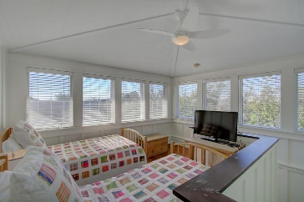
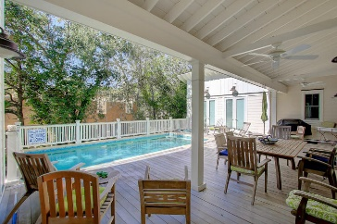


3105 Cameron Boulevard
Isle of Palms, SC 29451
MLS# 17001826
$1,950,000
OPEN HOUSE
Sunday 2-5
Spectacular beach home just 1 block from the beach built by ALKA Construction offers amazing light and that wonderful Coastal feel throughout. You will be blown away by the woodwork from floor to ceiling, the openness and how the home surrounds the raised pool. Upon entering the home you'll notice the Tabby surround fireplace with gas logs, gorgeous Brazilian Mahogany floors and numerous French doors all leading to the pool area. A separate, large dining room with built-ins is just off the gourmet kitchen. Enjoy the marble counter tops and tile back splash, Wolf gas top stove with pot filler, Bosch dishwasher, Sub Zero refrigerator, farm sink, and the custom cabinetry and drawers. From the 10' ceilings, extensive crown molding, beams and gorgeous, custom lighting throughout this home has every detail covered. 3105 Cameron isn't short of bedrooms either. The main floor offers 2 bedrooms (1 of those could be a master) and on the 2nd floor are 4 bedrooms--2 with en suites (1 is the master) and 2 bedrooms that share a bath. The loft/tower area currently houses 2 twin beds making a fun bedroom for kids but would make a great sitting room/office as well with ocean views. From the garage under the house you'll have elevator access to all floors of this home. A tremendous amount of storage is under the home. Additional features are the Ipe Decking, copper flashing, Anderson windows and doors, 2 car garage under the home and a Tabby foundation. This vacation rental home is in pristine condition and averages between $100,000-$115,000/year in gross income.
Darlene Smith
Office - (843) 886-8110
Mobile - (843) 696-7824
darlenesmith@carolinaone.com
DarleneSmithTeam.com
Carolina One Real Estate
1503 Palm Blvd Ste
Isle of Palms, SC 29451

