Slide 1
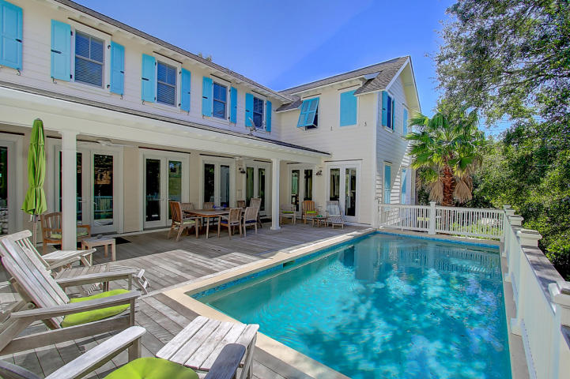
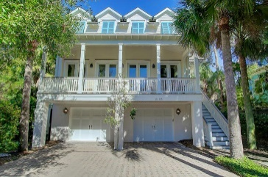
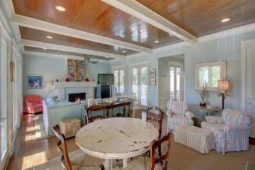
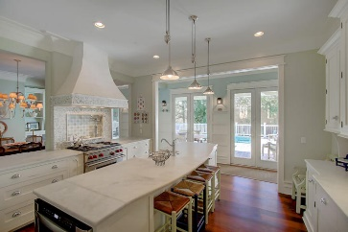
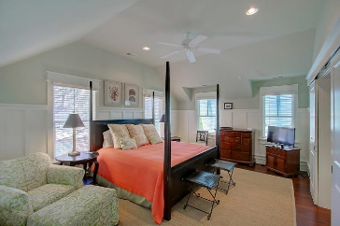
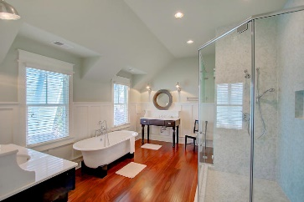
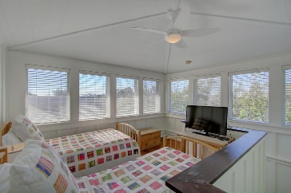
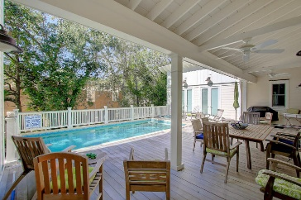


3105 Cameron Boulevard Isle of Palms, SC 29451 MLS# 17001826 Reduced to $1,720,000
Spectacular Custom 6 bed/5 bath
Just 1 Block To The Beach
Walk inside this beautiful beach home and the southern coastal charm is palpable!! This spectacular beach home just 1 block from the beach built by Alka Construction Co. offers amazing light and spacious living. The woodwork from floor to ceiling throughout the house is breathtaking. Upon entering the home you'll notice the Tabby surround fireplace with gas logs, gorgeous Brazilian Mahogany floors. Several French doors from the kitchen area, living room area, and a downstairs bedroom surround the raised pool. A perfect home for large family Beach Vacations where everyone can have their private space and yet be together to enjoy the pool and great fellowship. A separate, large dining room with built-ins is just off the gourmet kitchen. Enjoy the marble counter tops and tile back splash, Wolf gas top stove with pot filler, Bosch dishwasher, Sub Zero refrigerator, farm sink, and the custom cabinetry and drawers. From the 10' ceilings, extensive crown molding, beams and gorgeous, custom lighting throughout--this home has every detail covered down to the unique door handles. 3105 Cameron isn't short of bedrooms either. The main floor offers 2 bedrooms (1 of those could be a master) and on the 2nd floor are 4 bedrooms--2 with en suites (1 is the master) and 2 bedrooms that share a bath. The loft/tower area currently houses 2 twin beds making a fun bedroom for kids but would make a great sitting room/office. From the garage under the house you'll have an over sized elevator with access to all floors of this home. A tremendous amount of storage is under the home with additional washer and dryer. Additional features are the Ipe Decking, copper flashing, Anderson windows and doors, 4 car garage under the home with ample parking on the driveway, tank less water heater, irrigation system and Tabby accents. This vacation rental home is in pristine condition and averages between $100,000-$115,000/year in gross income.
Darlene Smith Office - (843) 886-8110
Mobile - (843) 696-7824
darlenesmith@carolinaone.com
DarleneSmithTeam.com
Carolina One Real Estate
1503 Palm Blvd Ste
Isle of Palms, SC 29451

