Slide 1
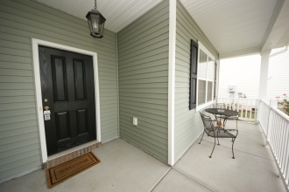
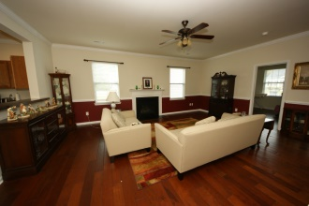
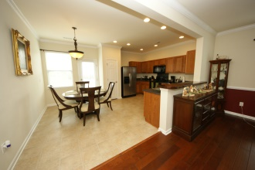
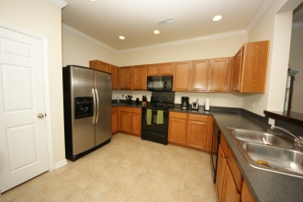
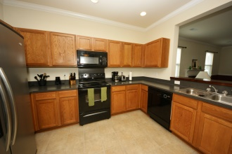
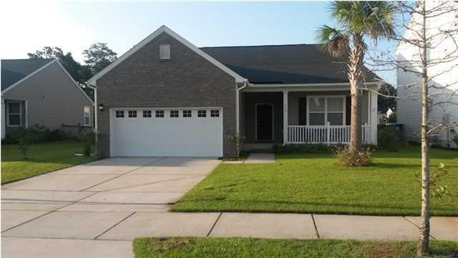
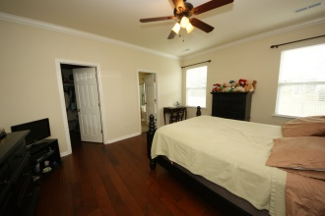
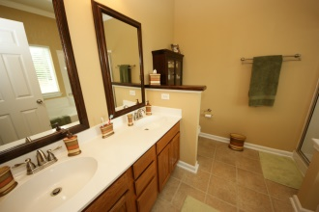
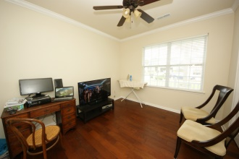
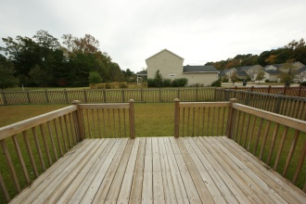
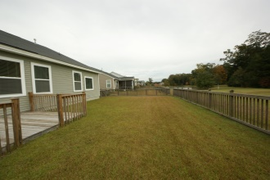


3105 Cold Harbor Way Charleston ~ MLS# 1425319 ~ $234,999
Back on the Market in Carolina Bay
This is a great opportunity to own a beautiful home in Carolina Bay below fair market value. This one story open floor plan, 4 bedroom/2 bath home with hand scrapped wood floors throughout most of the home, sits on a magical lot overlooking the pond, boasting vacation like living year round. Upgrades include flooring, back deck, fenced in yard, 4 bedrooms/ office/or guest room, lighting, lots of natural light throughout and master with a lovely en-suite, security system, transferable termite bond, etc..
Home was appraised for $236,000! Listed below fair market value!!
Carolyn Dubrofsky
843-324-9645 M
cdubrofsky@comcast.net
RE/MAX Historic of Charleston
The MarshallWalker.com Group
582 Rutledge Ave Charleston, SC 29403

