Slide 1
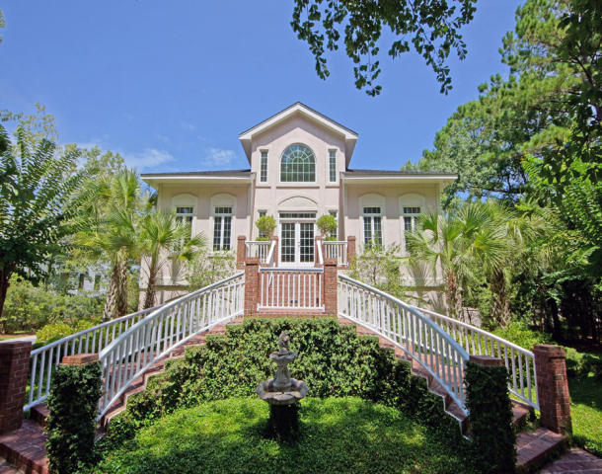
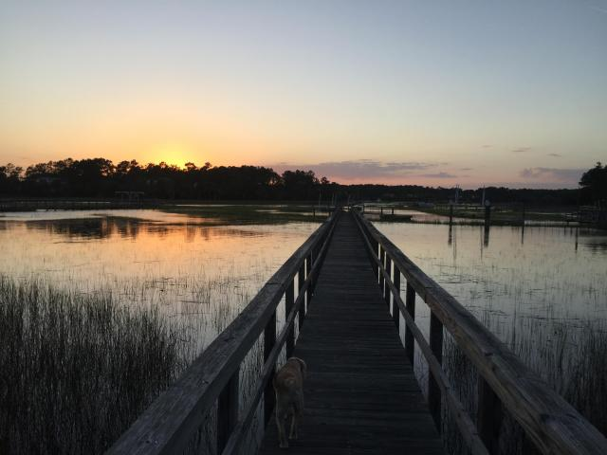
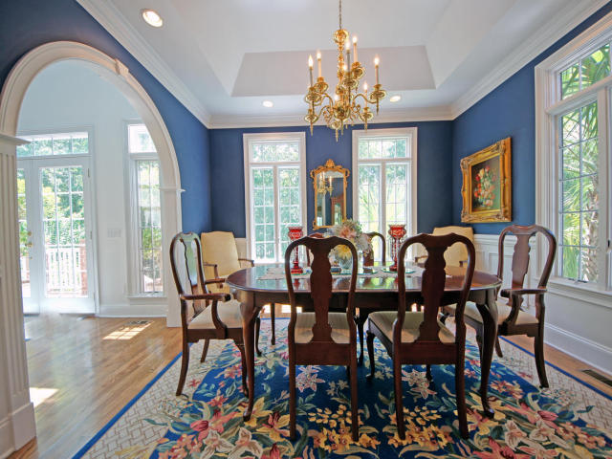
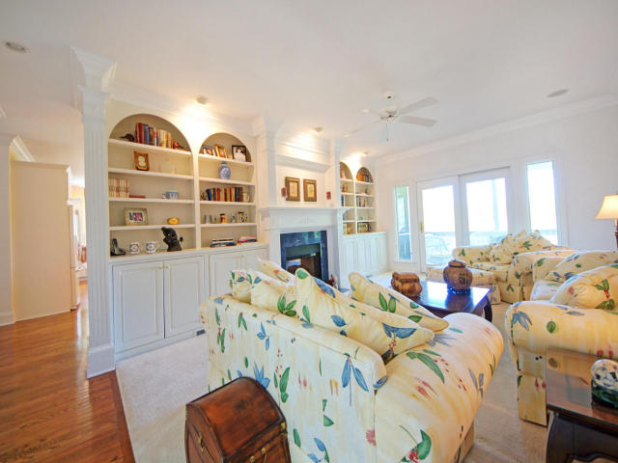
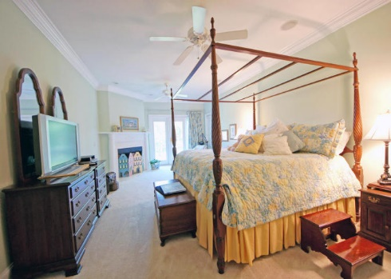
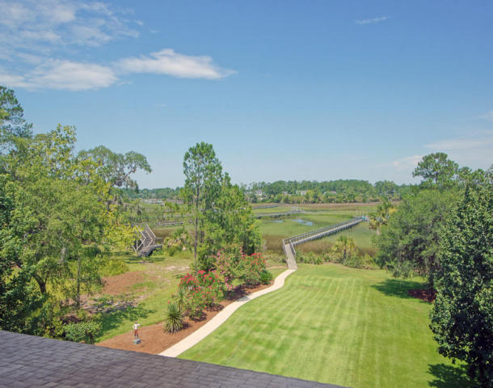
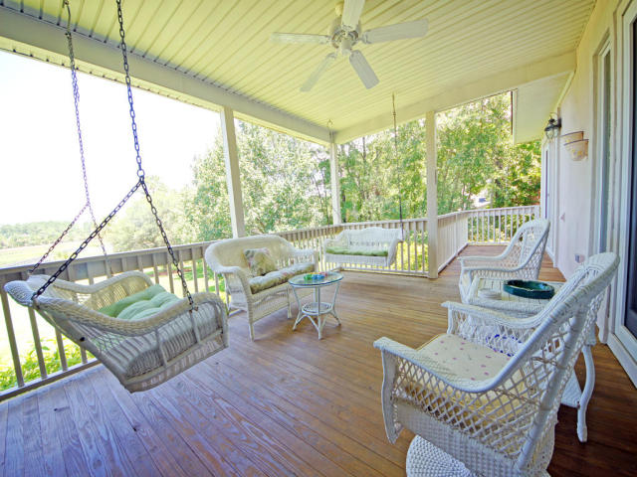

3106 Pignatelli Crescent Mt Pleasant ~ MLS# 16019410 ~ $1,250,000
Dunes West Waterfront Property
This meticulously maintained home is located on over an acre lot on Wagner Creek. It has an incredible waterfront view with a dock, boat lift and floater. With the huge landscaped back yard, you won't find a more serene setting as you relax on your choice of screened porch, covered open air porch or deck. There is a natural buffer from the quiet neighborhood street in the front with a horseshoe driveway. A grand stairway and fountain welcomes you in to the home. With high ceilings, newly refinished oak floors and fresh paint everywhere, it is obvious that the owners took immaculate care of this home. There are also brand new granite countertops in the kitchen and new tile flooring in the master bathroom. This property also comes equipped with an elevator shaft and tons of storage space.
Glenn Drew Wewers
(843) 534-6376
drew@charlestonproperty.net www.BrennamanGroup.com

