Slide 1
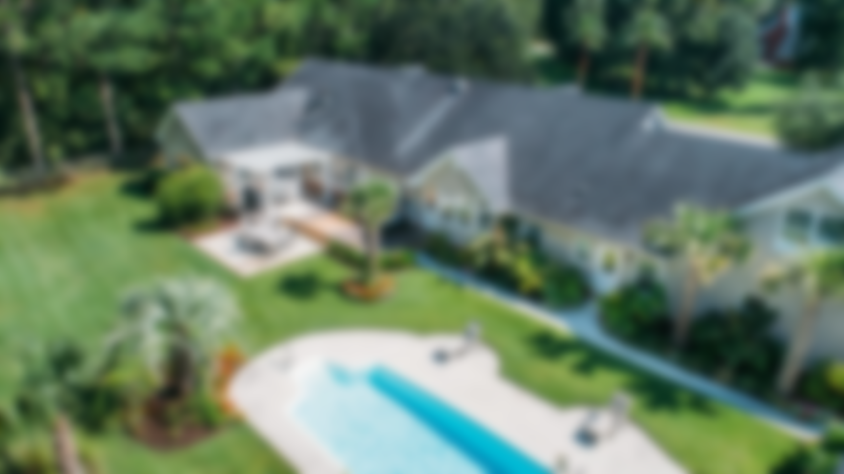
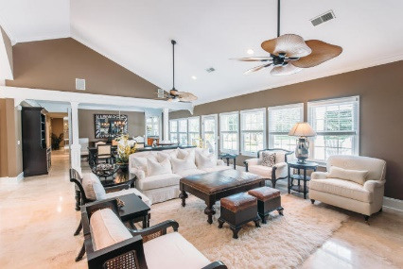
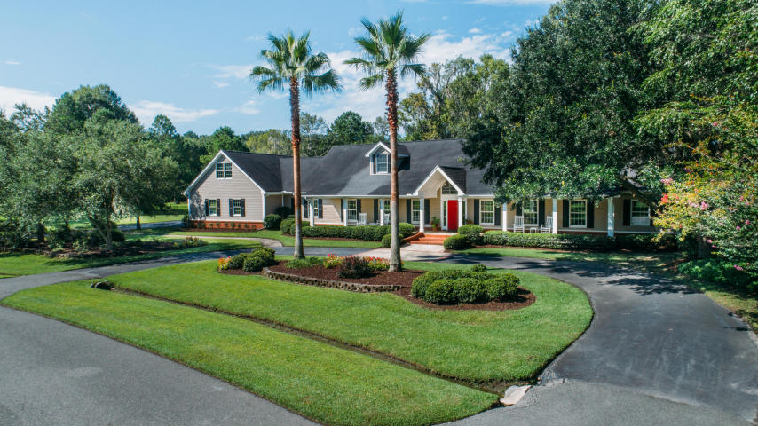
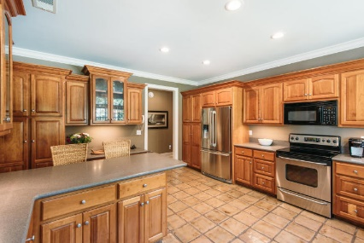
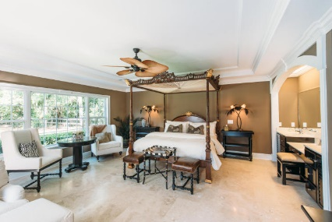
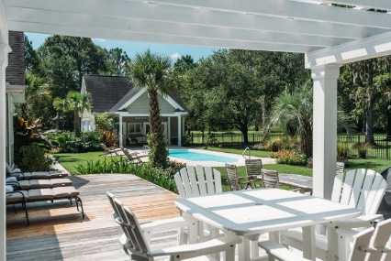
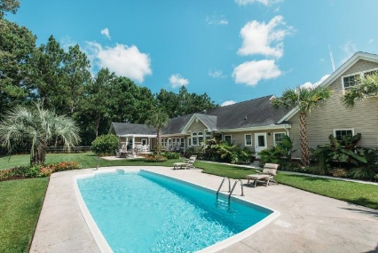
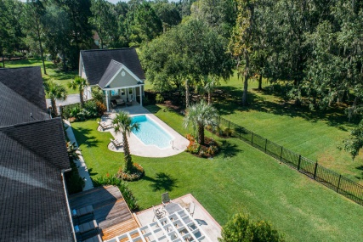
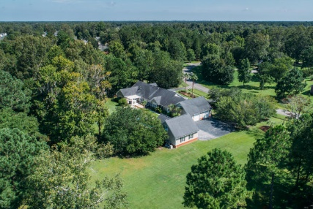
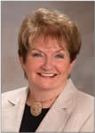

3106 Winners Circle West Ashley ~ Charleston, SC 29414 MLS# 18009549 ~ $735,000
Southern Living at Its Finest
From the first moment that you pull into this enchanting tree lined driveway, you will be able to envision your self living here. This elegantly appointed home is everything that you have dreamed of in your forever home. From the sprawling Southern front porch to the backyard oasis, this home has it all. The front doors open into an inviting Great Room that draws the eye directly outside to the multi level decks that lead out to the sensational entertainment area with in ground pool. Back inside you will be amazed by large amount of natural light that filters through the entire back of the home. The home features gorgeous travertine floors, with soaring ceilings. You will feel the elegance of this home as you walk through every room. Incredible attention to detail is evident in the beautiful crown molding, gas fireplace with stone surround, decorative columns and gorgeous ceiling fans. This house also boast an enormous 4 car garage. The garage ceilings are 15ft plus ceilings, perfect for the owner that wants to have a "dream garage". It is a MUST SEE! as is this whole property. Do not wait, make your appointment for a showing today.
Check out this video to see more: https://youtu.be/JItB0jV37Z0
Open House previously scheduled for 9/15/16 Has been rescheduled due to bad weather
Barbara Shaw
REALTOR
(843) 442-2889
barbarasellscharleston@gmail.com
Christine Stafford
REALTOR
(843) 709-7330
christine.stafford@agentownedrealty.com
AgentOwned Premiere Group | 1800 Trolley Rd | Summerville, SC 29485

