Slide 1
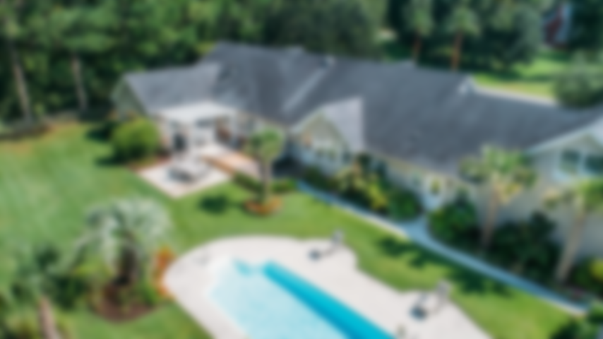
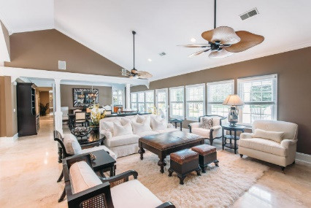
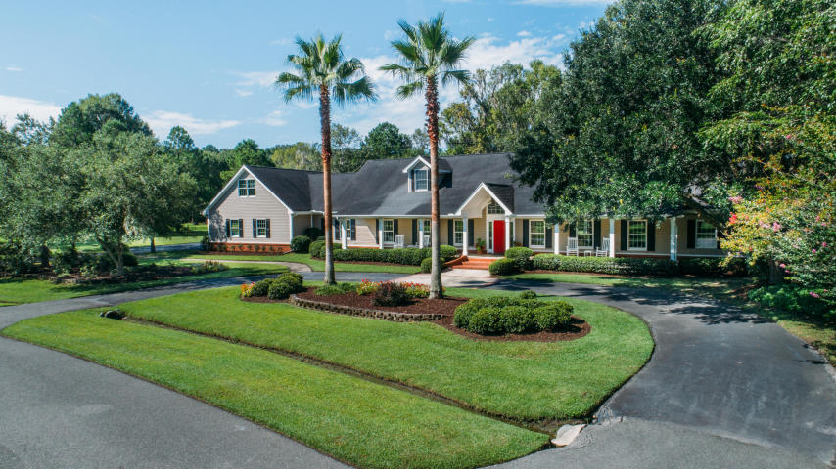
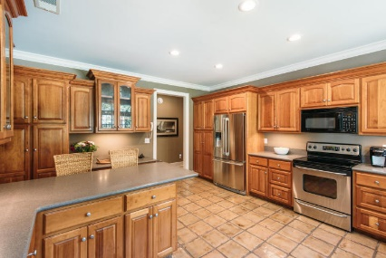
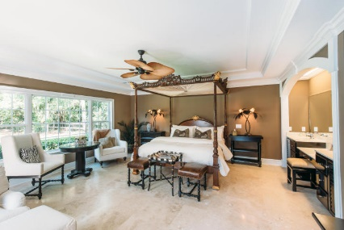
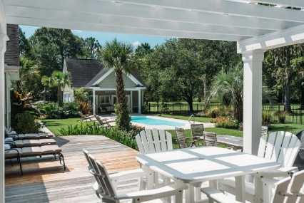
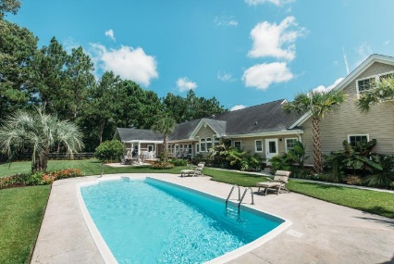
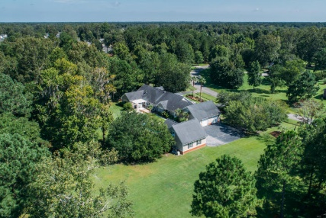
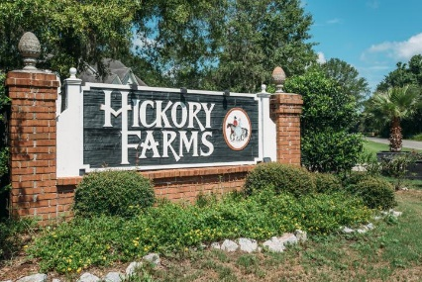
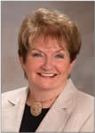

3106 Winners Circle
Hickory Farms ~ Charleston, SC 29414
MLS# 17022534 ~ $890,000
Southern Living at Its Finest
This immaculate, exquisitely decorated home sits on just over 2 acres of park-like property less than 4 miles from I526 and St. Francis hospital, and minutes to downtown Charleston. The curb appeal of this home is something you must see to fully experience. Walk past the rocking chairs on the sprawling Lowcountry front porch to enter the home and you are immediately drawn in to the generously-sized open area of the sitting room, living room and dining room, all leading to the rear deck and pool. Gorgeous travertine floors and plenty of natural light flow throughout the home's open, airy layout.
With 5 bedrooms, 3 full and 2 half baths, generous living space and beautiful finishes, you'll enjoy a perfect setting for both relaxing and entertaining.
Open to the rear deck and pool, the master suite offers an ensuite bath including glass block shower with dual shower heads. The kitchen looks out to the pool and offers stainless steel appliances and beautiful Cherry cabinets. The home also includes a finished room over the garage that can be used as a gym, playroom or media room and an enormous spotless garage with two car bays and a workshop area with built-in workbench.
As if this weren't enough, there is also a guest house with an additional two-car garage and room for living quarters, bathroom and kitchenette. A perfect apartment for an in-law, teenager or caregiver - or the ultimate man-cave. Just imagine spending your Sunday afternoons floating in your heated, saltwater pool and watching your favorite sport on the big-screen TV mounted in the covered porch area of the guest house.
Hickory Farms, an enclave of just 54 homesites, is a hidden West Ashley gem that offers large acreage and the opportunity to keep horses right in the heart of Charleston. Envision coming home to a sprawling yard adorned with palm trees, grand oaks and horses grazing in your neighbors' yard.
Call to make this dream a reality!
Open House previously scheduled for 9/15/16 Has been rescheduled due to bad weather
Barbara Shaw
REALTOR
(843) 442-2889
barbarasellscharleston@gmail.com
Coldwell Banker Residential Brokerage
4969 Centre Pointe Dr. Ste 203
Charleston, SC 29418
www.coldwellbankerluxury.com

