Slide 1
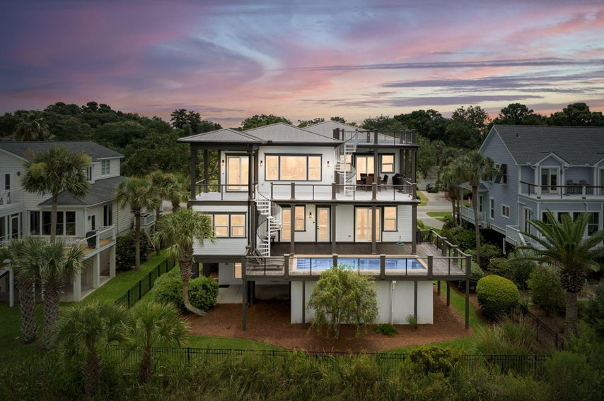
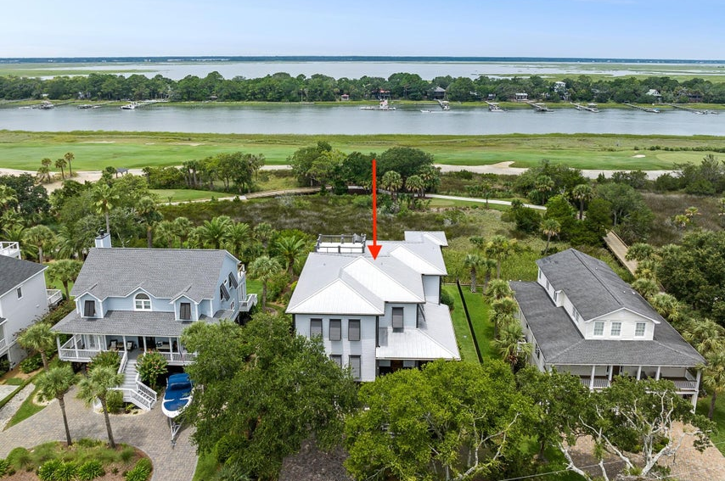
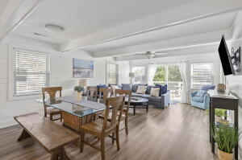
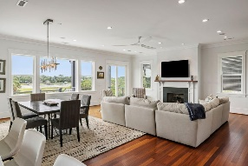
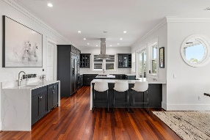
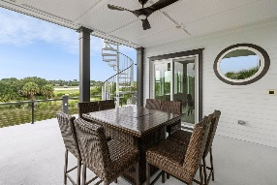
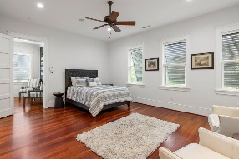
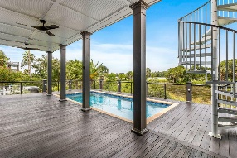
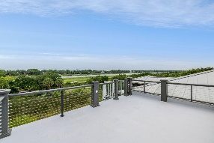
3109 Waterway Boulevard Isle of Palms, SC 29451 | MLS# 24021266 | $3,950,000
Darrell Creek Elevated Home With Elevator & Salt Pool
Custom Beach House, High-end Finishes, Sunset Views!
Gorgeous, custom beach house with high end finishes and stunning views of the Intracoastal Waterway, marsh, and Wild Dunes Resort golf course. The views are maximized by a reverse floor plan, numerous walls of windows, and three levels of porches. From the drive-under garage, take the elevator or stairs up to the 2nd floor of the home and enter into the open-concept family room, dining area, and kitchen. These main living areas feature hardwood floors, crown molding, and custom lighting/fans and are strategically located along the back side of the house, providing 180-degree water views. Several glass doors access porches that run the width of the house. The first floor back porch has a built-in gunite pool.
The kitchen features beautiful custom cabinetry, island with Wolf gas cook top and stainless steel vent hood, wet bar, breakfast bar, stone countertops, built-in paneled refrigerator/freezer, built-in stainless steel double-oven, stainless farm sink, and built-in paneled dishwasher. This home is an entertainer's dream! The house has been meticulously maintained. Upgrades/improvements include the following: New metal roof 2019; New HVAC 2021; New water heaters May 2022; Interior paint 2022 and touch ups 2024; Renovated kitchen and butler's pantry 2022; Upgraded Jack N Jill and primary up bathrooms 2022; Refurbished pool 2022 - included new plaster, waterproofing, new equipment inside and outside, new sand 2022, and new equipment again 2024 (raised motor off the ground); New Wolf cook top 2022; New washer & dryer 2022; Replaced all exterior components of central vac system 2022; New gutters 2023; New ice maker 2024; Elevator inspected and serviced 2022 - Inspected and serviced June 11, 2024; New alarm system w/ cameras and electronic interfacing - garage doors, front door, Wi-Fi access, and Wi-Fi thermostats 2022; Replaced ALL porch/stair railings and replaced any aging wood around the entire exterior; Painted all exterior trim, siding, hurricane shutters 2022; Installed new aluminum fencing 2024; Replaced ALL windows and glass doors with new construction IMPACT windows and doors 2024; Replaced trim (in and out) on all windows and doors; Replaced all exterior siding and house wrap 2024; Repainted entire exterior 2024; Replaced two garage service doors in 2023; Completely renovated the primary bath downstairs; Flat roof patched and repainted 2024; Garage interior - all wood surfaces painted with anti-mildew paint including stairs and doors. Wood decks will be re-stained as weather permits. The house and its views are truly dreamy! Prime location on the quiet, back side of the island. Less than a half mile to the beach. Just under a mile to Islander 71 Fish House and Raw Bar and IOP marina and boat launch. Two miles to the Front Beach shops and restaurants.
Enjoy a video tour of this lovely home
Andrea Rogers
843-532-3010 | andrearogers1@gmail.com | www.andrearogersrealtor.com
AgentOwned Preferred Group | 1400-G Palm Blvd | Isle Of Palms, SC 29451

