Slide 1
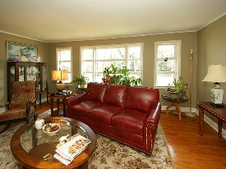
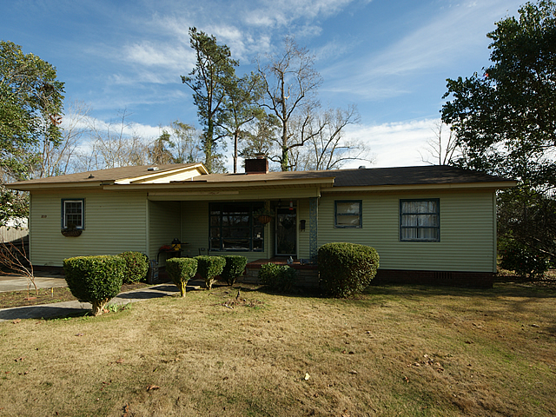
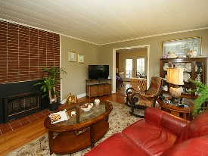
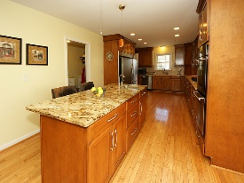
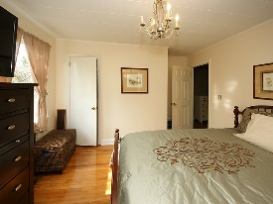
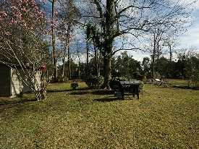
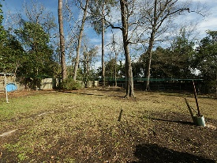
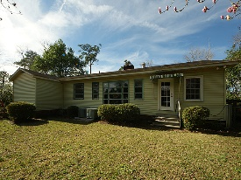


New Listing With Buyer Incentives!
310 Fairlawn Drive
Fairlawn
Moncks Corner, SC 29461
Open House Canceled!
Under Contract In 3 Days!
MLS# 17002543 | $175,000
3 Bed / 2 Bath
Seller will pay up to $5000 towards a new roof!! This chic home has the original hardwood floors but boasts a spectacular remodeled kitchen! New cabinets, granite counter tops, island, and stainless appliances to include a gas stove and double ovens. Entry way could be used as an open foyer or cute sitting room. Living room is bright and sunny with a perfect view of the private back yard. This home is charming, sits on a spacious lot and we are priced to sell!
Connie White, Broker
C: 843-532-3356
conniesyouragent@gmail.com
Charleston Homes
597 Old Mt. Holly Road
Suite 301
Goose Creek, SC 29445

