Slide 1
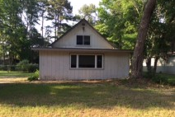
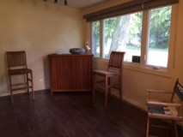
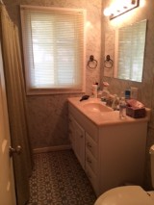
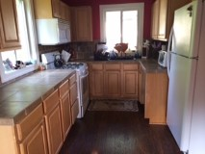
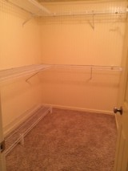
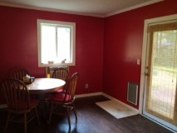
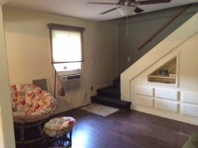
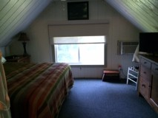
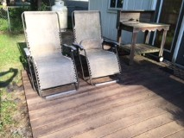
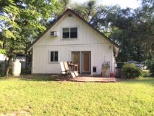

$10,000 Price Reduction!
310 Sinkler Avenue
Eutawville, SC 29048 | MLS# 15012951 | $129,900
3 Beds | 1½ Baths | 1,400 Square Feet
This lake property was recently renovated to include master bedroom on the first floor with large walk in closet! This home has 3 bedrooms, and 1.5 bathrooms and plenty of room to enjoy the lake with friends and family! Nice fenced backyard. Large eat in kitchen when weather permits. Must see the beautiful new floors in living room. New black out shades in upstairs bedroom and new shades in other rooms as well. Property is within a block from public boat landing! Come enjoy lake life!!!!!
Carla C Davis
Mobile - (843) 437-4873
gaweber@tds.net
AgentOwned Premiere Group
141 A N. Main Street
Summerville, SC 29483

