Slide 1
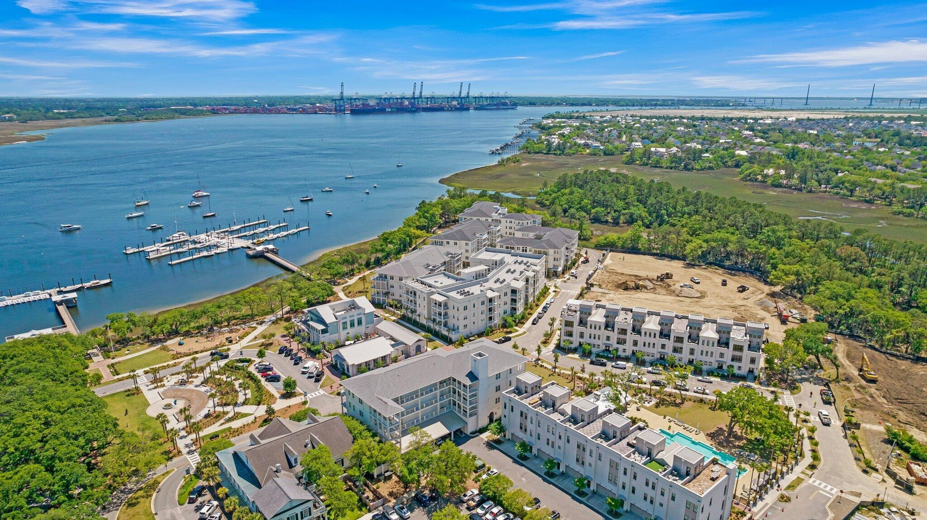

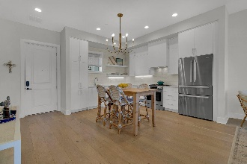
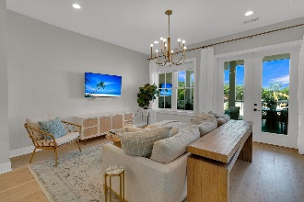
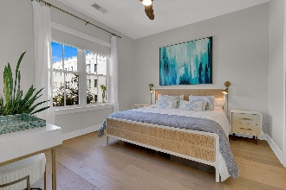
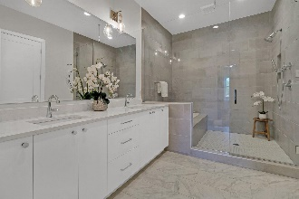
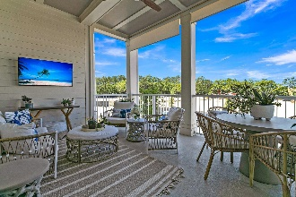
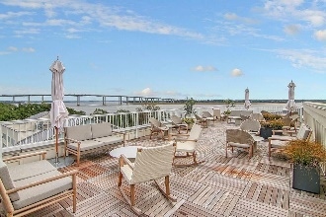
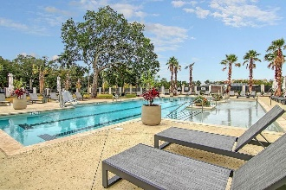
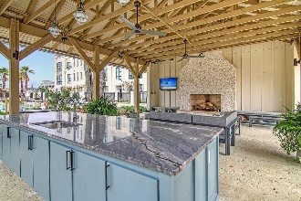
Daniel Island Luxury Waterfront Condo
JUST
LISTED
310 Longshore Street #625 Daniel Island | Charleston, SC 29492 | MLS# 24009568 | $935,000
Lowcountry waterfront living at it's finest! Like new luxury condominium located at The Waterfront, the newest community on Daniel Island. Walking distance to shops, restaurants, parks, concerts, and community docks with access to the Daniel Island Yacht Club, the CareFree Boat Club and the Daniel Island Ferry - perfect for a trip to downtown Charleston. This spacious, 1 bedroom, 1.5 bath light-filled condo, features an open concept floor plan, an oversized balcony, stainless steel appliances, hardwood floors throughout, a luxurious bathroom and a walk-in closet. Upgrades include: designer lighting, privacy shades on porch, window treatments, and professionally installed closet system in master. Residents of the Egret building have access to a large roof top terrace with gorgeous views of the Wando River - perfect for enjoying that morning cup of coffee or evening cocktail. Exclusive amenities include resort style pool, pool house with outdoor fireplace and TV, state of the art fitness center, beautifully landscaped courtyard, outdoor grilling area, outdoor fire pit, secured access to building and parking garage with 1 assigned parking space. Regime fee covers HOA and property management, common area maintenance, flood insurance, property insurance for the building, and utilities for the unit including - water, sewer, gas, cable and internet. Regime fee also covers security, concierge services, and all Waterfront amenities.
ALL FURNISHINGS AND FURNITURE MAY BE PURCHASED AT AN ADDITIONAL COST IF BUYER IS INTERESTED IN PURCHASING A FULLY TURN KEY HOME!
Video Tour | Virtual Tour
Paige Rhodes 843-830-3281 paige.rhodes@carolinaoneplus.com

