Slide 1
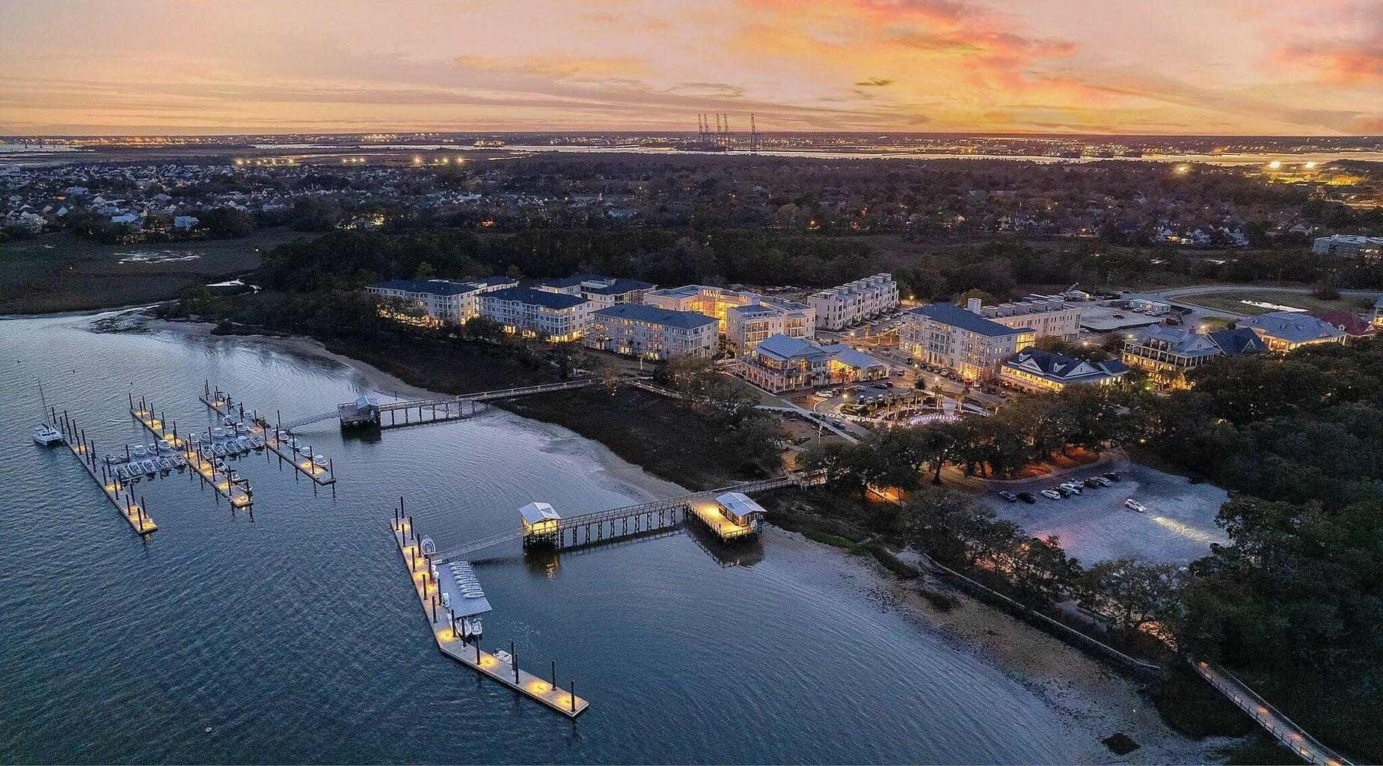
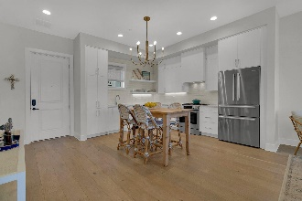
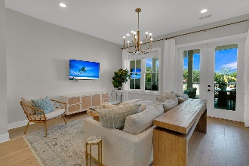
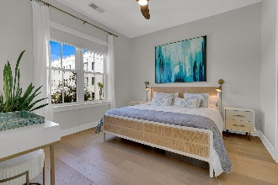
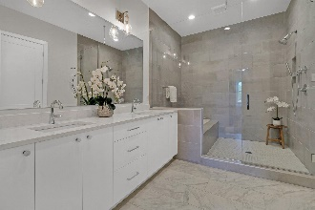
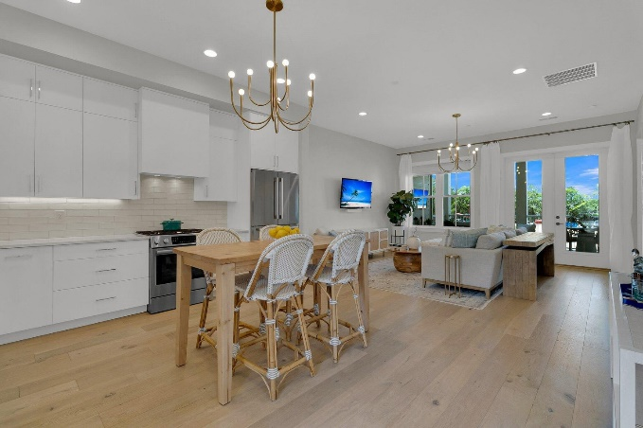
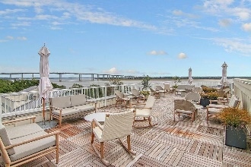
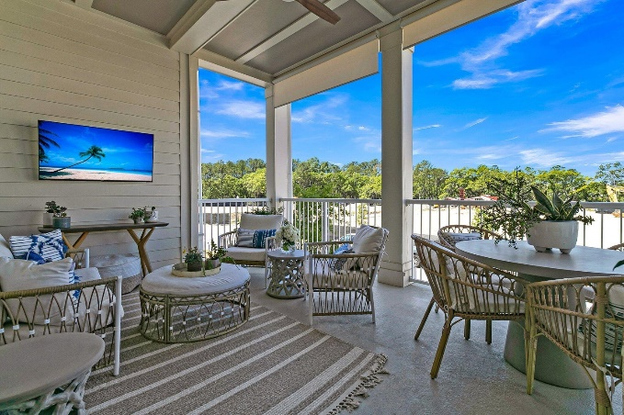
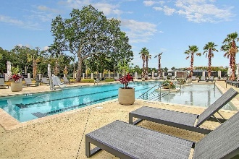
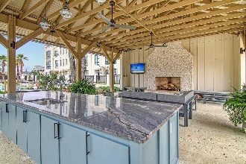

Daniel Island
Luxury Waterfront Condo
PRICE
REDUCTION
310 Longshore Street #625
Daniel Island | Charleston, SC 29492
MLS# 24009568 | $899,999
Lowcountry waterfront living at it's finest! Like new luxury condominium located at The Waterfront, the newest community on Daniel Island. Walking distance to shops, restaurants, parks, concerts, and community docks with access to the Daniel Island Yacht Club, the CareFree Boat Club and the Daniel Island Ferry - perfect for a trip to downtown Charleston.
Spacious, 1 bedroom, 1.5 bath light-filled condo
Open concept floor plan
Oversized balcony
Stainless steel appliances
Hardwood floors throughout
Luxurious bathroom and a walk-in closet
Upgrades include:
  designer lighting
  privacy shades on porch
  window treatments
  professionally installed closet system in master.
Residents of the Egret building have access to a large roof top terrace with gorgeous views of the Wando River - perfect for enjoying that morning cup of coffee or evening cocktail.
Exclusive amenities include resort style pool, pool house with outdoor fireplace and TV, state of the art fitness center, beautifully landscaped courtyard, outdoor grilling area, outdoor fire pit, secured access to building and parking garage with 1 assigned parking space.
ALL FURNISHINGS AND FURNITURE MAY BE PURCHASED AT AN ADDITIONAL COST IF BUYER IS INTERESTED IN PURCHASING A FULLY TURN-KEY HOME!
Video Tour | Virtual Tour
Paige Rhodes
843-830-3281 | paige.rhodes@carolinaoneplus.com

