Slide 1
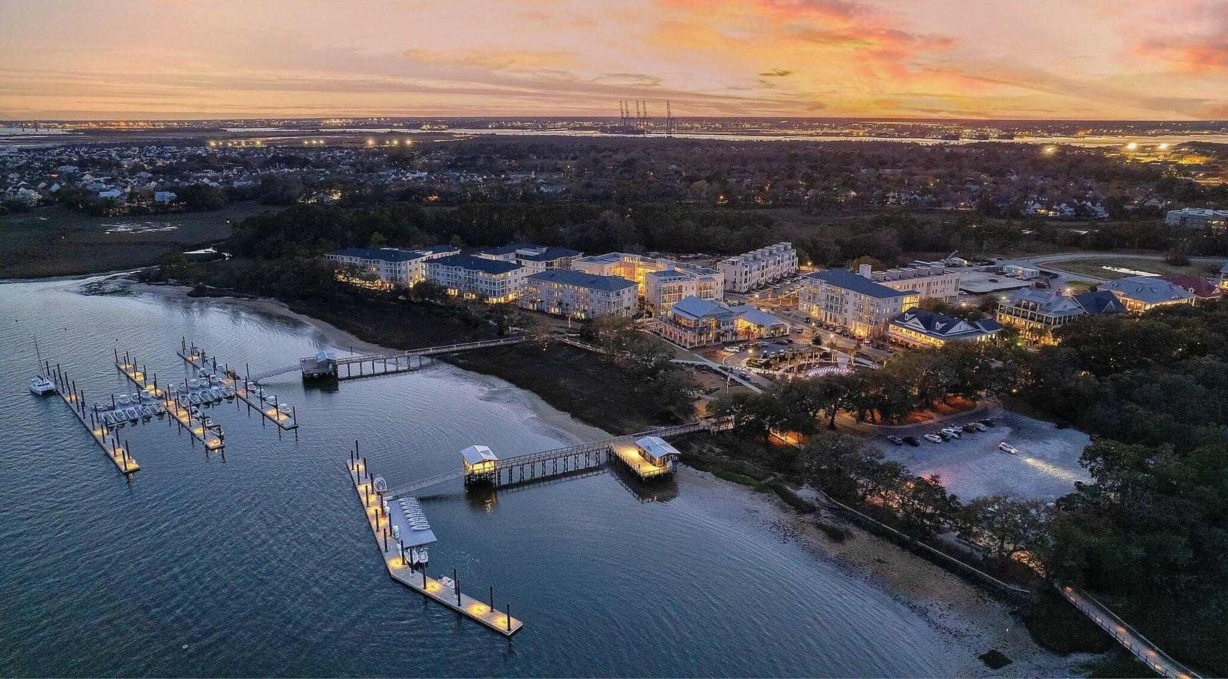

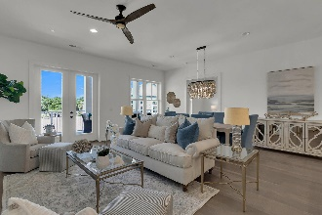
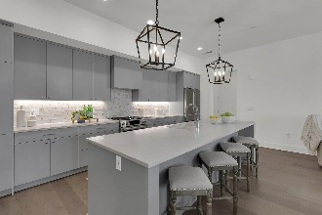
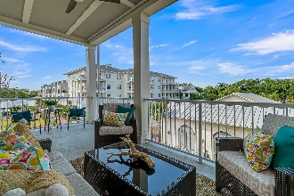
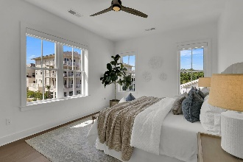
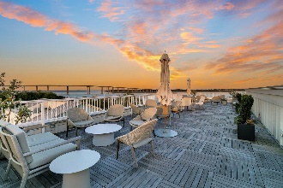
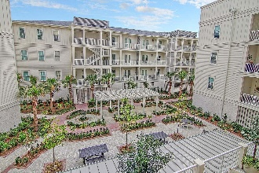
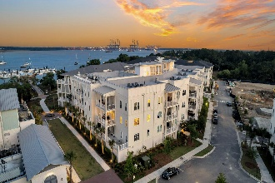
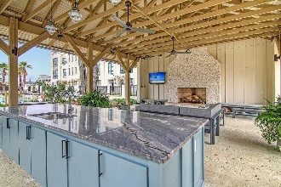
Daniel Island Luxury Waterfront Condo
Why Wait for New Construction?
PRICE
REDUCED $50K
310 Longshore Street #632
Daniel Island | Charleston, SC 29492 | MLS# 24010723 | $1,545,000
Ever dream of living on the water? Now is your chance! Like new luxury condominium located at The Waterfront, the newest community on Daniel Island. Walking distance to shops, restaurants, parks, concerts, and community docks with access to the Daniel Island Yacht Club, the CareFree Boat Club and the Daniel Island Ferry - perfect for a trip to downtown Charleston. This spacious, 2 bedroom, 2.5 bath, light-filled condo with 10-foot ceilings, features an open concept floor plan, a balcony with river views, stainless steel appliances, hardwood floors throughout, a spa-like master bathroom, large walk-in closets and extra storage at every turn! Guest room with an ensuite bath could easily double as a home office. Current owners have invested in coastal decorative lighting, motorized shades and black out shades, professional closet systems in all closets, and added a large floor to ceiling storage closet in the entryway hallway. This turn key unit has it all and must be seen to fully appreciate the location and the lifestyle the Waterfront offers - ideal for full-time residents, but the "lock & leave" living also offers peace of mind to homeowners who use it as a second home. Why wait for new construction when you can purchase a move-in ready luxury condo with river views now? CONDO MAY BE PURCHASED FULLY FURNISHED FOR AN ADDITIONAL COST.
Residents of the Egret building have access to a large roof top terrace with gorgeous views of the Wando river - perfect for enjoying that morning cup of coffee or evening cocktail. Exclusive amenities include resort style pool, pool house with outdoor fireplace and TV, state of the art fitness center, beautifully landscaped courtyard, outdoor grilling area, outdoor fire pit, secured access to building and parking garage with 2 assigned parking spaces. Waterfront residents also have access to a secured storage area for paddle boards, surfboards and bikes. Regime fee covers HOA and property management, common area maintenance, flood insurance, property insurance for the building, and utilities for the unit including - water, sewer, gas, cable and internet. Regime fee also covers security, concierge services, and all Waterfront amenities.
Video Tour | Virtual Tour
Paige Rhodes 843-830-3281
paige.rhodes@carolinaoneplus.com

