Slide 1
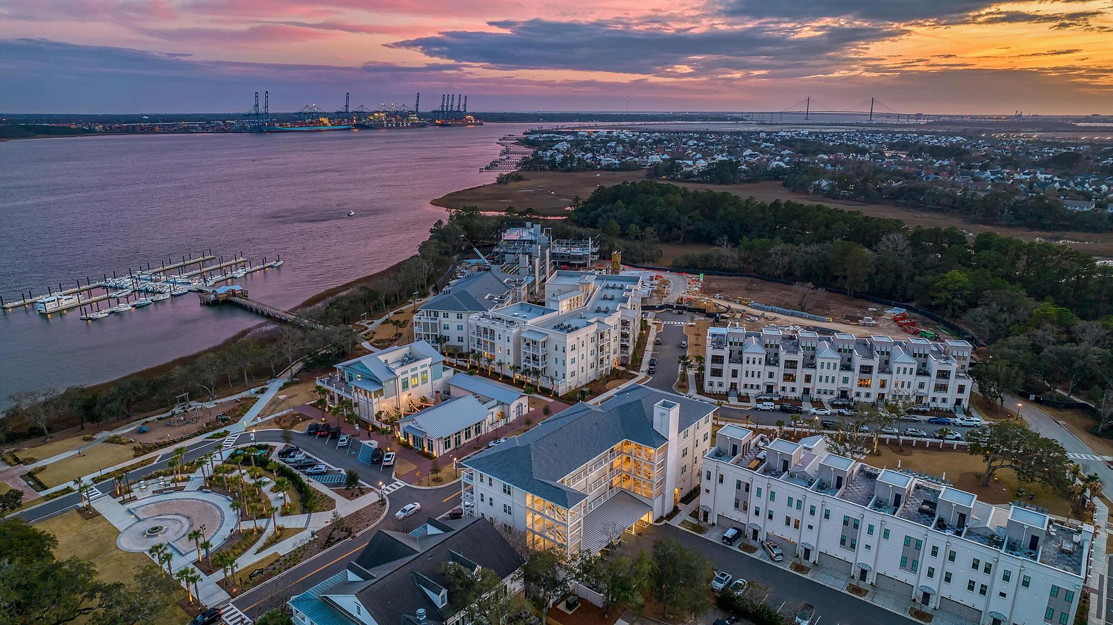

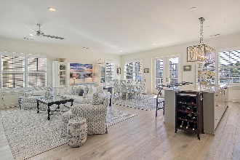
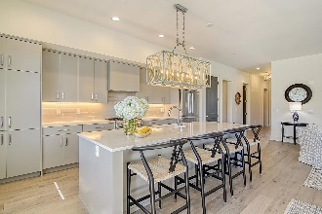
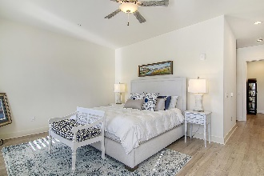
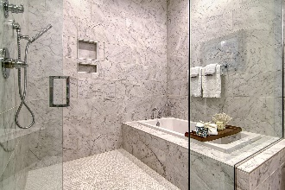
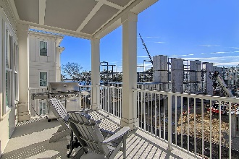
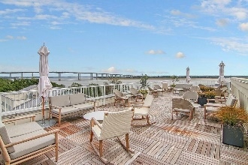
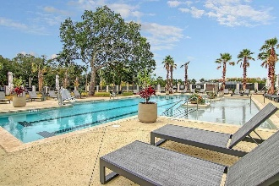
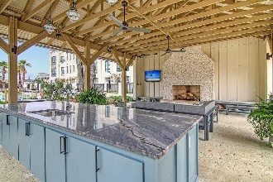
Daniel Island Waterfront Condo with River Views!
310 Longshore Street #638 Daniel Island, SC 29492 | MLS# 23001766 | $2,200,000
Lowcountry waterfront living at it's finest! Newly constructed luxury condominium located at The Waterfront, the newest community on Daniel Island. Walking distance to shops, restaurants, parks, concerts, and community docks with access to the Daniel Island Yacht Club, the CareFree Boat Club and the Daniel Island Ferry - perfect for a trip to downtown Charleston! This spacious, light filled 3-bed (PLUS den/study), 3-bath condo with partial river views, features an open floor plan, two balconies, stainless steel appliances, upgraded lighting, hardwood floors throughout, plantation shutters, luxurious bathrooms and oversized closets with custom built-ins. Residents of the Egret building have access to a large roof top terrace with gorgeous views of the Wando River perfect for enjoying that morning cup of coffee or evening cocktail. Amenities include resort style pool, pool house with outdoor fireplace and TV, state of the art fitness center, beautifully landscaped courtyard, outdoor grilling area, outdoor fire pit, secured access to building and secured parking garage with 2 assigned parking spaces.
Take a video tour: https://vimeo.com/791380307
Paige Rhodes 843-830-3281 paige.rhodes@carolinaoneplus.com

