Slide 1
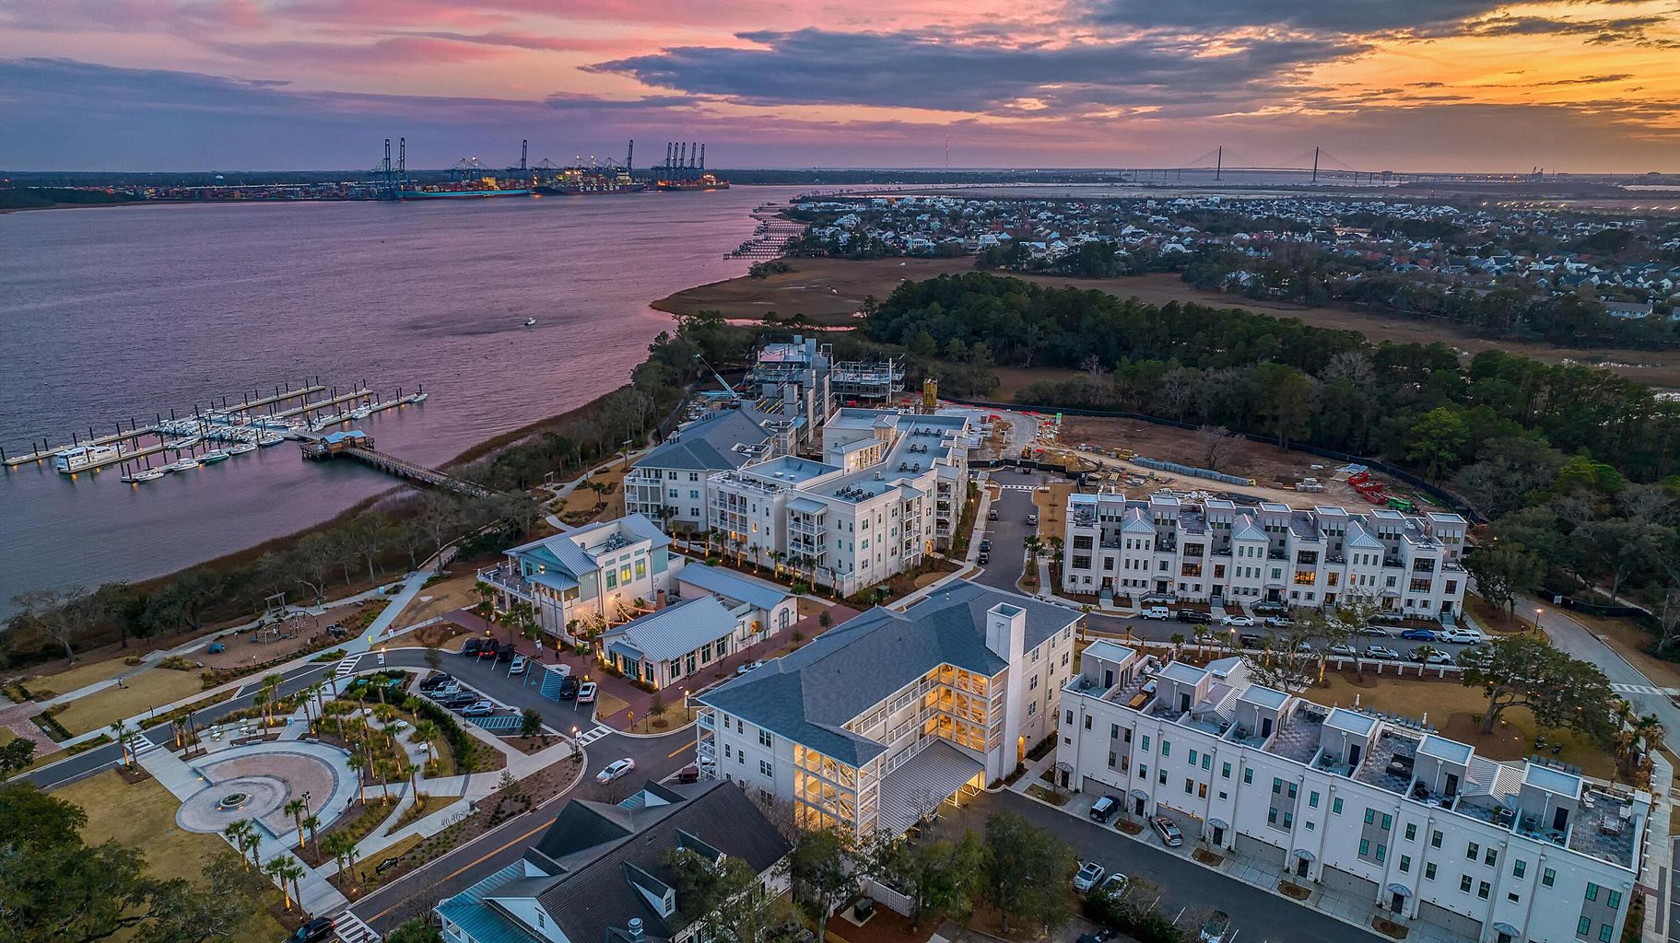

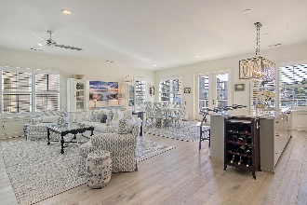
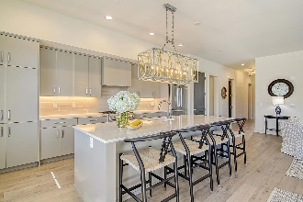
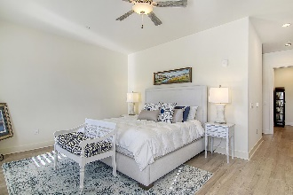
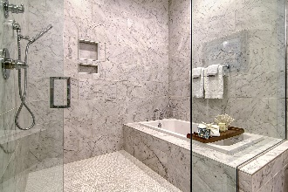
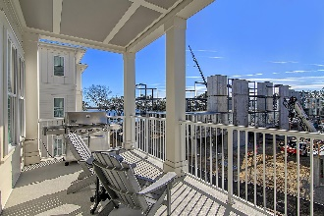
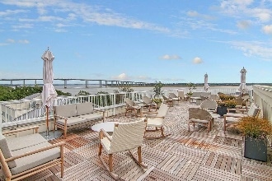
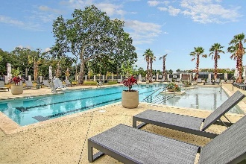
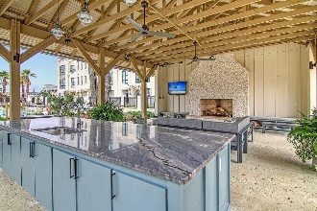
Daniel Island Waterfront Condo
with River Views!
MAJOR PRICE REDUCTION!
310 Longshore Street #638 Daniel Island, SC 29492 | MLS# 23001766 | NEW PRICE! $1,999,500
Why wait for new construction when you can purchase a move in ready condo now? This luxury condominium is located at The Waterfront, the newest community on Daniel Island. This spacious, light filled 3-bed 3-bath unit has a separate den/study, river views, and MAY BE PURCHASED FULLY FURNISHED. This unit features an open floor plan, two balconies, stainless steel appliances, upgraded lighting, hardwood floors throughout, plantation shutters, luxurious bathrooms, oversized closets with custom built-ins and two assigned parking spaces in a secured garage. Residents of the Egret building have access to a Rooftop terrace with gorgeous views of the Wando River, perfect for that morning cup of coffee or evening cocktail. Amenities include resort style pool, pool house with outdoor fireplace and TV, state of the art fitness center, beautifully landscaped courtyard, outdoor grilling area, outdoor fire pit, and secured access to building. The Waterfront is walking distance to shops, restaurants, parks, concerts, and community docks with access to the Daniel Island Yacht Club, the CareFree Boat Club and the Daniel Island Ferry - perfect for a trip to downtown Charleston!
Take a video tour: https://vimeo.com/791380307
Paige Rhodes 843-830-3281 paige.rhodes@carolinaoneplus.com

