Slide 1
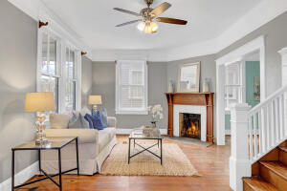
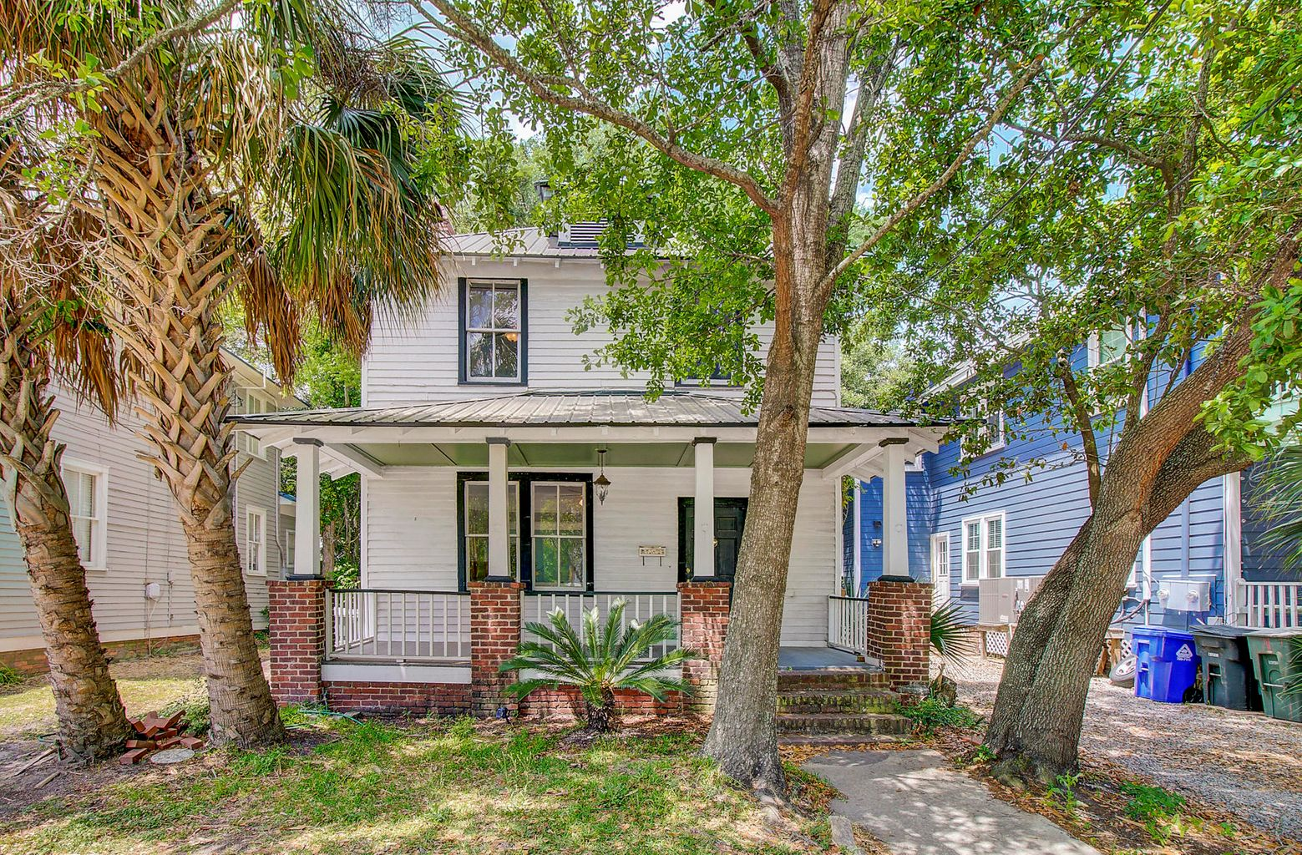
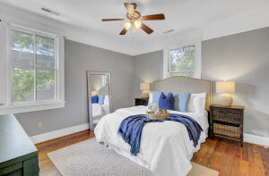
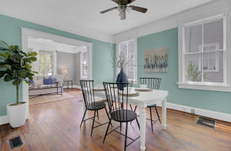
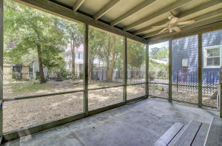
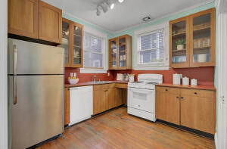
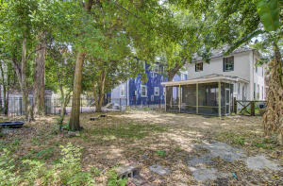


JUST LISTED
Historic Downtown Charleston Home For Sale
310 Congress Street
Hampton Park Terrace
Charleston, SC 29403
MLS# 21012419 | $624,900
If you have ever dreamed of owning a historic downtown property in a magnificent location, now is your opportunity! Welcome to 310 Congress Street, located in the Hampton Park Historic District. This Foursquare style home was built in 1920 and has been placed on the National Register of Historic Places. From the moment you approach the front door this property radiates charm! A full front porch beckons you to sit and watch neighbors pass by. Upon entry your heart will skip a beat as you feel like you have stepped back in time. A large family room with a wood burning fireplace spans the entire front of the home. The character of this home is undeniable, with a formal dining room located off the kitchen and overlooks the family room. A sizable addition off the rear of the original home adds a great deal of versatility to this 3 bedroom floor plan by providing a space perfect for a home office, den, study or even guest quarters with a full bathroom. The large screened porch is another bonus to this home. Upstairs you will find all three bedrooms, a large hall closet and second full bath.You can't help but notice magnificent hardwood floors throughout the entire home adding to the character of this historic property. The large fenced in back yard is a blank canvas - it would make an amazing vast space for children and pets to play all year long. Perhaps a hardscape with an outdoor kitchen or fire pit would be more to your liking. Why not both? You can dream big because there is no shortage of space in this yard! The location could not be more desirable. Adjacent to The Citadel, across the street is Johnson Hagood Stadium. The thrill of game day awaits! Iconic Hampton Park is a mere two blocks away. Other attractions nearby include The Charleston Riverdogs Stadium, the Jack Adams Tennis Center and numerous trendy establishments for dining. The lucky new owners of 310 Congress can enjoy the privilege of living in a Historic Downtown Residence while being in the heart of it all in this highly pedestrian location. Come see this home for yourself and you just may be swept away by the abundant charm and character throughout!
Check out the video tour here: https://video214.com/play/pKydFjeG5xmCnkSRRr1iGg/s/dark
Ellen O'Neil
Broker/Owner, ABR, e-PRO, CNE
Charleston Realtor of Distinction
(843) 300-8530
www.EllenONeilProperties.com

