Slide 1
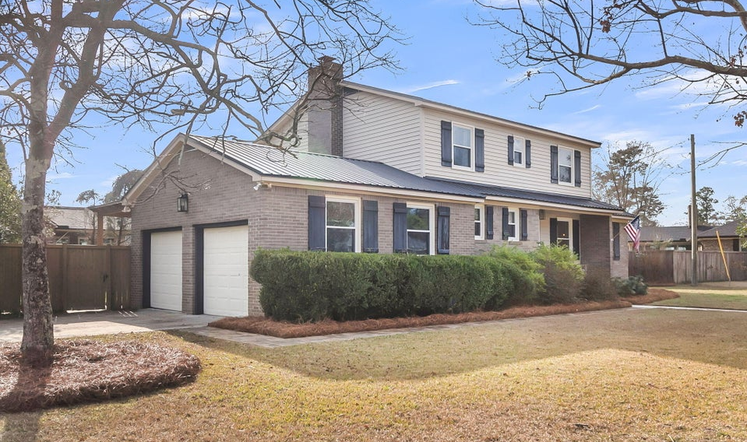
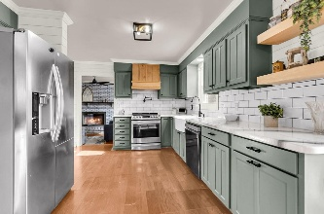
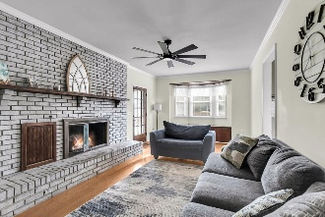
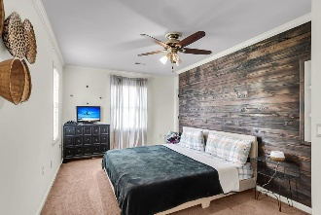
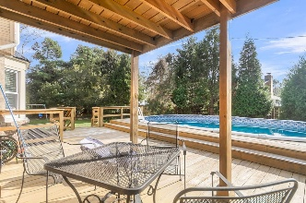
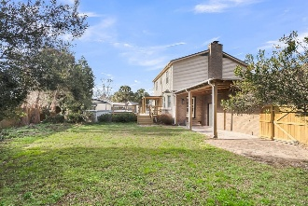


Just Listed Home with Lake Access!
$15,000 Agent Bonus
with ratified contract by 4/15/18
310 Land O Pines Cir
Land-O-Pines
Moncks Corner, SC 29461
MLS# 26001096
$430,000
$12,100 Under
Recent Appraised Value
**LOCATED in Historic Pinopolis with Lake access! This beautiful home offers the best of lake life and a quiet retreat from the business of life! This is what Southern living truly means, with the picturesque oak tree lined roads, and established residents, you can truly find your forever home here. As you walk in, there is so much natural light and the functional layout leading to the modern farmhouse kitchen is perfect for entertaining. There is a flex room that could be an office or whatever you decide to make it. The backyard is a private oasis featuring an above ground pool with a new liner and deck, ideal for summer gatherings or relaxing weekends. Enjoy the best of Lowcountry living boating , fishing or kayaking on Lake Moultrie, One of SC's premiere lakes. With ample outdoor space and recreational opportunities nearby, this home offers both lifestyle and value!
William R Everett, Jr
(843) 693-8539– C
(843) 576-2701 – O
bill@theeverettgroup.net
RE/MAX Southern Shores
9209 University Blvd, Charleston, SC 29406

