Slide 1
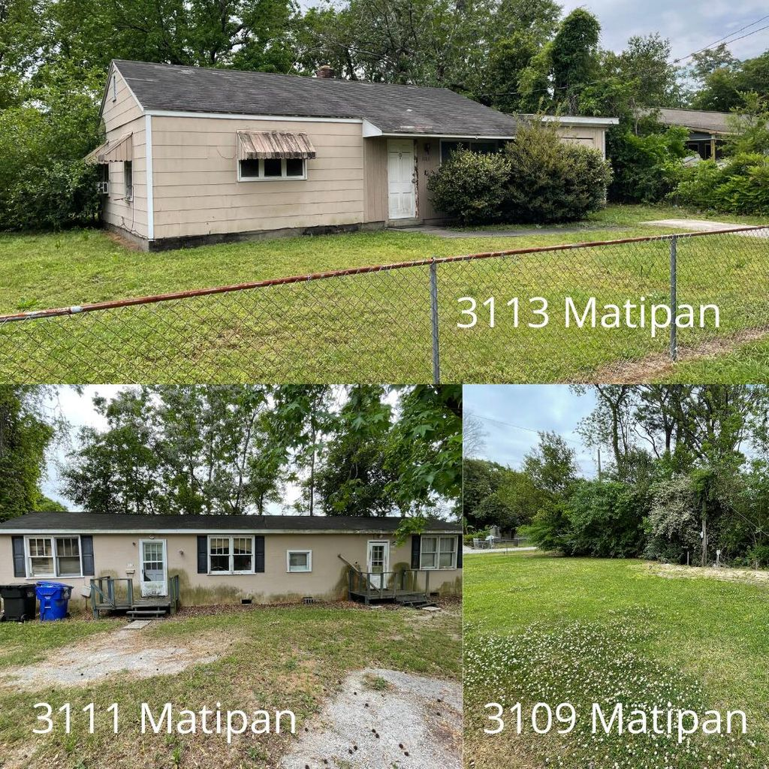
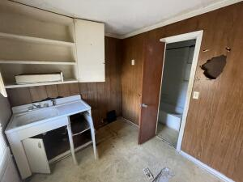
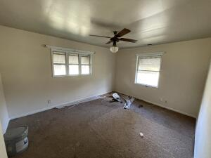
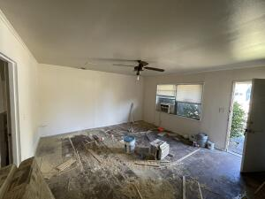
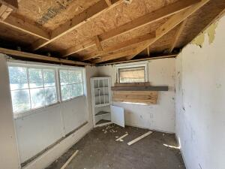
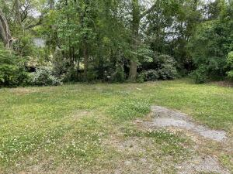
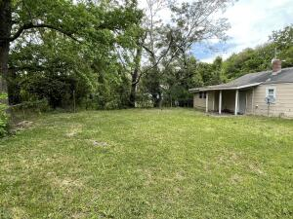



Single Family, Duplex and Vacant Lot PACKAGE DEAL!
3113 Matipan Avenue
Dorchester Terrace
North Charleston, SC 29405
MLS# 22011264
$275,000
Opportunity Zone!
Sale includes 3109, 3111 and 3113 Matipan Ave! 3109 Matipan is a 0.16 acre vacant lot with utilities, cleared and ready to build a single family dwelling of your choice, use as a storage area, to park your RV, list goes on!
3111 Matipan is a duplex with 1 bedroom and 1 bathroom on each side. Side A is rented at $650/month, Side B is vacant and needs work. 3113 Matipan is a cottage style home with 2 Bedrooms and 1 bathroom.
All located in a CONVENIENT location. Right around the corner from I-26, minutes to downtown Charleston, plenty of restaurants and shopping nearby! Property being sold in current condition (as-is). House needs work. PLEASE BE CAREFUL WHEN ENTERING. Owner has not occupied units. Will not be sold individually.
Nick Mazzilli
(843) 640-5575
nick@nickmcharleston.com
www.mavenrealtysc.com
Maven Realty
2180 McMillan Ave
#71672
Charleston, SC 29405

