Slide 1
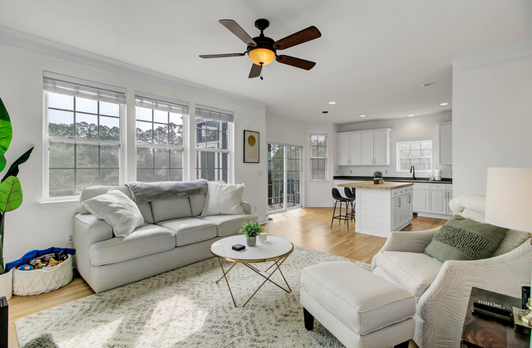
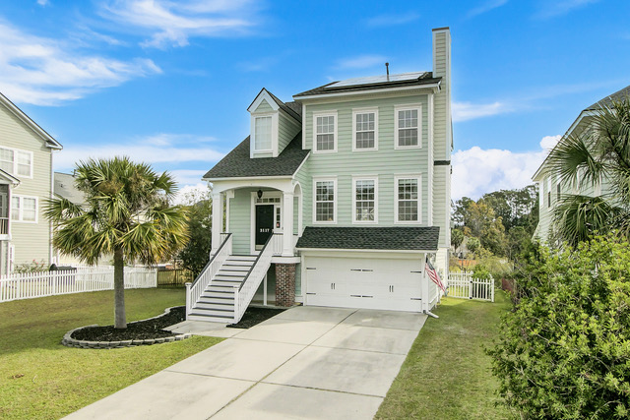
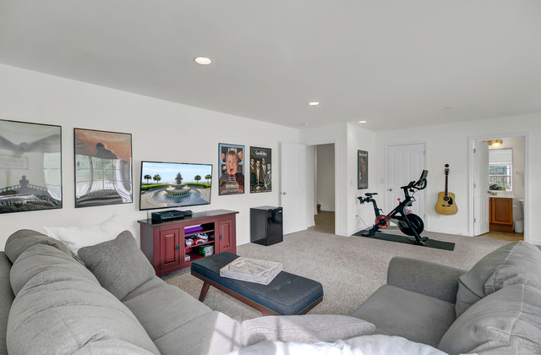
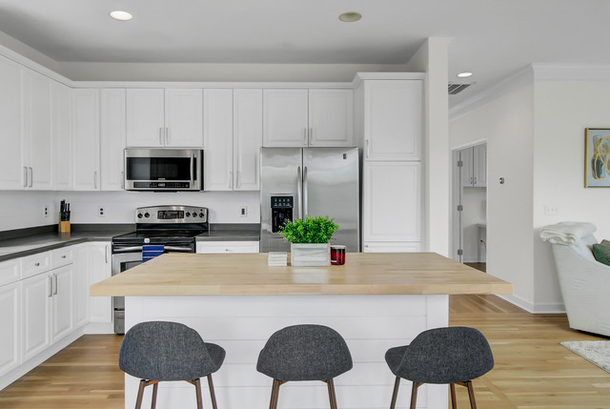
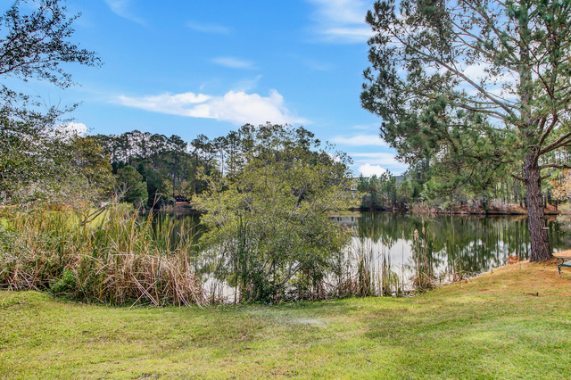
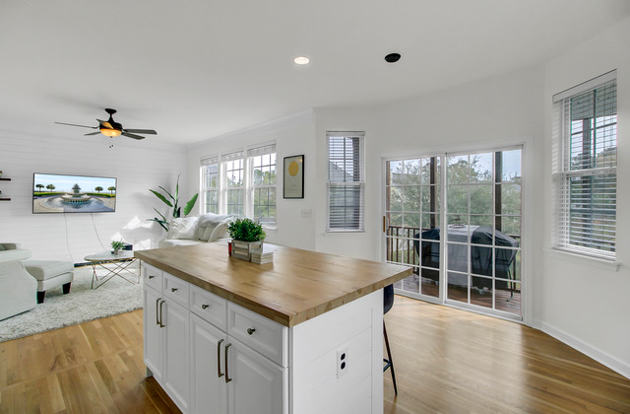
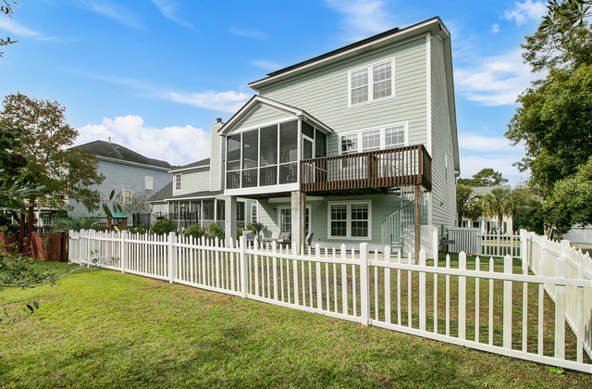


New Listing & Open House!
3117 Sonja Way
Park West
Mount Pleasant, SC 29466
MLS# 22028793 | $740,000
Rarely is a true move in ready home presented, but here it is!
Recent improvements throughout give a Coastal Farmhouse feel to this 4 bedroom BEAUTY in Marsh Walk at Park West, one of Mt. Pleasant’s favorite communities. Located on a pond lot, you will LOVE the versatile floor plan.
There is a mother in law suite option (currently a movie room and exercise area) on the lower level with sliders to the beautiful fenced in back yard. The home is freshly painted, has a NEW ROOF, and updated kitchen and baths. Did I mention shiplap accent walls?
Schedule a tour through Showing Time, or
pop by the OPEN HOUSE on SUNDAY ~ 12-3 PM!!
Property Website
Ellen O'Neil
Broker/Owner, ABR, e-PRO, CNE
Charleston Realtor of Distinction
(843) 300-8530
www.EllenONeilProperties.com

